Slide 1
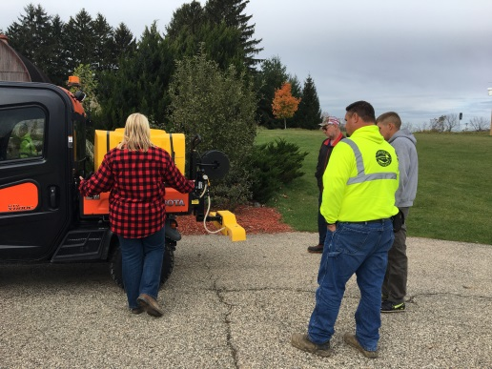
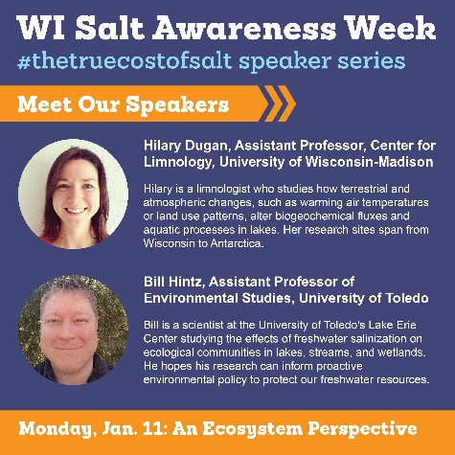
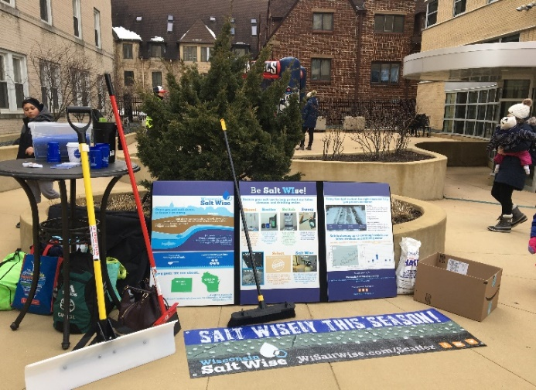
WI Salt Wise- wisaltwise.com
Goal: Reduce salt pollution in our lakes, streams, and drinking water.
Target Audiences:
Applicators
Homeowners
Salt Retailers
Businesses
Key Messages:
Once you put salt down, it doesn’t go away
Excessive salt use harms our waters and infrastructure.
Mechanical removal first.
Use the right product for conditions.
Apply the correct amount,
a little goes a long ways.
Outreach Methods/Tools:
Trainings/Demos
Presentations, articles,
videos and materials for partners.
Chloride Reduction Grants
(Madison Metro. Sewerage District)
Notes:
Founding member of WI Salt Wise
+Starting to see interest with applicators especially since the launch of the City of Madison certification program. Now that we have some case studies we can refer to and local municipalities and applicators implementing changes it’s a lot easier to promote BMPs with applicators.

