Slide 1
Your Name
Affiliation

Slide 2
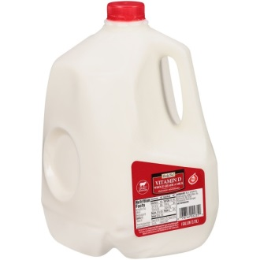
Problem- Too much runoff!
How much water runs off an average home when it rains 1”?
Roof-1800 ft2
1800 ft2 = 259,200 in2
259,000 in2 x 1in= 259,000 in3
259,000 in3 * 1 gallon/231 in3=
Image: Rainscaping Iowa
1,122 gallons!!!
How much water runs off your home?
https://water.usgs.gov/edu/activity-howmuchrain.html
Notes:
1800ft 2 roof area average house
2-4 inches of rain/hour during Aug 2018 storm

Slide 3
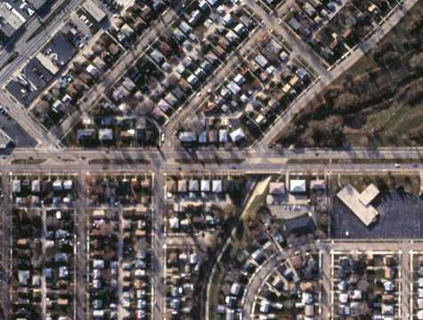
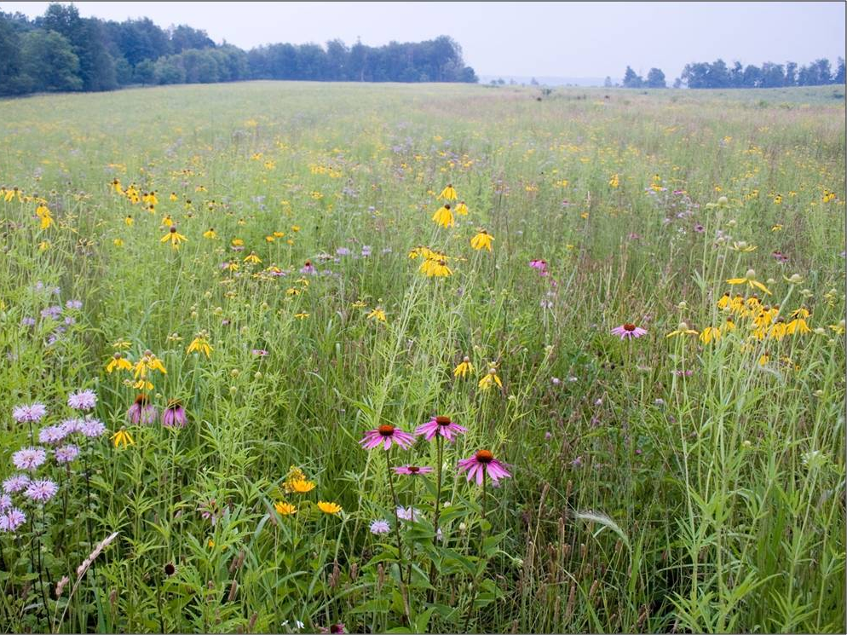
Goal: Reduce runoff
Need to make this
Act more like this
Notes:
Need to make changes so our cityscapes function more like our natural/undeveloped landscapes.

Slide 4
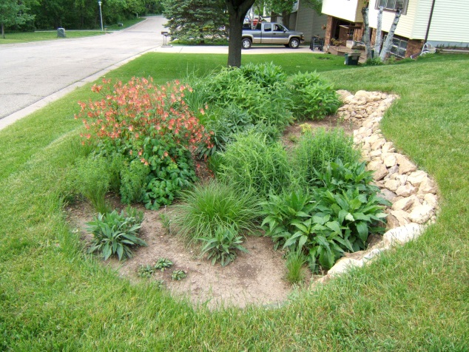
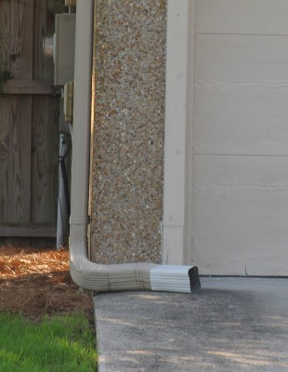
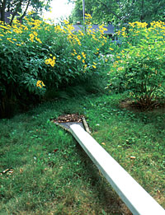
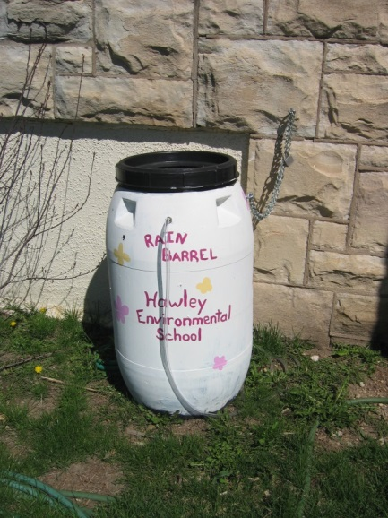
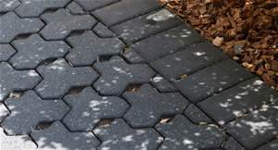
Keep rain where it lands
Replace some turf with Native Gardens or Rain Gardens
Redirect downspouts to natural areas
Install a Rain Barrels
Consider pervious paving options

Slide 5
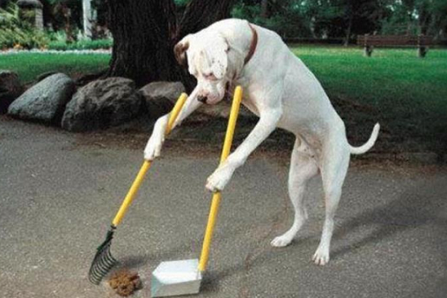
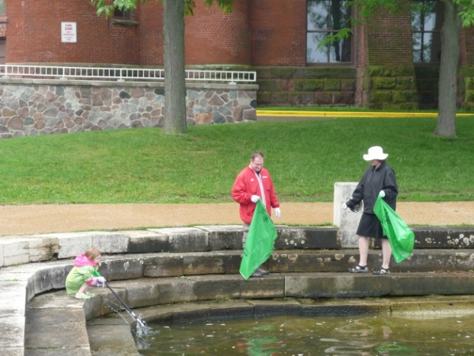
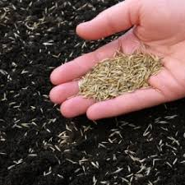
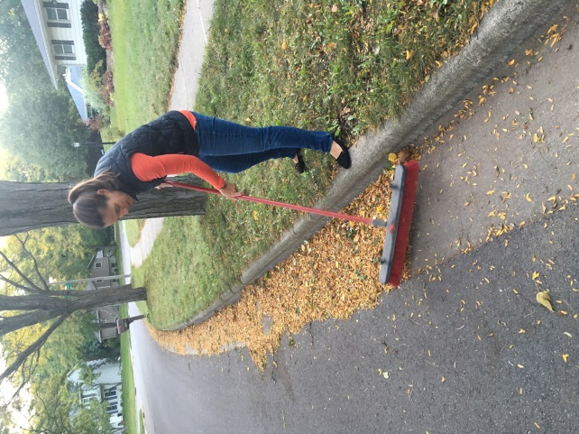
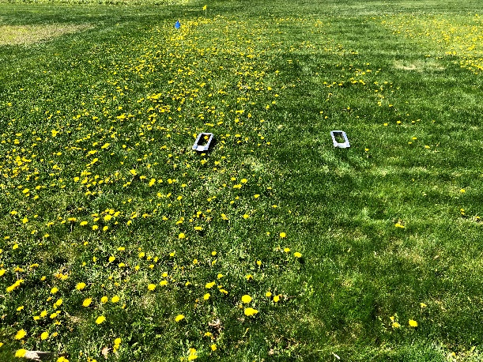
Make sure only rain goes down
the storm drain
Cover bare soil to prevent erosion
Pick up after pets
Dispose of Trash and hazardous chemicals properly
Maintain a healthy lawn using minimum amount of fertilizer/herbicides
Use the right amount of salt for safety
Keep Leaves out of the street before the rain
Notes:
www.danecountycleansweep.com
https://uwlab.soils.wisc.edu/farmers/lawn-garden/
Pet waste contains nutrients and bacteria harmful to aquatic life and humans using local waters.
Rain water that runs through leaves on the street creates a “leaf-tea” rich in dissolved phosphorus. This tea fuels algae growth in our lakes.

Slide 6
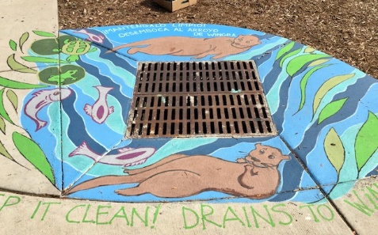
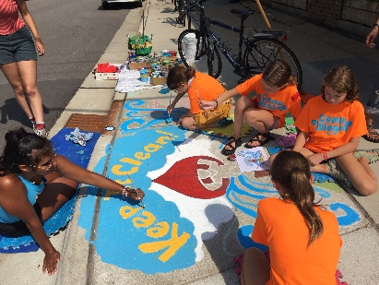
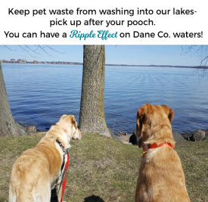
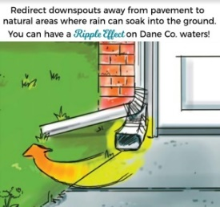
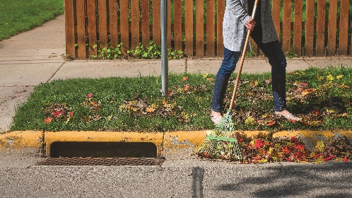
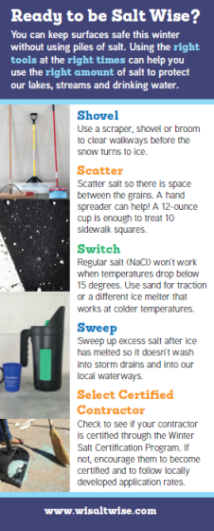
Madison Area Stormwater Partnership (MAMSWaP) Education Efforts (Ripple Effects- www.ripple-effects.com)
Late Winter/Spring
Summer
Fall
Now accepting plant orders and donations
Now accepting storm drain mural applications
Fall
Winter
Notes:
Goal- create campaigns or programs to reduce barriers to taking action and make it as easy as possible for residents, businesses and groups.

Slide 7
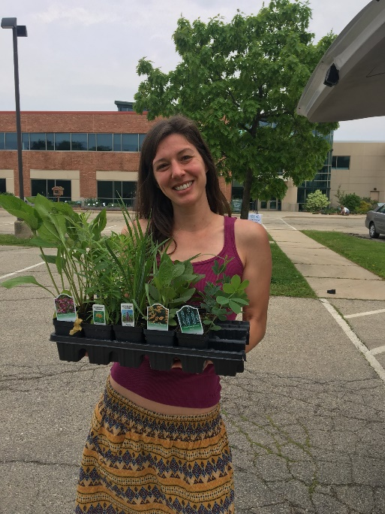
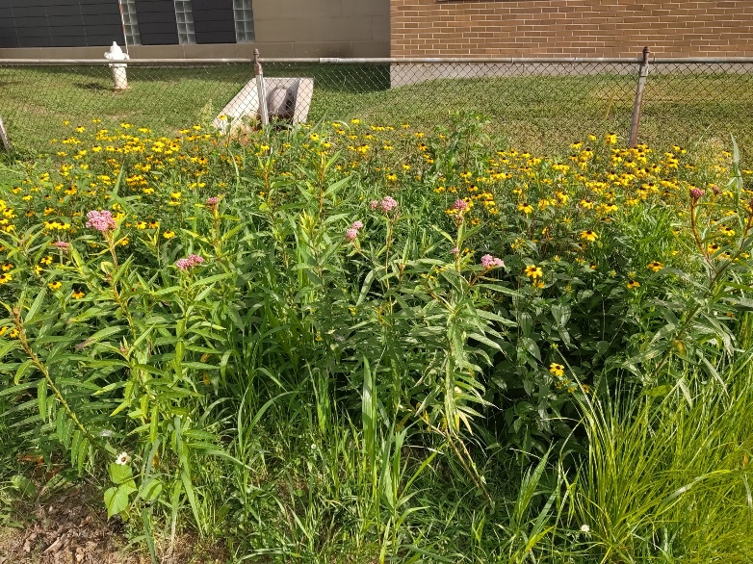
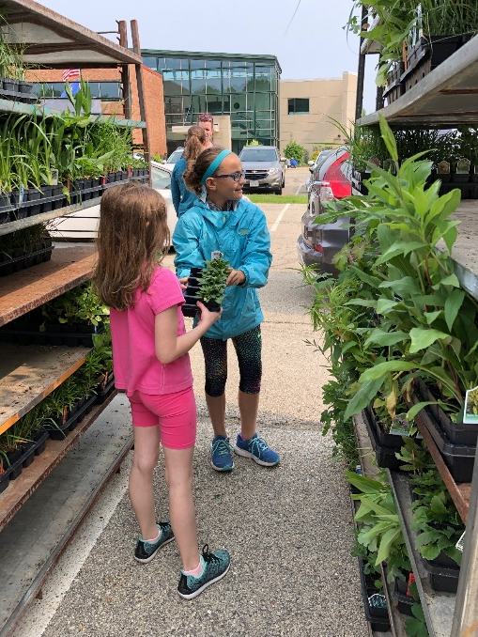
Plant Dane encourages Dane County residents and organizations to build native gardens and rain gardens through educational opportunities, resources and access to low cost native plants.
Sponsored by the Madison Area Municipal Stormwater Partnership (MAMSWaP) in an effort to reduce and improve quality of stormwater runoff to our lakes, rivers and streams.

Slide 8
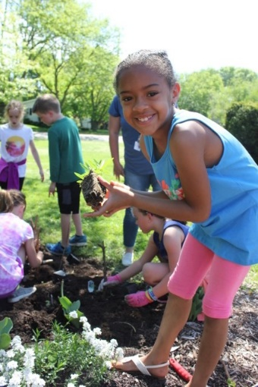
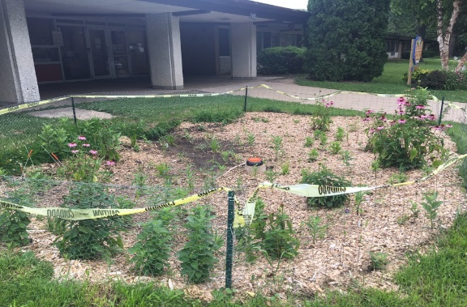
ORDER native plants online-
-40+ species including garden kits
-$2.25/each (order in multiples of 4)
-order deadline 3/20
DONATE funds for native plants for school/community projects through Plant Dane order system.
-donate by 3/20
GROW native plants for community projects.
-seed and instructions provided
-training available
LEARN how to build a rain garden. Workshop on
Feb. 29th- 8:30-11:30AM at the Fitchburg Community Center. $10
www.ripple-effects.com/plantdane
Notes:
All info on our plant dane website www.ripple-effects.com/plantdane including species lists. Online registration for workshop.
The growing native plants program is very new and we are partnering with the Office of Lakes and Watershed on it. Basically we are asking people to learn how to grow native plants from seed in milk jugs. They hold trainings in the fall and then participants are asked to grow and take care of the plants until the following fall. The idea is that these would be grown to give to schools or groups who need plants, not individuals. We have a link to the program on our web site along with an application for FREE plants. There are 2 cycles that groups can apply for one with plant delivery in June and one with plant delivery in early fall. We are hoping to provide plants to groups in June through any donations made through the Plant Dane cost share program and get fall plants from the volunteer growers.
Fun facts:
13 annual Plant Dane cost-share program
280 participants in 2016
13700 plants ordered in 2016

Slide 9
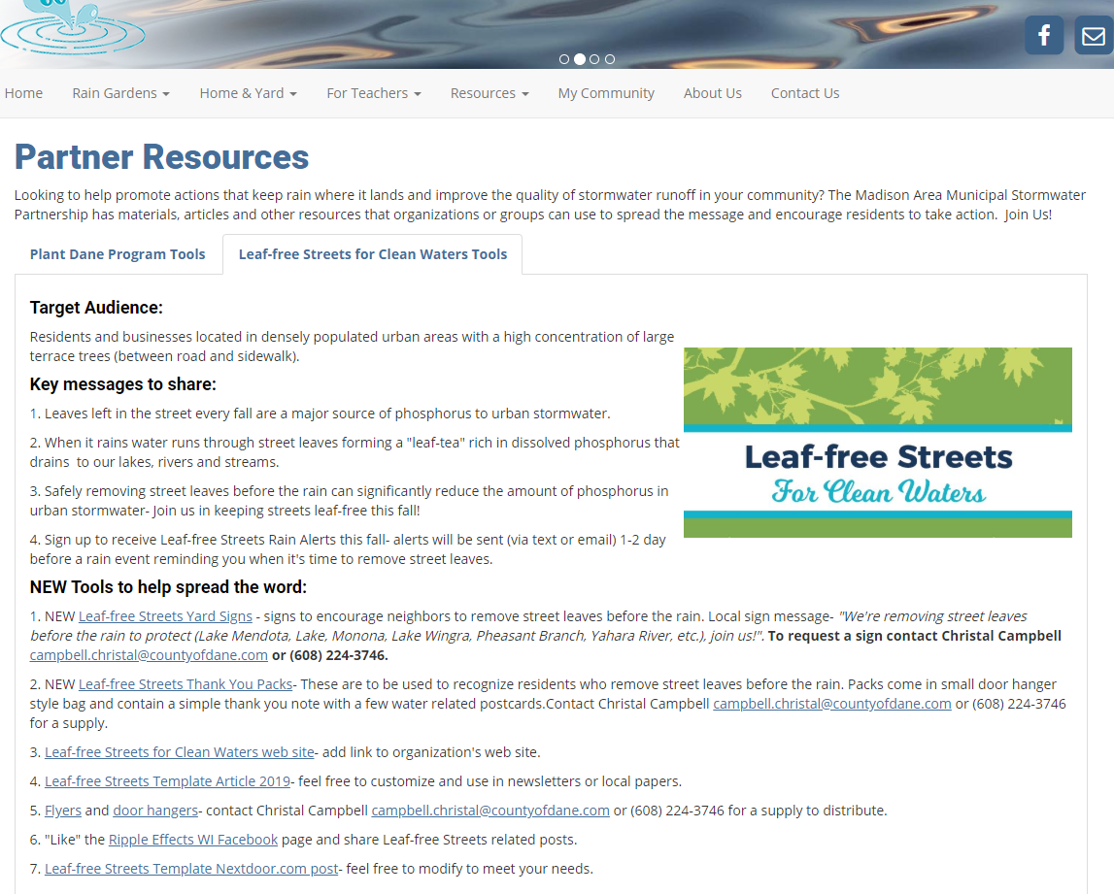
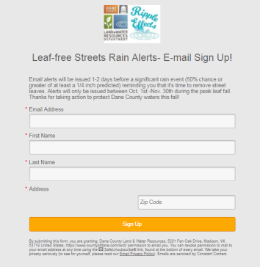
Get Involved - Partner Toolkits

Slide 10
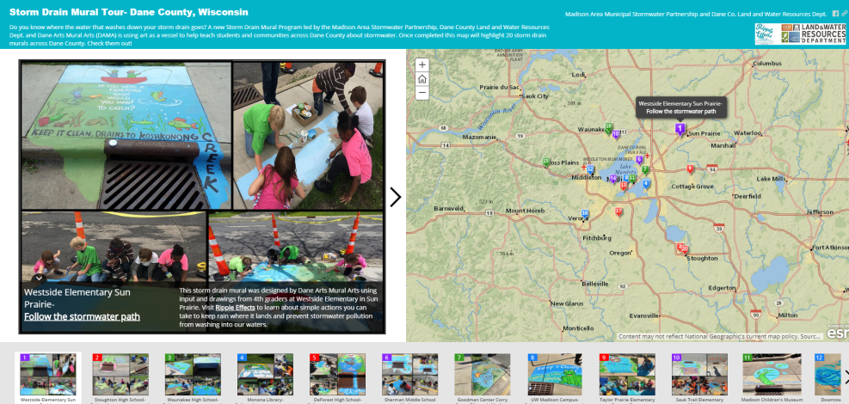
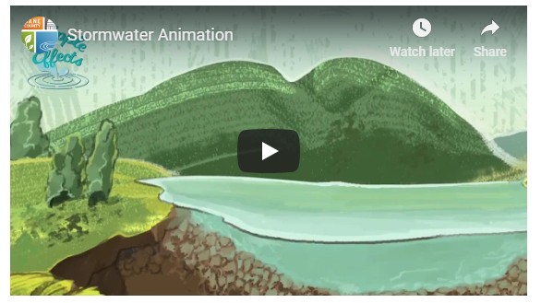
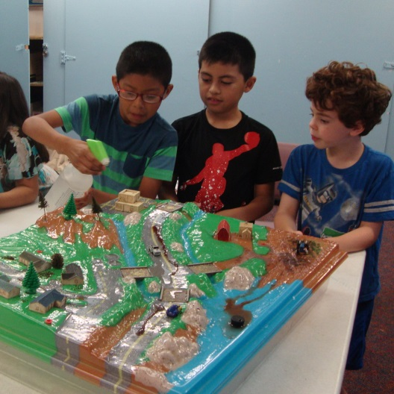
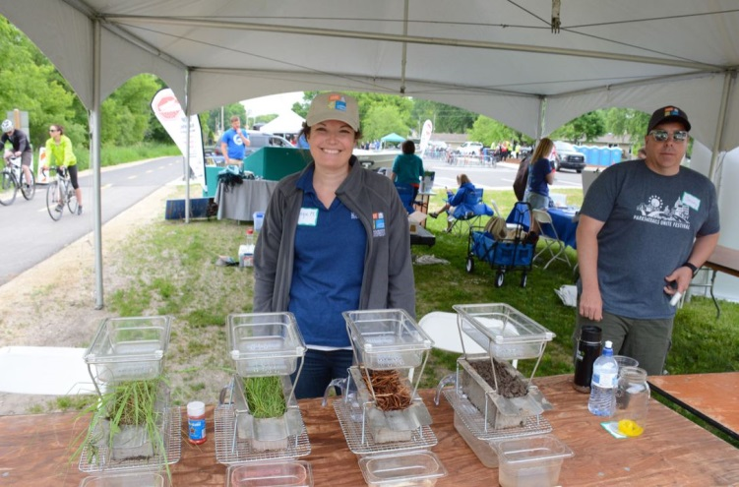
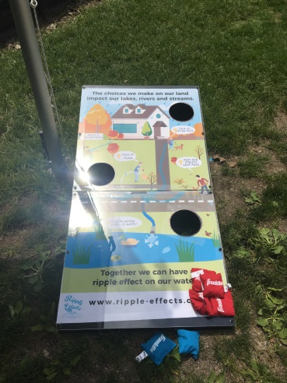
Get Involved – Educational Resources
Storm Drain Murals
Stormwater Animation Video
Bean Bag Toss Game/Tabletop Rainfall Simulator
Enviroscape

Slide 11
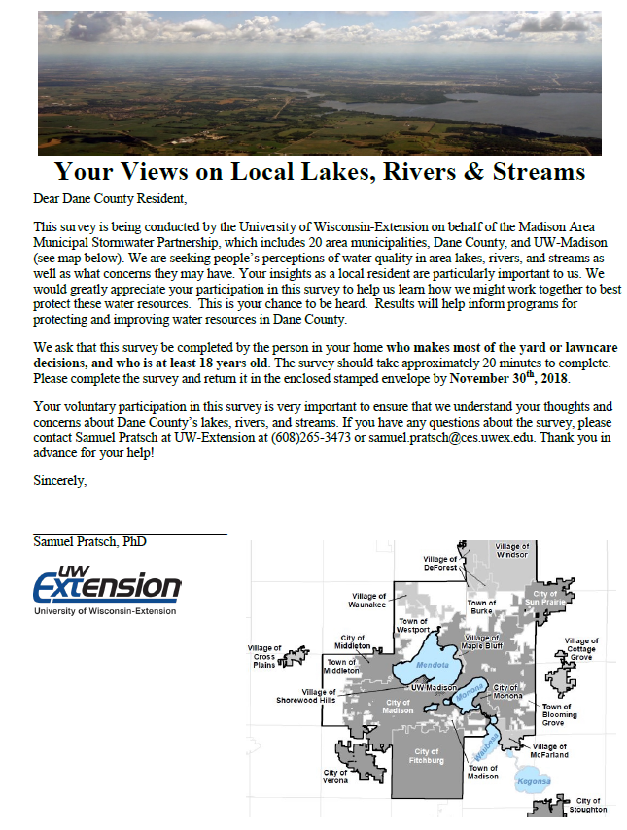
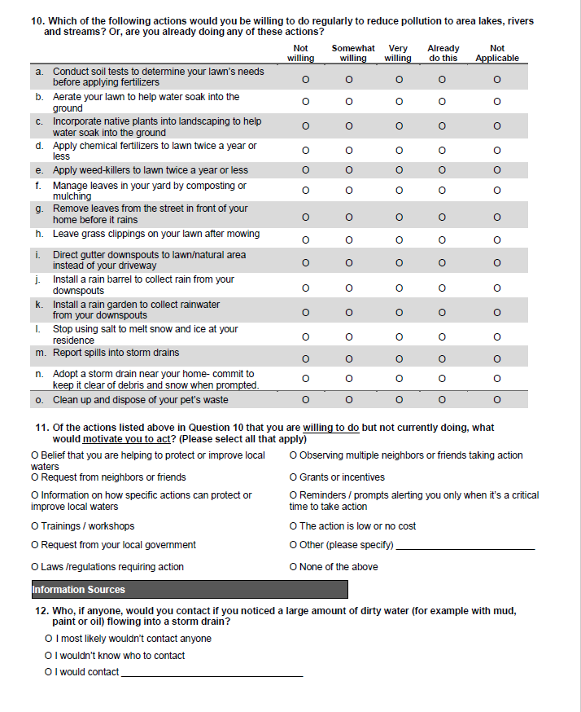
Survey Results and Future Plans
MAMSWaP 2018/19 Stormwater Survey
Highlights:
Mailed random sample survey- 431 responses (29%)
Do you live in a watershed? 49% responded “Yes”, 33% “Don’t Know”, 18% “No”
Where does stormwater runoff go? 19% responded to a municipal sewerage treatment plant
Main impacts of stormwater runoff – Flooding #1 answer
Willingness to take actions (somewhat or very willing):
-56%- incorporate native plants
-60%- aerate lawn
-58% -install rain barrel
-40%- remove street leaves before rain
-61%- Adopt a Storm Drain***
-73%- report spills***
-45%- stop using winter salt
-58%- install a rain garden
43% of respondents wouldn’t know who to
contact if they noticed a spill to a storm drain
Notes:
Continuous need for education-
-only 50% responded yes that they live in a watershed- people don’t understand the connection between what we do on land impacts our waters.
-20% of people think the water that enters the storm drain is treated as is the case in a CSO, not SSS
In the process of creating a county ordinance that would give enforcement authority to Dane County public health across the county. We don’t have that right now which makes it difficult to develop an outreach campaign where we have a single point of contact or hotline that we can direct reports to. It’s an easy ask of people to let us know if something other than rain is going down the drain. It’s also an education tool to help people understand that whatever goes down the storm drain ends up in our waters.

Slide 12
Questions?
Your Name
Your Contact Information
www.ripple-effects.com

