Slide 1


Your Name
Your Affiliation

Slide 2


Slide 3
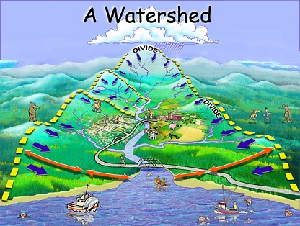

Watersheds
A watershed is an area of land that catches precipitation and drains into a particular water body.
Notes:
Watersheds
The area of land that catches precipitation and drains to the waterbody is its watershed. Everything that happens on the land impacts local and downstream water.

Slide 4
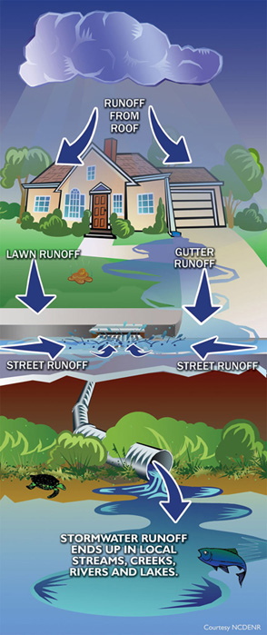
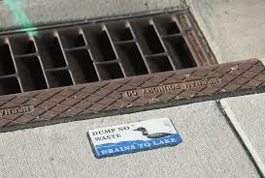
Stormwater
Rain that runs off our lawns, roofs, pavement is called Stormwater runoff.
Runoff enters our storm drains is NOT treated and ends up in our lakes, rivers and streams.

Slide 5
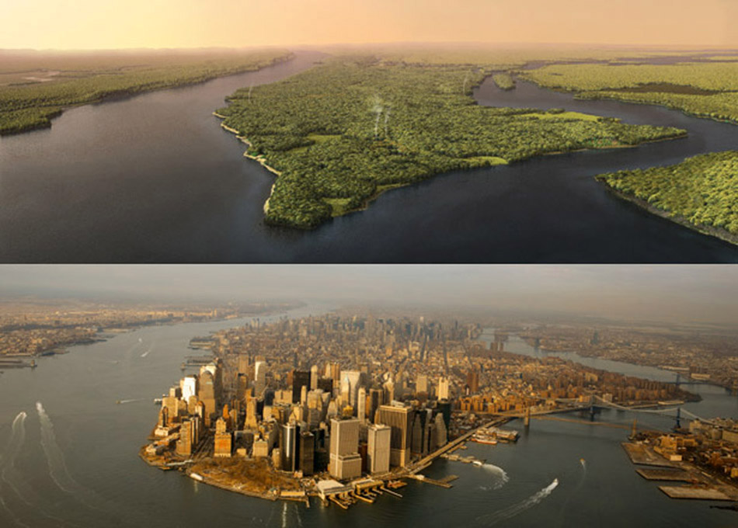
Changing Landscapes
http://urbangeographies.tumblr.com/
Notes:
Changed Landscapes: we moved from this… to this…
Our landscapes have changed dramatically – humans have taken over and there are very few natural spaces left. Sometimes its hard to understand the scale of our impact – see Manhattan image.
Even natural areas in our neighborhoods and communities tend to be dominated by lawns and/or non native species.
It’s not that we can’t incorporate more naturals spaces – but culturally, clean, manicured lawns and decorative plants (who cares where there from) have become the cultural norm.

Slide 6
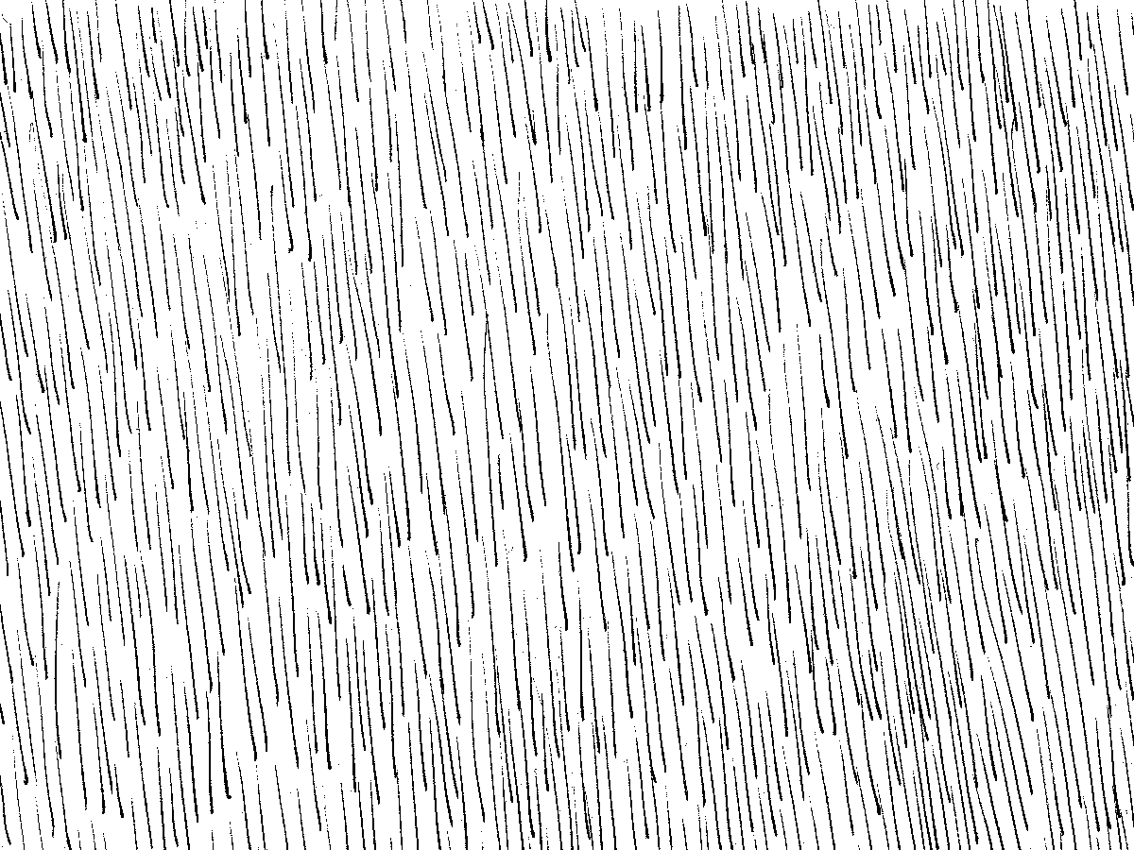

Changing Landscapes
In natural systems much of the rain that falls...
…soaks into the earth
Notes:
More native plants and natural spaces – why? Because in natural systems, much of the rain that falls soaks into the earth

Slide 7
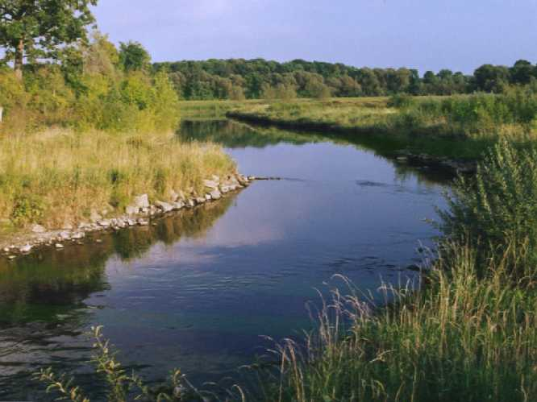
Changing Landscapes
…where it flows from underground into our natural waterways

Slide 8
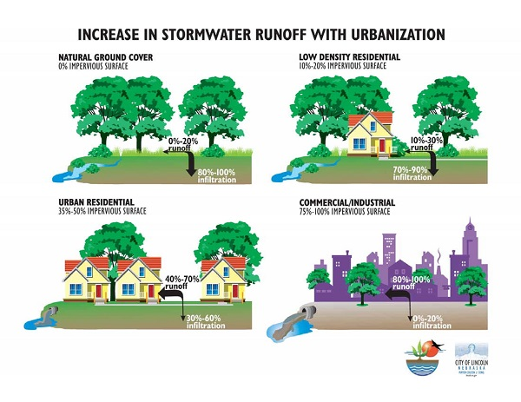
Changing Landscapes: Runoff
Image: greatlakesresilience.org
Notes:
http://greatlakesresilience.org/sites/default/files/casestudy_img_TwoHarbors_LandUseChangeAndSurfaceRunoff.jpg
This urbanization has an impact on how much water soaks into the ground.
Going back to the water cycle, before the land was developed with houses, businesses and roads, here is how the cycle worked. 80-100% of the water soaked in and only 10-20% ran off.
As development takes place, more and more water runs off instead of soaking in.

Slide 9
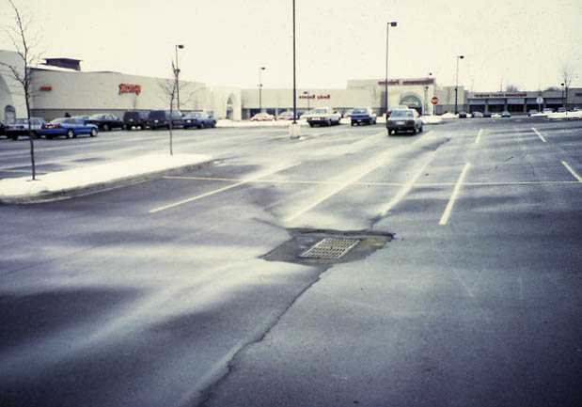
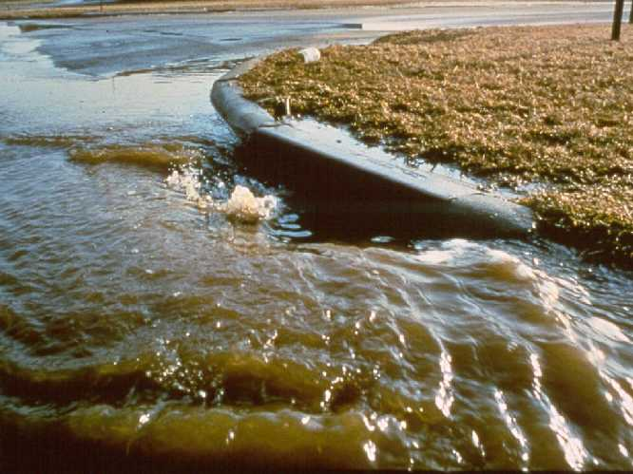
Changing Landscapes: Runoff
In more developed areas rain falls on our roadways, parking lots & roofs
and much of it runs off into our lakes, rivers and streams carrying pollutants and sediment with it.

Slide 10
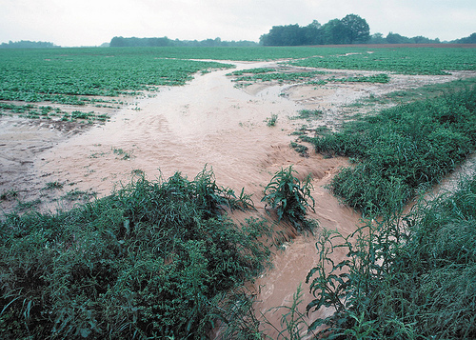
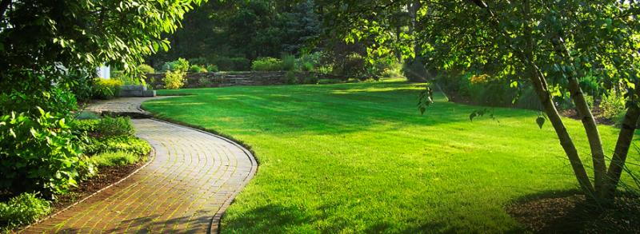
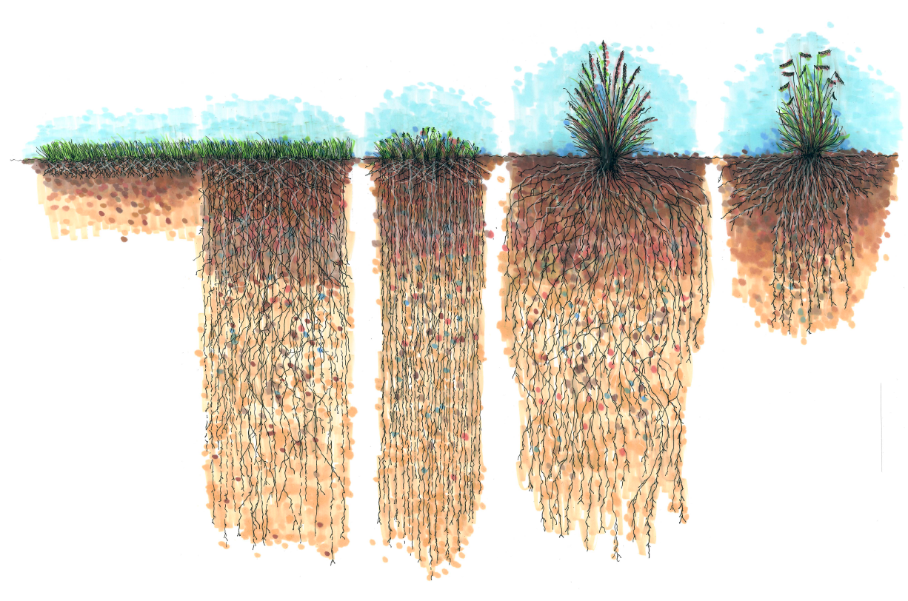
Changing Landscapes: Runoff
Photo: Natural Green Lawn Care, LLC
Photo: USDA
Kentucky bluegrass
buffalo grass
Photo: Chesapeake Bay Story
Image: Rainscaping Iowa
Notes:
Watersheds
Impervious surfaces aren’t just cement and concrete. They include: streets, parking lots, roofs, compacted turf grass, and heavily tilled agricultural fields – where the water cannot soak into the ground.
Native grasses buffalo grass and blue grana

Slide 11
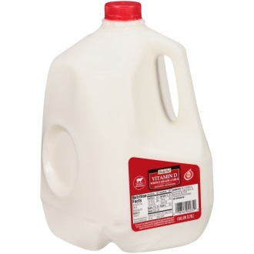
Changing Landscapes: Runoff
How much water is runs off when it rains 1”?
Average house 1800 ft2
1800 ft2 = 259,200 in2
259,000 in2 x 1in= 259,000 in3
259,000 in3 * 1 gallon/231 in3=
Image: Rainscaping Iowa
1,122 gallons!!!
How much water runs off your home?
https://water.usgs.gov/edu/activity-howmuchrain.html
Notes:
Watersheds
1800ft 2 house average

Slide 12
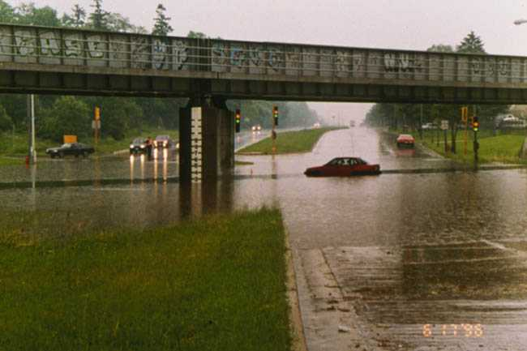
Flooding
Notes:
The change in how water flows in streams causes many problems. As mentioned, flooding is a problem, and not just for cities, but for agriculture too. Many farmers who are downstream from cities are finding their fields flooding more often, and not only in the spring, but sometimes several times a year.

Slide 13
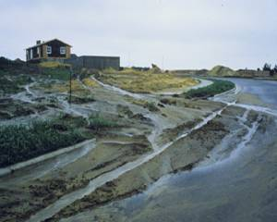
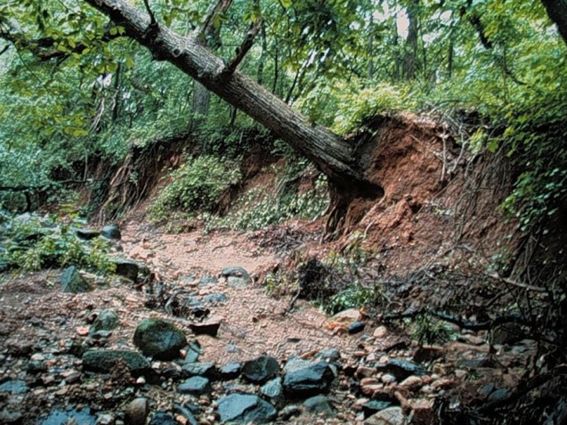
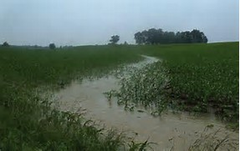
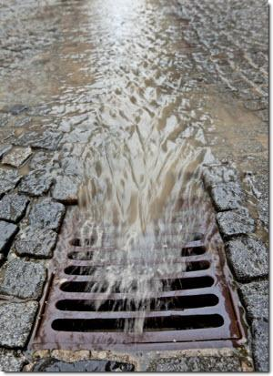
Erosion
Notes:
High amounts of runoff increase stream/river velocities which promotes increased bank erosion.
The great force causes massive erosion along stream banks.
This erosion occurred in the Milwaukee area after two large storms. The line of rocks shows you where the original stream bank was and how much land eroded away.
(Photo: Tree toppling: Lincoln Creek, Milwaukee 2000, flood crest three feet above normal. Original stream width was where the line of large rocks is.)

Slide 14
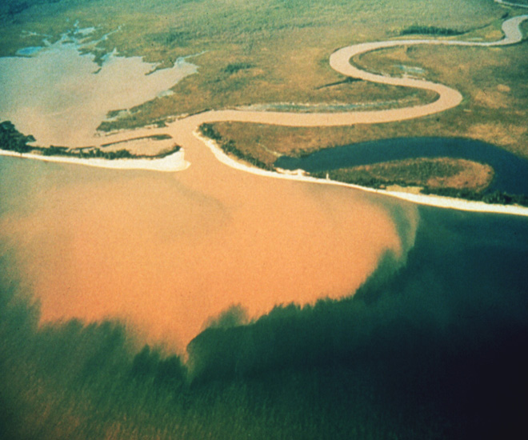
Water Quality
Notes:
But every year when the snow melts and spring rains come, blankets of soil wash off the land and into our waterways.
(Photo: Sediment plume from Six Mile Creek as it enters Lake Mendota, Dane County)

Slide 15
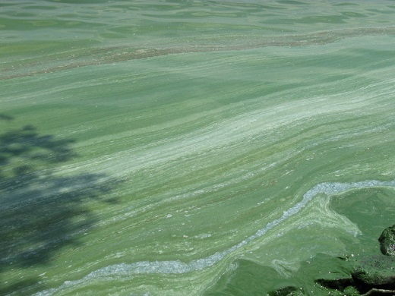
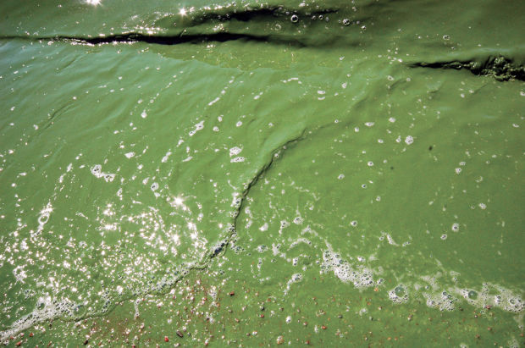
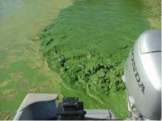
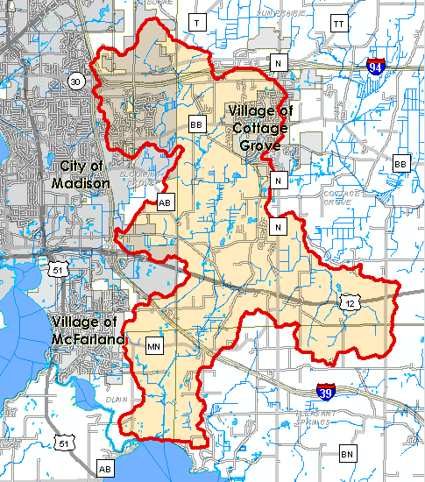


Algae
1 lb. phosphorus : 500 lbs. algae
Photo: WDNR
Photo: Madison.com
Photo: WDHS
Example: Door Creek Watershed
Annual phosphorus load =15,050 pounds
7,525,000 lbs
Notes:
Algae
Nutrients, including phosphorous, from fertilizers, leaves, grass clippings - can cause excessive algae growth in water bodies.
For example, average TP load in Door Creek is 15,050 lbs which has the potential to produce over 7 million lbs of algae.
One thing we can do to help is increase upland infiltration practices and natural areas help slow down the water, reducing erosion and nutrient inputs.
**Annual total phosphorus and total suspended sediment loadings in pounds by source category for the Door Creek Watershed based on results generated by Dane County Land and Water Resources Department using data from Yahara WINs Extended SWAT Model to Estimate Baseline Phosphorus Loading to the Yahara Watershed (Montgomery Associates Resource Solutions, LLC, 2014).

Slide 16
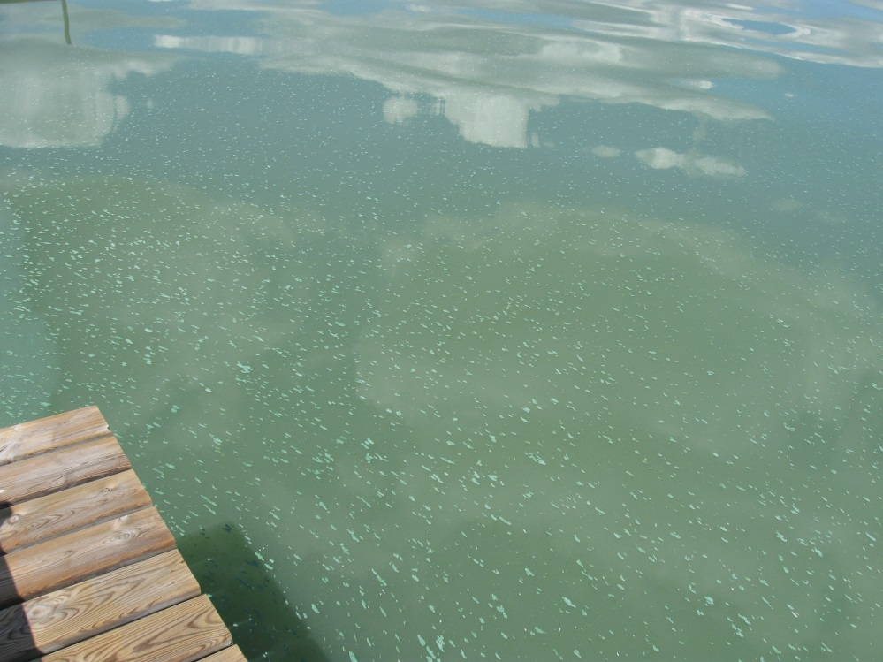
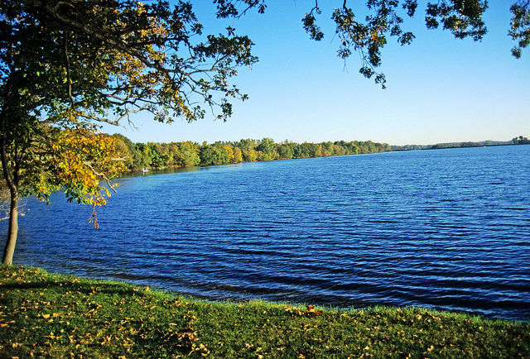
Solutions
What Can We Do to Make Sure our Water Look More Like This and Less Like This?
Notes:
Kegonsa 2012
To ensure we have waters that are:
Suitable habitat for fish and other organisms
-swimable/fishable for recreation
-and in some cases drinkable in areas where people rely on their surface waters for drinking water.

Slide 17
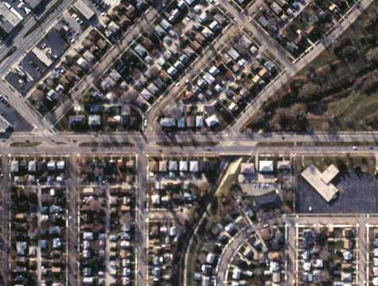
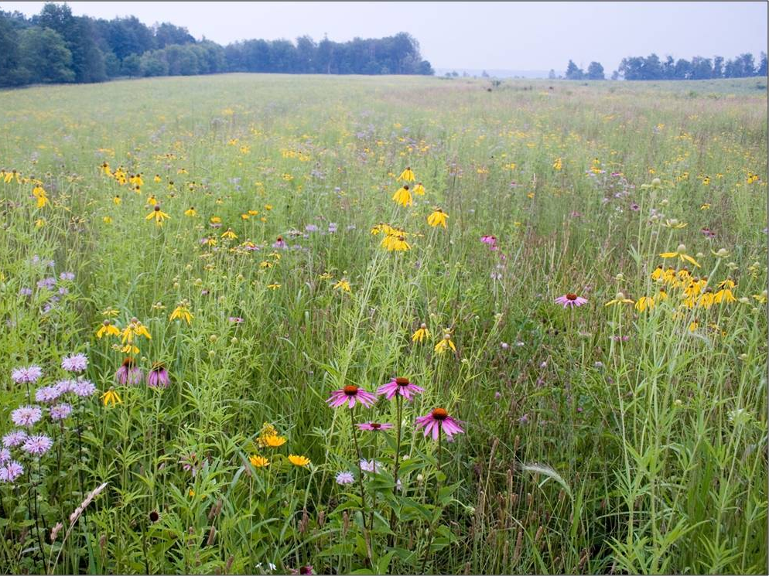
Solutions: Help water soak into the soil
Need to make this
Act more like this
Notes:
Need to make changes so our cityscapes function more like our rural landscapes.
Native plants have deep root systems that promote infiltration and help water soak into the ground rather than runoff .

Slide 18
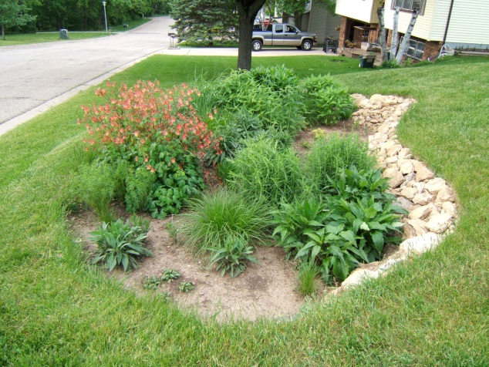
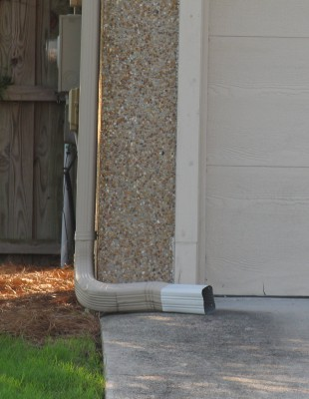
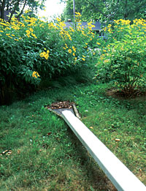
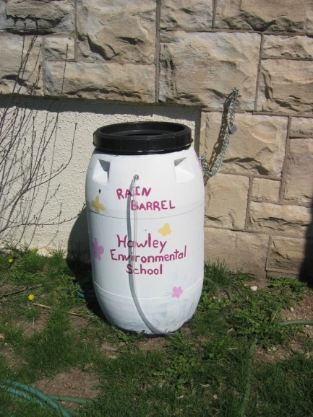
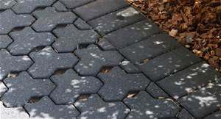
Solutions: Help water soak into the soil
Replace some turf with Native Gardens or Rain Gardens
Redirect downspouts to natural areas
Install a Rain Barrels
Consider pervious paving options

Slide 19
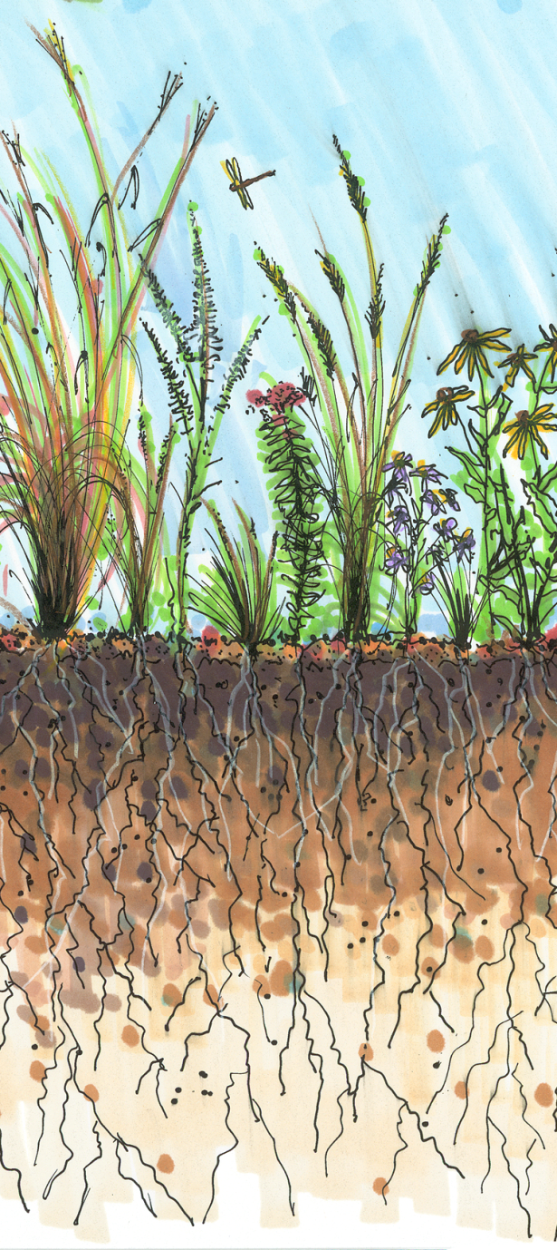

Other Benefits of Native Plants
Deep root systems that help infiltrate rain water
Adapted to the local climate and soils
Drought tolerant
Disease resistant
Developed complex relationships with the local organisms and ecosystem
Kentucky bluegrass
buffalo grass
Image: Rainscaping Iowa
Notes:
Buffalo Grass native to WI not great for high traffic areas
Other Benefits of Native Plants - Native plants have:
Adapted to the local climate and soils
Drought tolerant
Disease resistant
Developed complex relationships with the local organisms and ecosystem

Slide 20
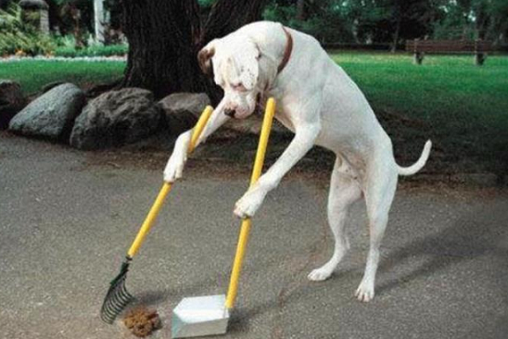
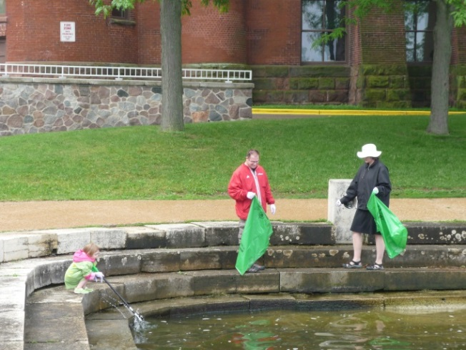
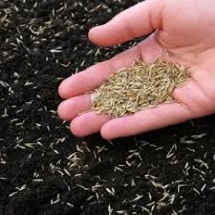
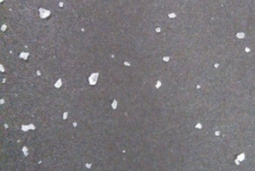
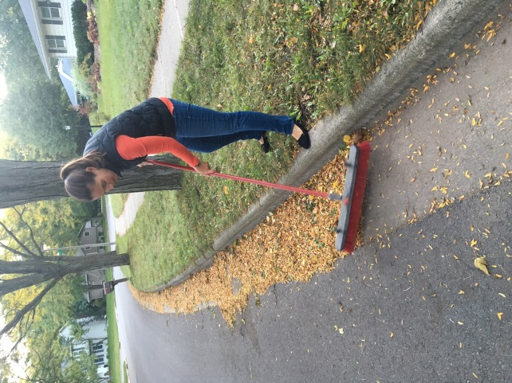

Solutions: Keep chemicals and debris from
washing into storm drain
Cover bare soil to prevent erosion
Pick up after pets
Dispose of Trash and hazardous chemicals properly
Use the right amount of salt for safety
Keep Leaves out of the street before the rain
Notes:
www.danecountycleansweep.com
https://uwlab.soils.wisc.edu/farmers/lawn-garden/
Pet waste contains nutrients and bacteria harmful to aquatic life and humans using local waters.
Rain water that runs through leaves on the street creates a “leaf-tea” rich in dissolved phosphorus. This tea fuels algae growth in our lakes.

Slide 21
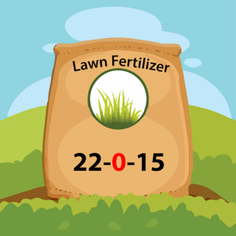
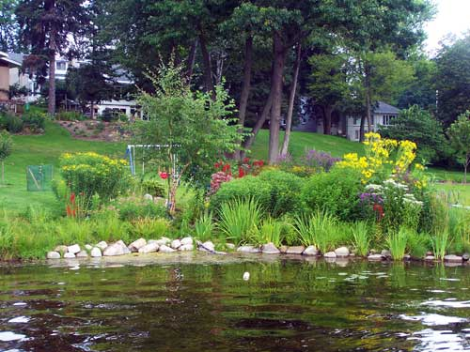

Yard/Lawn Care Tips for Healthy Waters
Consider adding native gardens.
Plant low maintenance grasses such as fescues in lower traffic areas.
Mow grass high (3-4”) with sharp blade.
Mow only 1/3 of height at a time and leave clippings on lawn.
If lawn is thin, apply slow-release Nitrogen fertilizer, in spring and fall (phosphorus free). Consider spring/fall compost applications to improve soil. GOOD SOIL IS KEY TO HEALTHY, FULL LAWN.
If needed, select reduced-risk herbicides/pesticides and use at the right time of year when most effective.

Slide 22



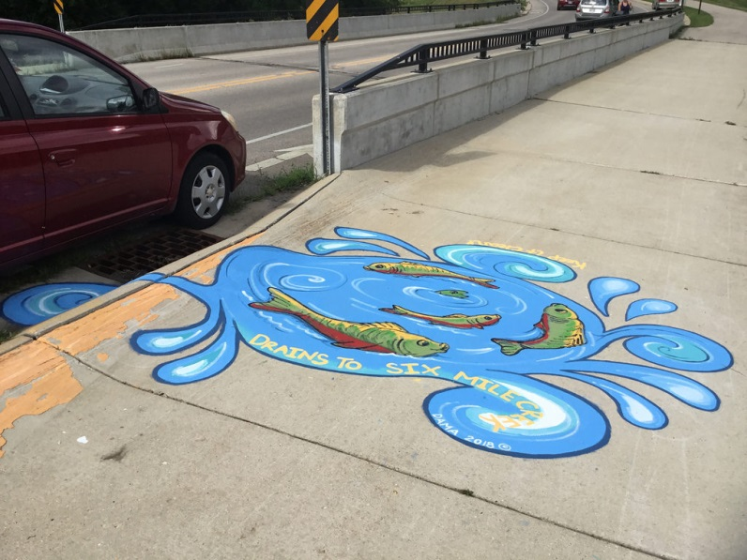

Madison Area Municipal Stormwater Partnership (MAMSWaP) Education Efforts
Ripple Effects
Plant Dane! Native Plant Program
Leaf-free Streets
WI Salt Wise
Partner Training
Public/School Presentations
Storm Drain Murals

Slide 23

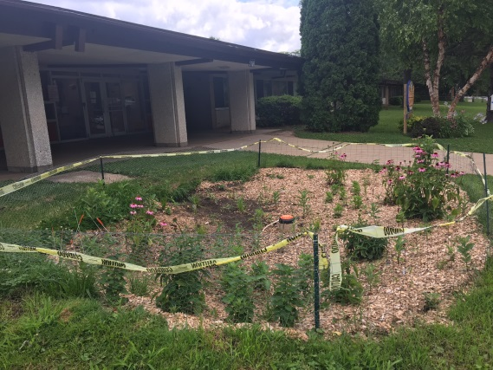
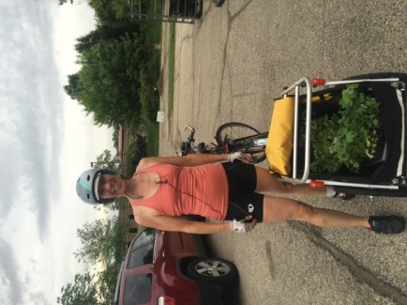
Plant Dane
Goal: Work with residents and organizations to replace impervious surfaces and turf with native gardens and rain gardens to reduce stormwater runoff.
Options:
Order low-cost native plants (50+ species, $2.25/each)
Apply for free native plants- fall applications due July
Donate funds towards native plants for community projects.
Grow native plants for community projects.
Learn how to build a rain garden- Rain Garden Workshop.
Capture rain water- discounted rain barrels.
Notes:
Danewaters.com

Slide 24

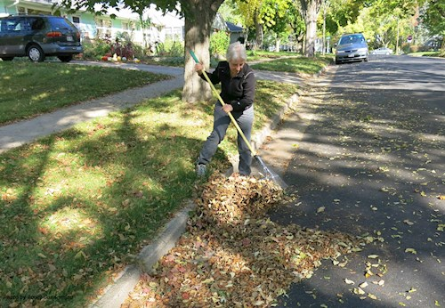
Leaf-free Streets
Goal: Work with residents and municipalities to remove street leaves before the rain.
Leaves left in the street every fall are a major source of phosphorus to urban stormwater.
When it rains water runs through street leaves forming a "leaf-tea" rich in dissolved phosphorus that drains to our lakes, rivers and streams.
Safely removing street leaves before the rain can significantly reduce the amount of phosphorus in urban stormwater- Join us in keeping streets leaf-free this fall!
Notes:
Danewaters.com

Slide 25
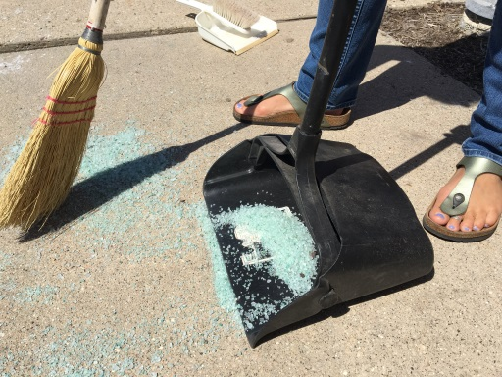

WI Salt Wise
Goal: Work with winter maintenance professionals and residents to reduce winter salt use.
It only takes one teaspoon of salt to pollute up to 5 gallons of fresh water.
One 12 oz. cup of salt is enough to treat 10 sidewalk squares. Scatter the salt leaving space between the grains.
When pavement temps drop below 15, salt won’t work. Switch to sand for traction or a different ice melter (PDF) that works at lower temperatures.
Hire a winter maintenance professional that has already been certified through the Winter Salt Certification Program or encourage your current applicator to become certified.
www.wisaltwise.com
Notes:
Danewaters.com

Slide 26
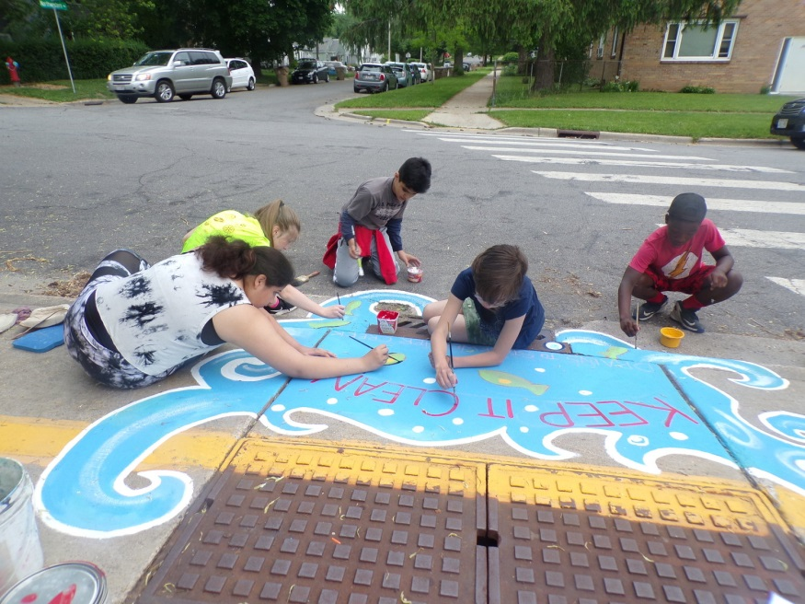
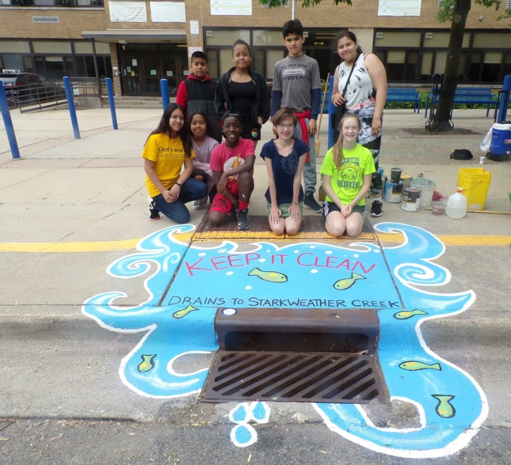
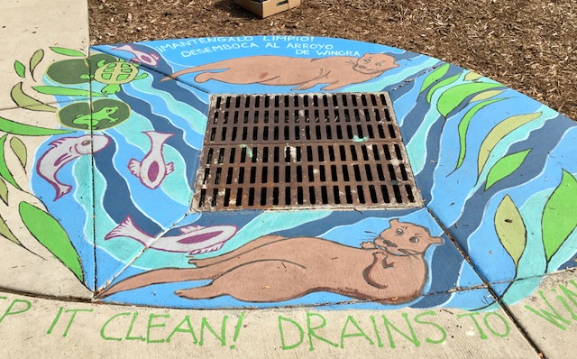
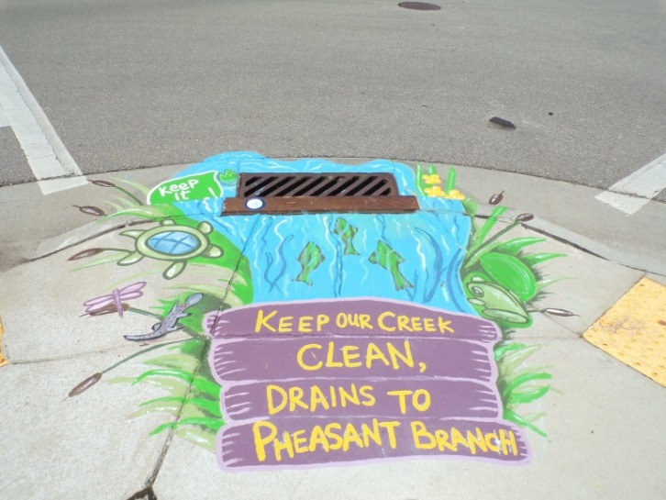
Educate and spread the word!
Storm Drain Mural Map Tour

Slide 27
Questions?
Your Name
Your Contact Information
www.ripple-effects.com

