Slide 2
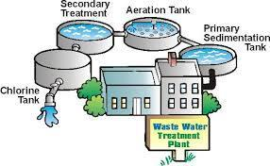
To Wastewater Treatment Plant
(sanitary sewer)

Slide 3
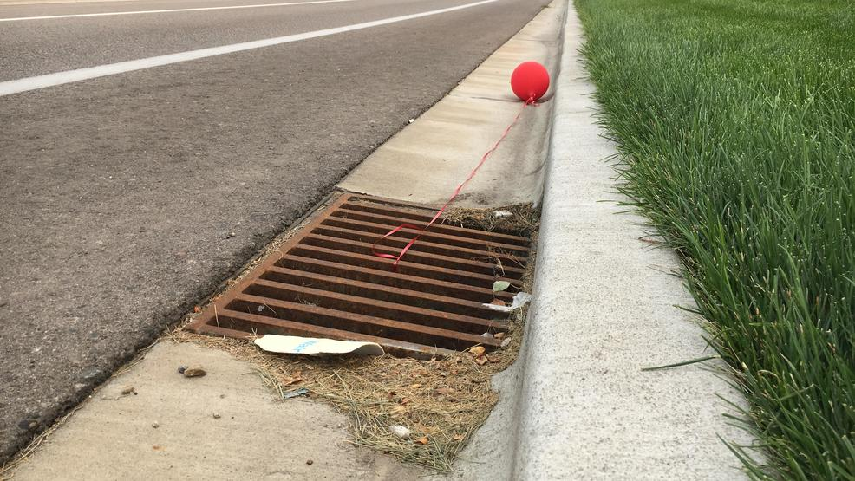
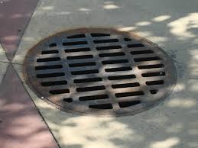
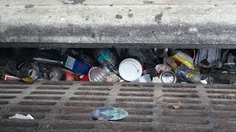
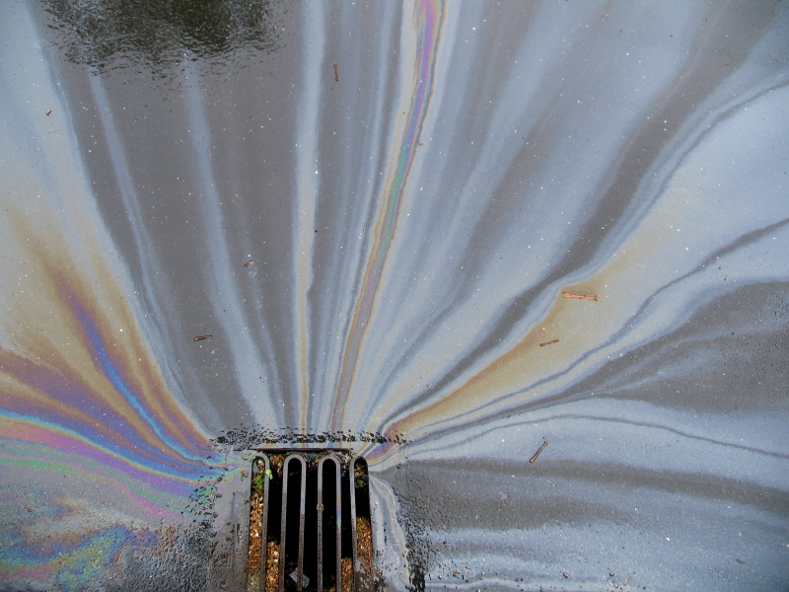
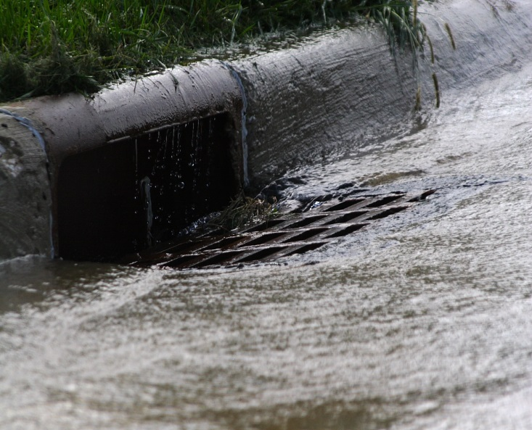
Storm Drains

Slide 4
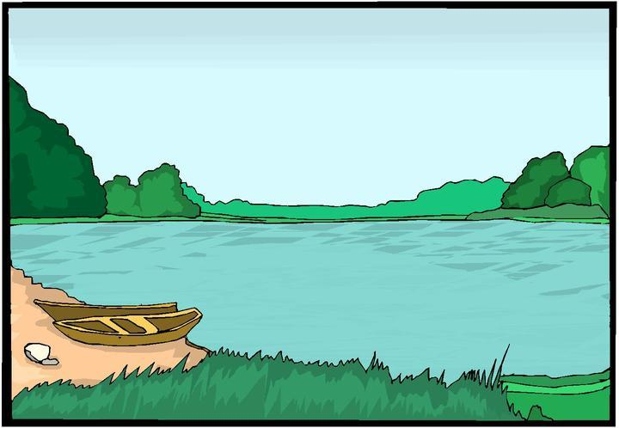
Straight to Lake, River or Stream
(storm sewer)

Slide 5
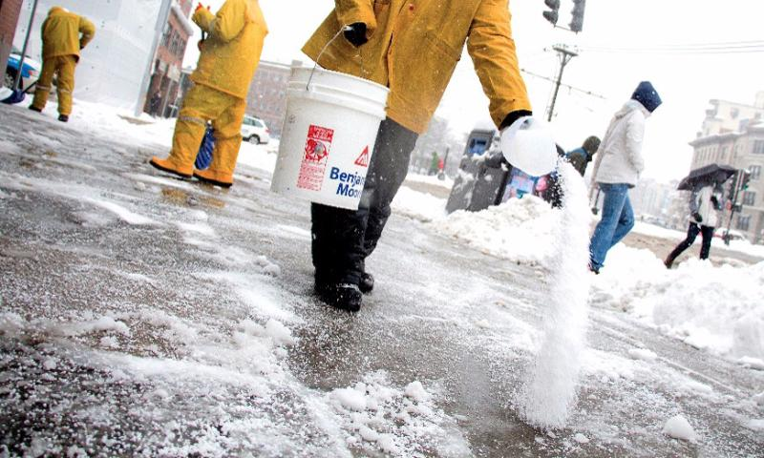
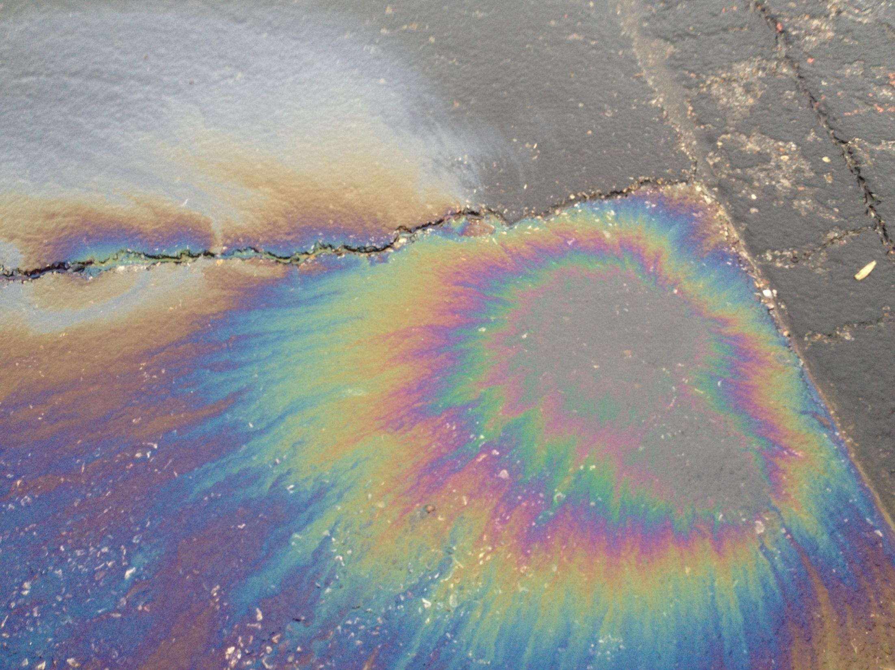
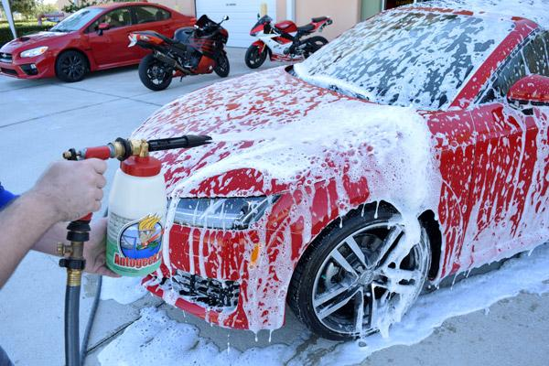
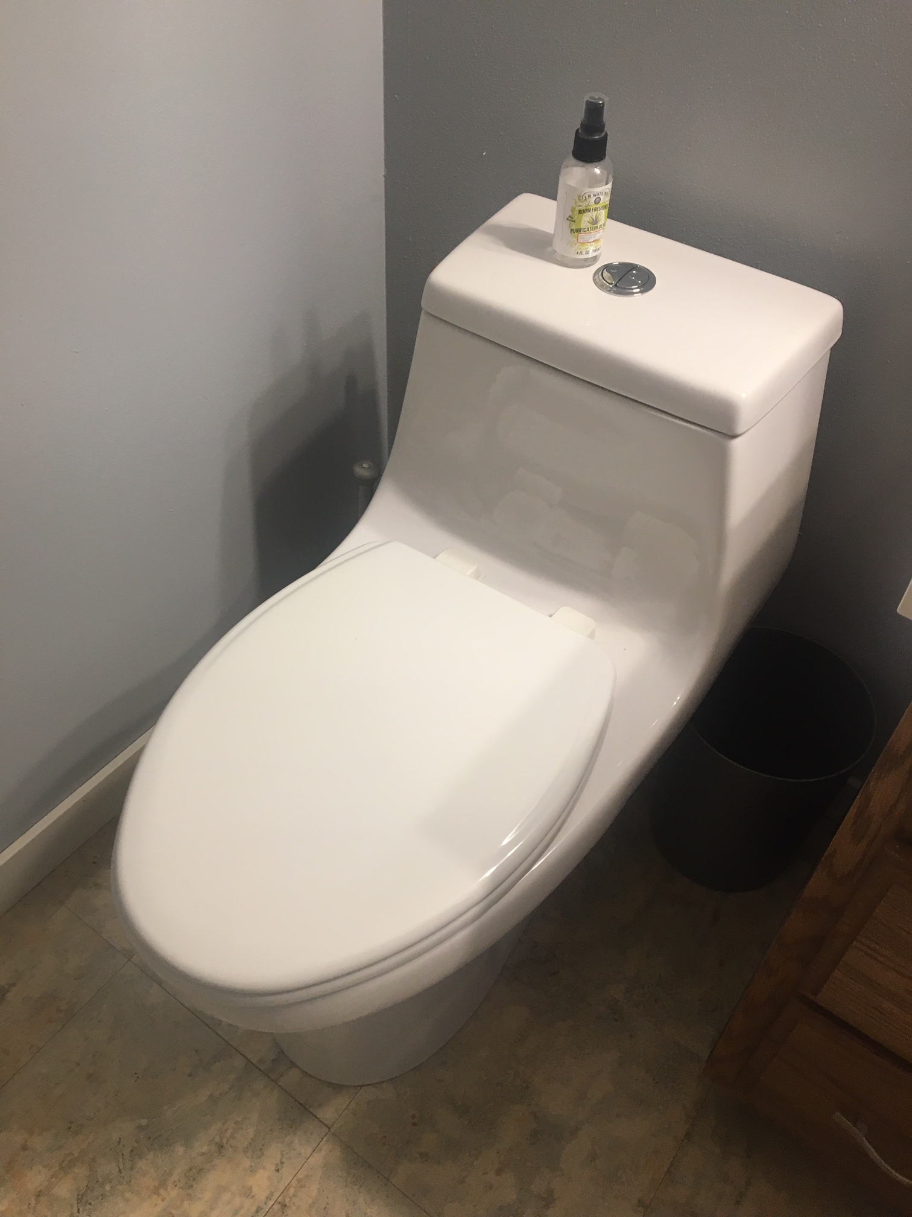
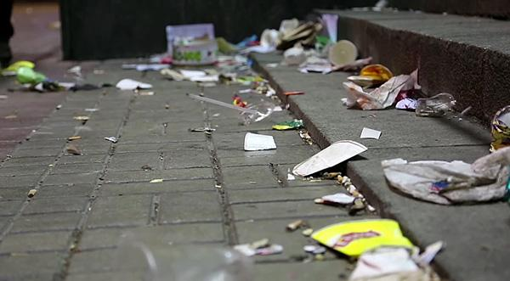
Sanitary sewer treatment plant
Storm sewer lake, river or stream

Slide 6
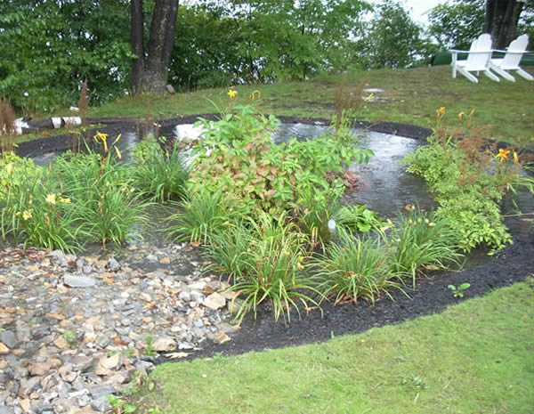
Tricky one!
NEITHER- WATER SOAKS INTO THE GROUND LIKE A SPONGE ☺ ☺ ☺
Sanitary sewer treatment plant
Storm sewer lake, river or stream

Slide 7
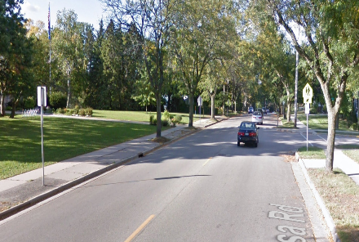
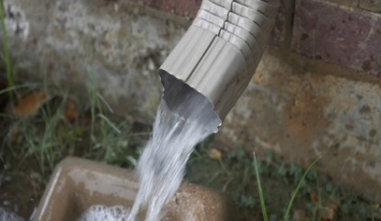
Sanitary sewer treatment plant
Storm sewer lake, river or stream

Slide 8
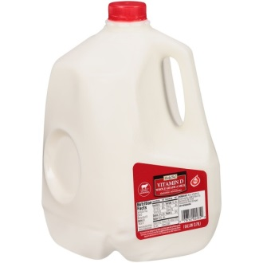
Problem- Too much runoff!
How much water is runs off when it rains 1”?
Average house 1800 ft2
1800 ft2 = 259,200 in2
259,000 in2 x 1in= 259,000 in3
259,000 in3 * 1 gallon/231 in3=
Image: Rainscaping Iowa
1,122 gallons!!!
(About 100 bathtubs)
How much water runs off your home?
https://water.usgs.gov/edu/activity-howmuchrain.html

Slide 9
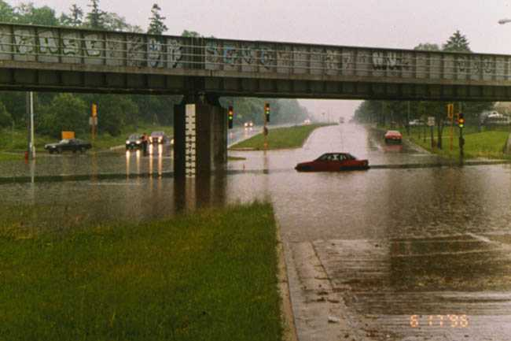
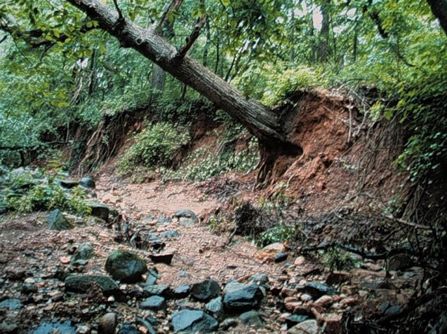
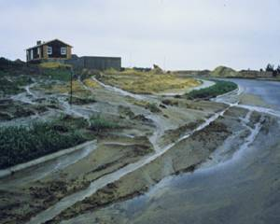
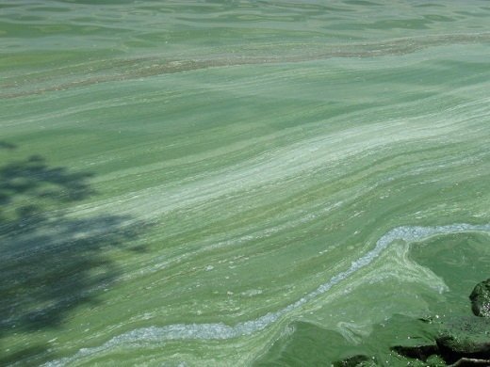
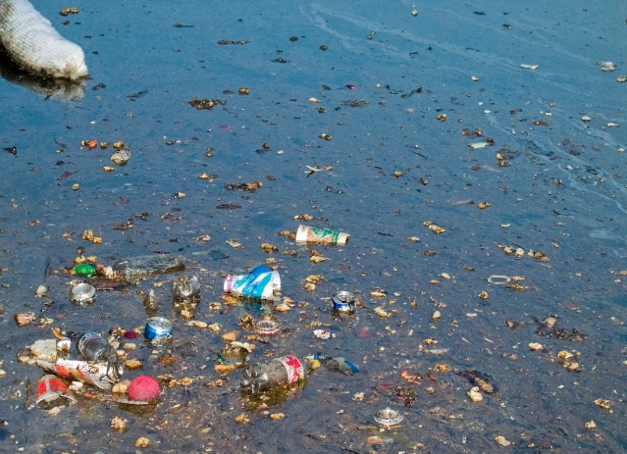
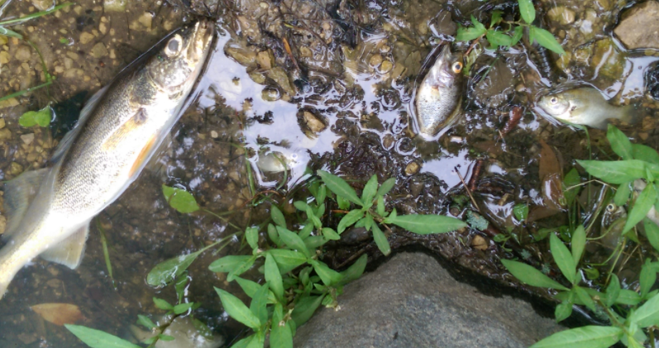
Too much runoff can cause BIG problems!
Flooding
Erosion
Polluted water
Harm wildlife
Photo: WDNR
Photo: UW Madison
1 lb. phosphorus = 500 lbs. algae

Slide 10
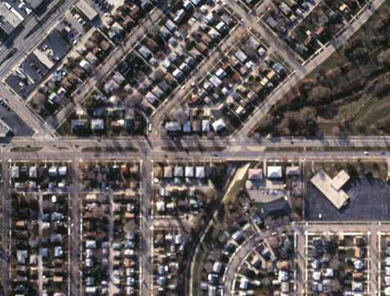
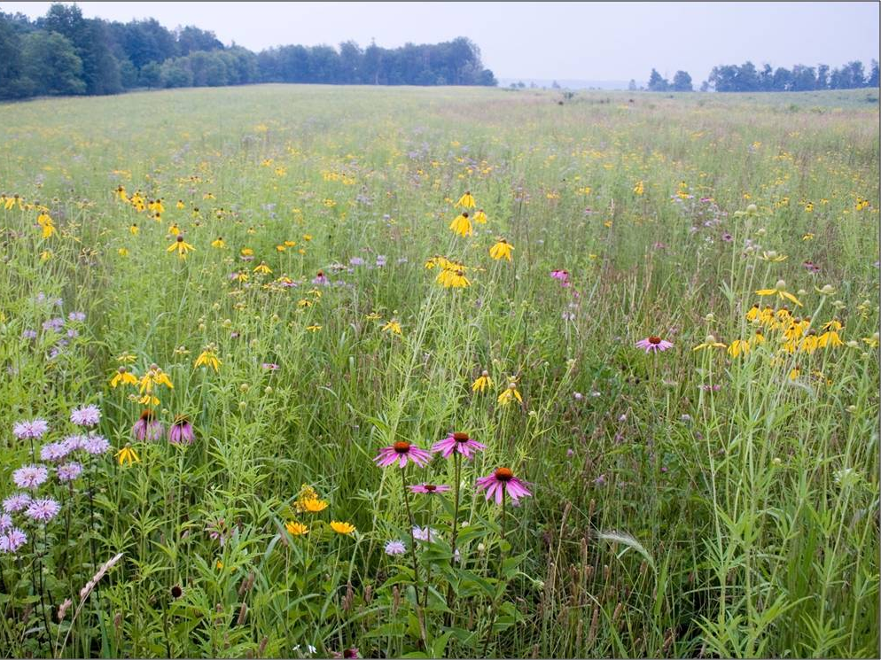
Solutions: Help Water Soak into the Ground
Need to make this
Act more like this
Notes:
Need to make changes so our cityscapes function more like our natural landscapes.
Native plants have deep root systems that promote infiltration and help water soak into the ground rather than runoff .

Slide 11
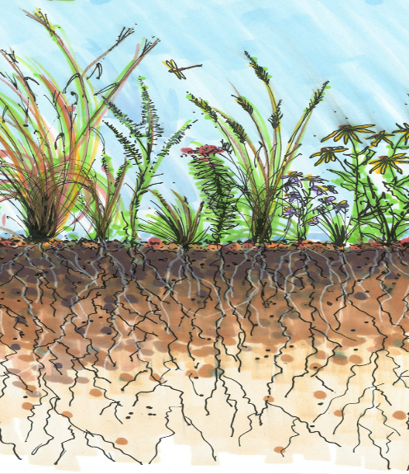
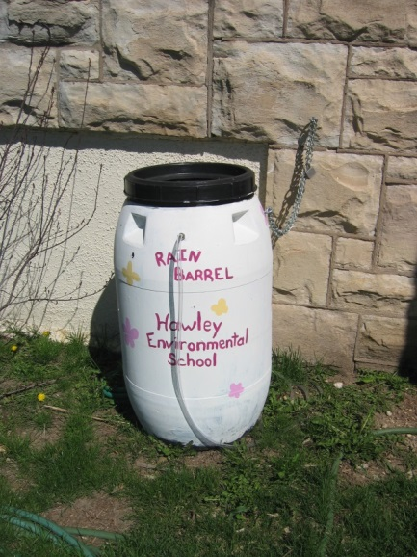
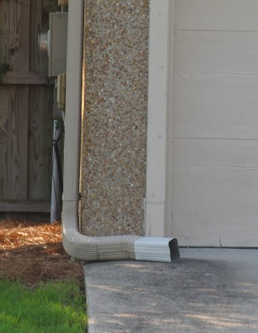
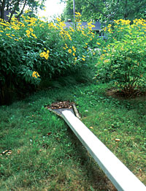
You Can Help-Keep Rain Where it Lands!
Help Water to Soak into the Ground
Image- Rainscaping Iowa
Plant some native plants or a rain garden.
Install a Rain Barrel
Point downspouts to grass or garden
Notes:
Special plants called natives are from Wisconsin and they have long roots underground that help the soil under them act kind of like a sponge and soak a bunch of water in the ground.
Rain barrels store the rain water so you can use it later to water plants or your lawn.

Slide 12
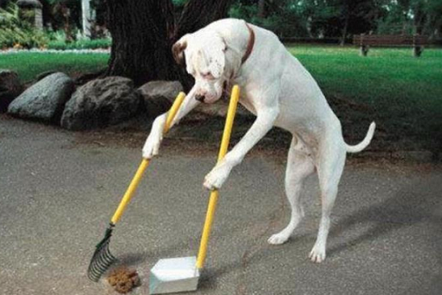
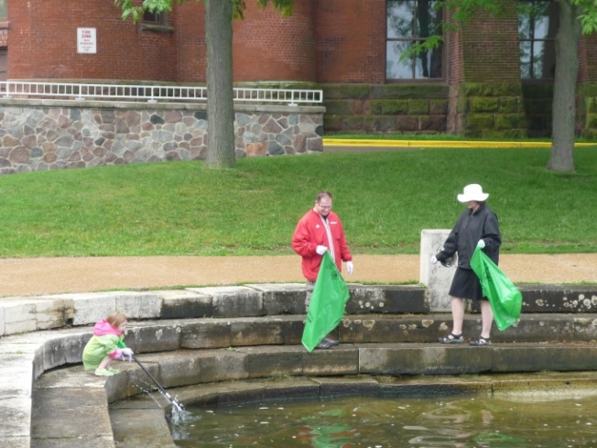
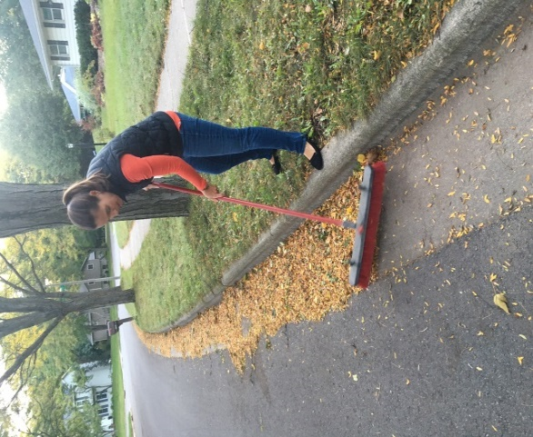
You Can Help-Only Rain Down the Storm Drain!
Pick up after pets
Don’t litter and pick up trash outside
Use the right amount of salt in the winter for safety
Keep Leaves and grass out of the street before the rain
Notes:
www.danecountycleansweep.com
Pet waste contains nutrients and bacteria harmful to aquatic life and humans using local waters.
Rain water that runs through leaves on the street creates a “leaf-tea” rich in dissolved phosphorus. This tea fuels algae growth in our lakes.

Slide 13
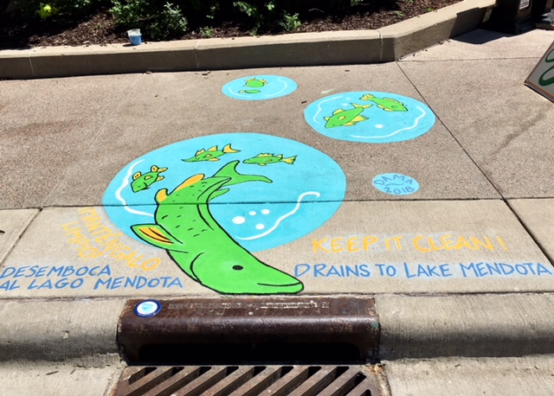
You Can Help- Share What You Learned with Others!
Notes:
Mural near Children’s Museum downtown

Slide 14
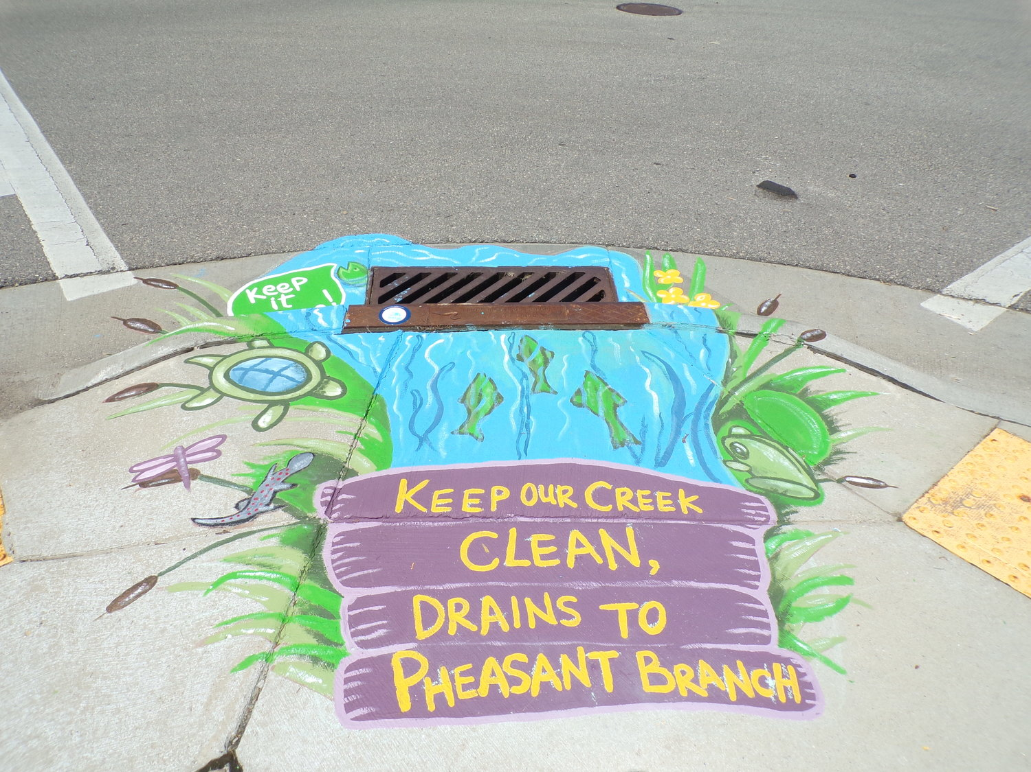
Notes:
Mural near downtown Middleton

Slide 15
Notes:
Mural at the Henry Vilas Zoo

Slide 16
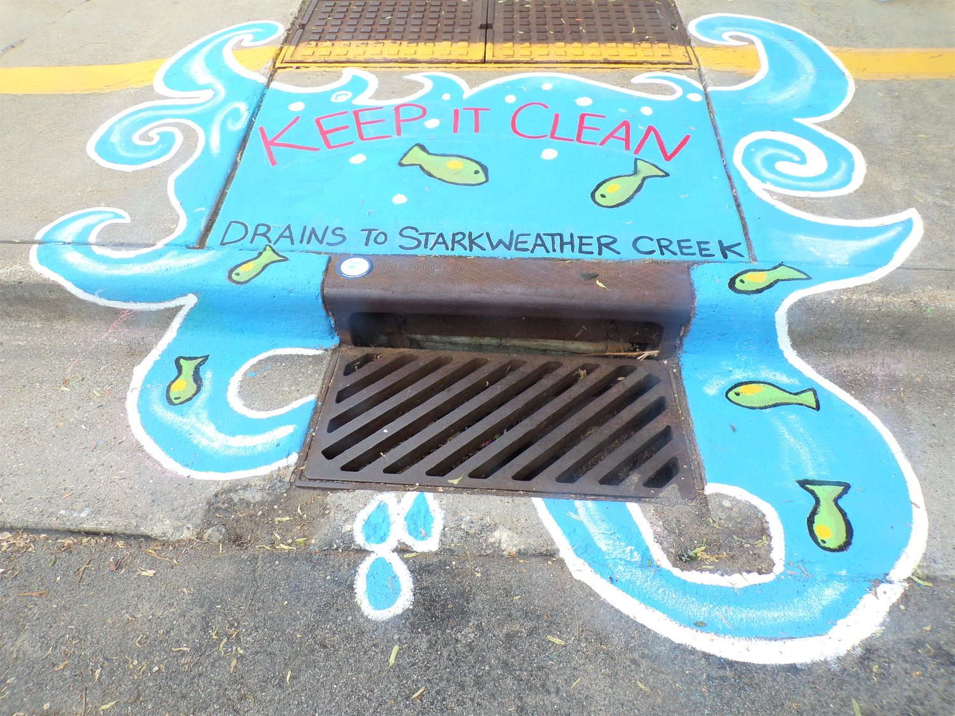
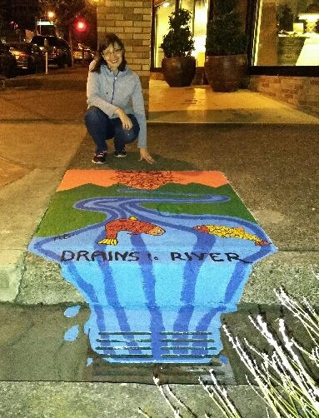
Notes:
Sherman Middle School Madison

Slide 17
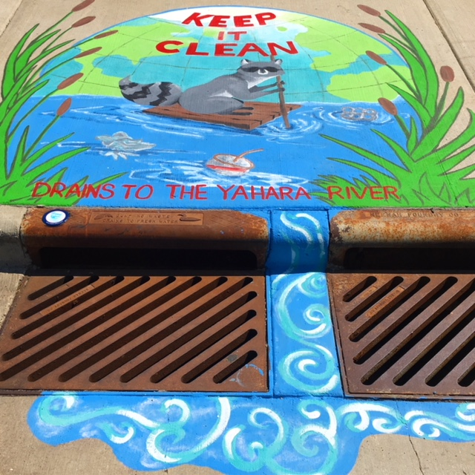
Notes:
Deforest High School

Slide 18
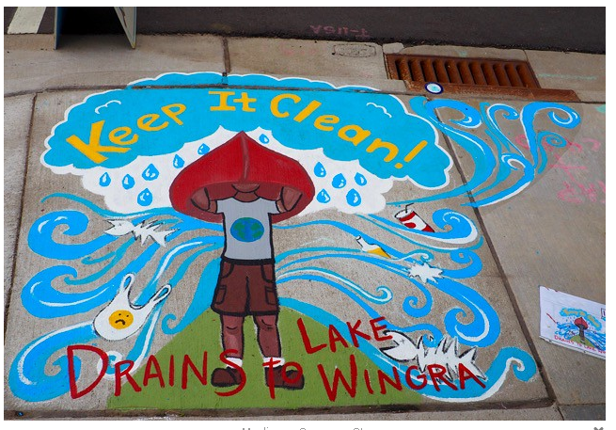
Storm Drain Mural Map https://countyofdane.maps.arcgis.com/apps/MapTour/index.html?appid=2ca8a2d056d0433dbab17619dd42f509
Notes:
In front of Collectivo Coffee- near Monroe Street

Slide 19
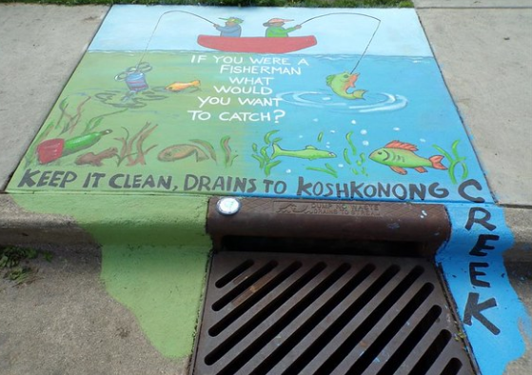
Notes:
Westside Elem Sun Prairie

Slide 20
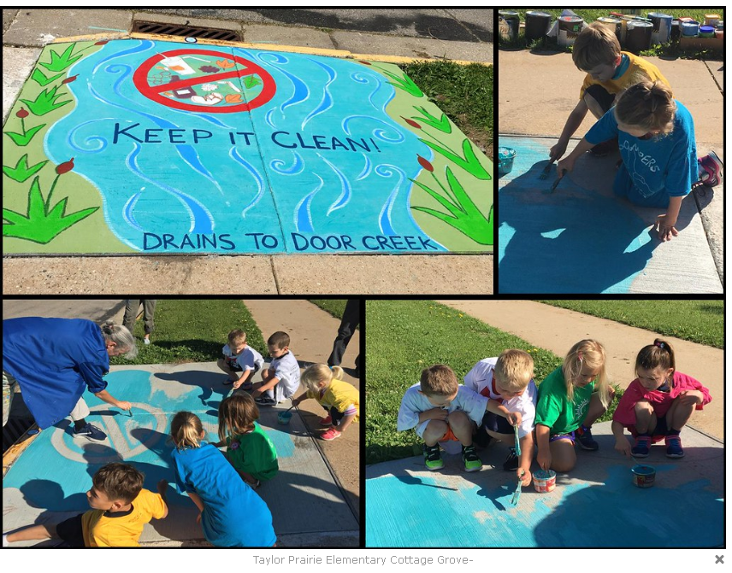

Slide 21
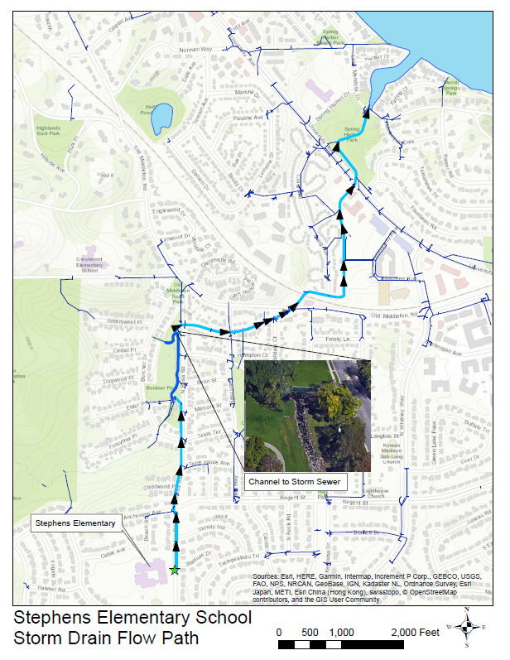

Slide 22
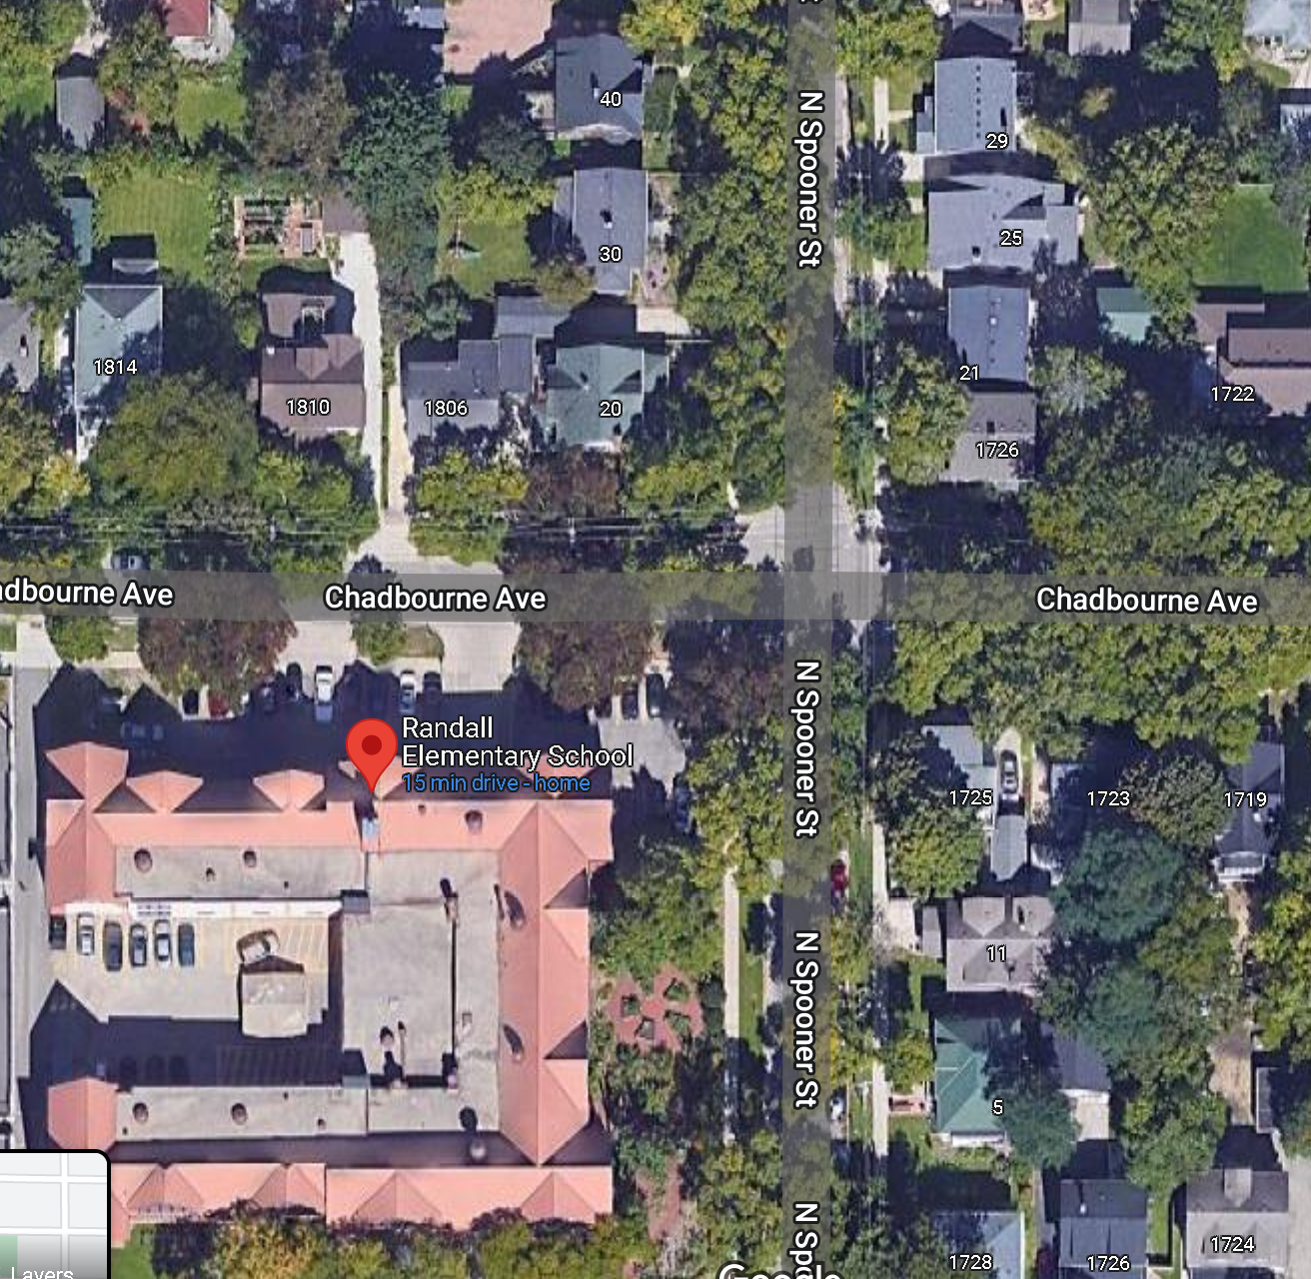
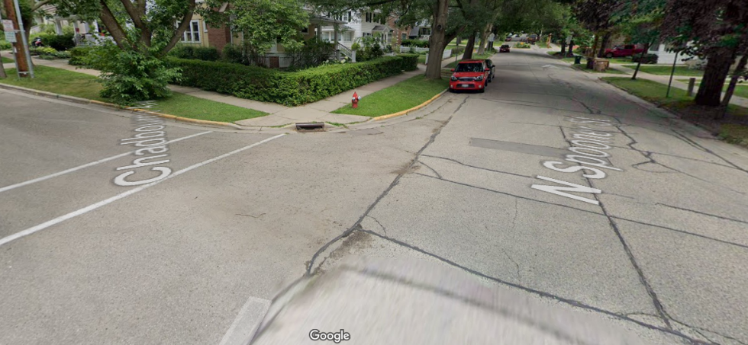
Location of storm drain mural at Randall Elementary
Keep It Clean Drains to Lake Monona

Slide 23
NOW IT’S YOUR TURN!
WHAT WILL YOUR MURAL LOOK LIKE?
When coming up with design ideas think about:
Things you want to protect that live in the water around here (fish, plants and animals)
What you want the water in the lake/river to look like
What you enjoy doing in or near the lakes/river
Thing you can do to help keep the water clean (clean up litter, pick up after pets)
Keep It Clean, Drains to Lake Monona

Slide 24
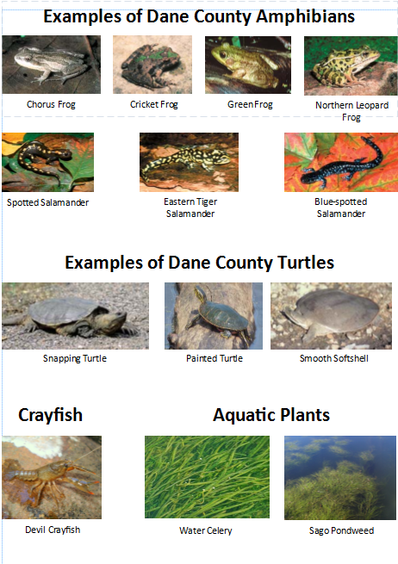

Slide 25
Questions?
Your Name
Your Contact Information

