Slide 1
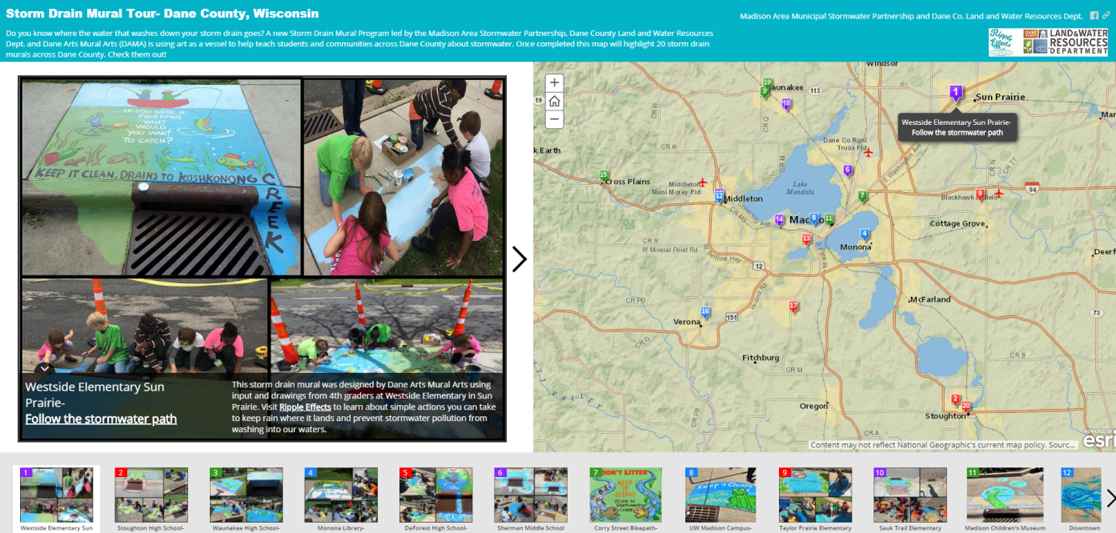
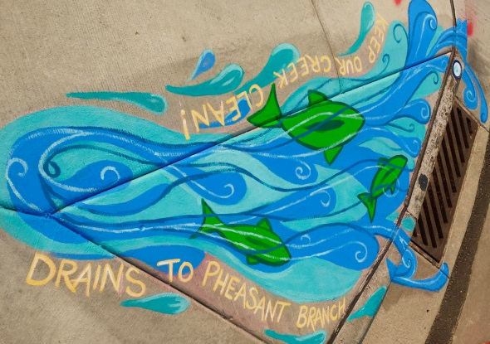
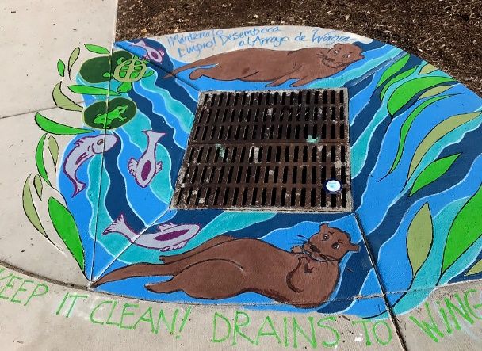
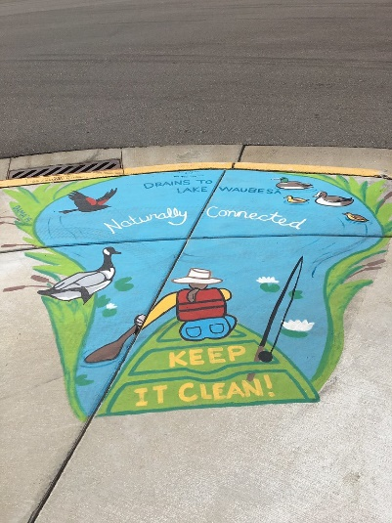
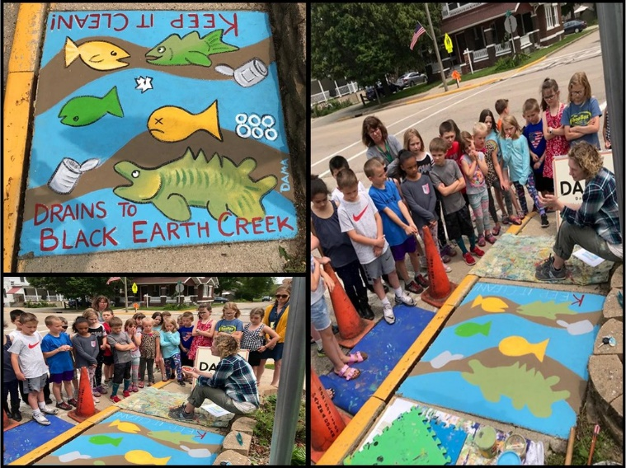
Storm Drain Murals
Storm Drain Mural Program
Goal: Raise awareness that stormwater runoff drains to local waters.
2023 Storm Drain Mural Applications Available in Dec.
Notes:
-Grant program where groups can apply to get a storm drain mural painted in their community.
-No cost to the municipality or applicant
-Option to help design and paint of choose from a catalogue of designs
- 30 murals across the county. Try to choose public areas near parks, libraries where people will see them.

Slide 2
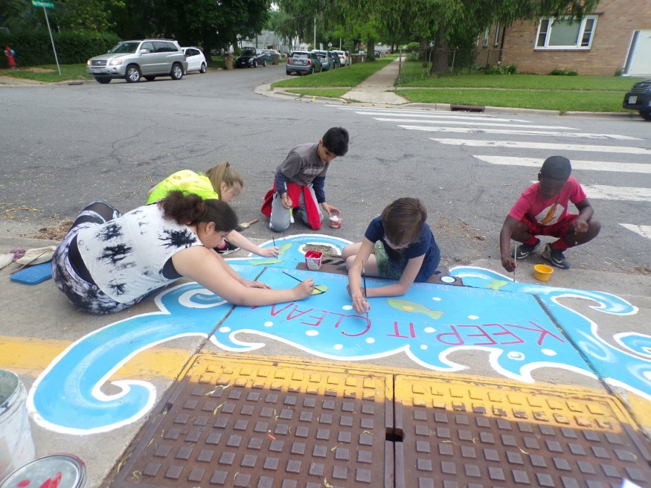
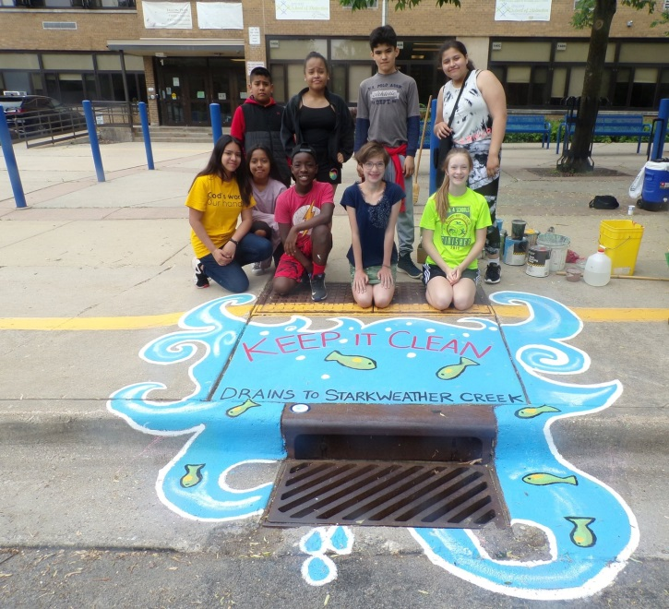
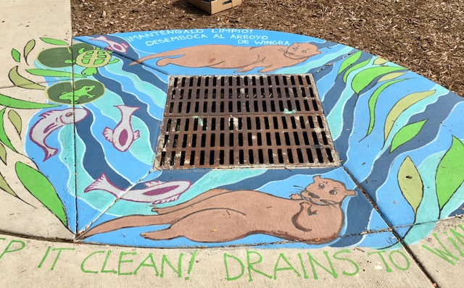
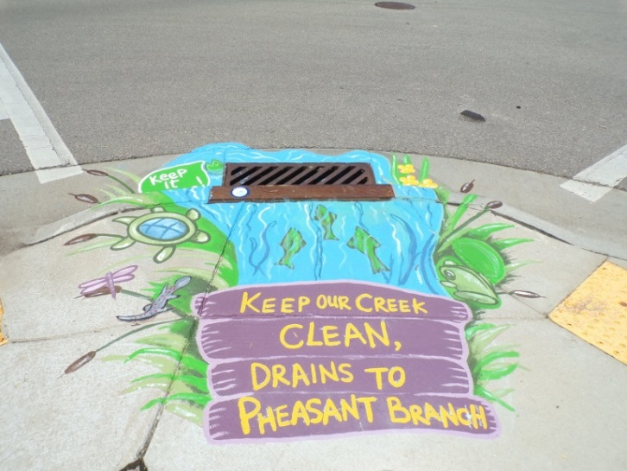
Educate and spread the word!
Storm Drain Mural Map Tour

