Slide 1
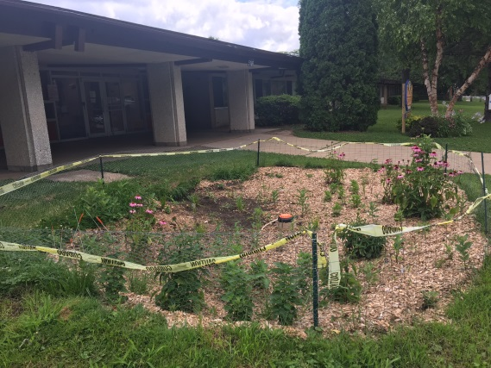
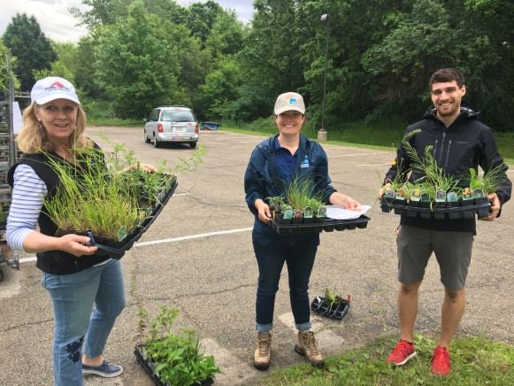
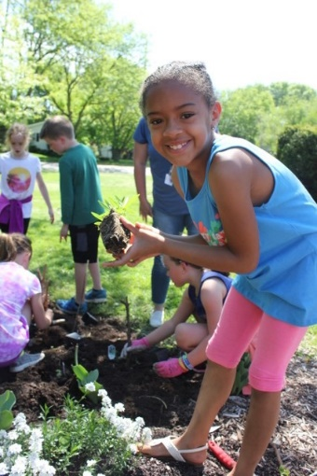
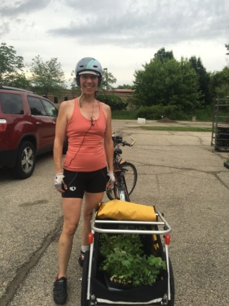
Plant Dane
Goal: Encourage residents and organizations to plant native gardens and rain gardens to increase infiltration and reduce stormwater runoff.
Options:
Order Low cost native plants- 40+ species, $XXX/each
Donate plants for Free Native Plants for School and Community Projects (spring)
Grow native plants from seed-training and seed provided. (fall)
Learn – attend a Rain Garden Workshop (virtual)
Notes:
12,000-15,000 plants per year, fund 30-40 native plant projects each year. I’d like to provide more individualized help on the rain garden front. There are some efforts in the works through a grant the Arb received and a pilot reimbursement program in the City of Madison that might help move in that direction.

Slide 2
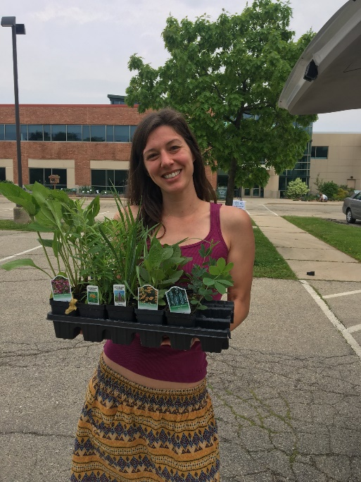
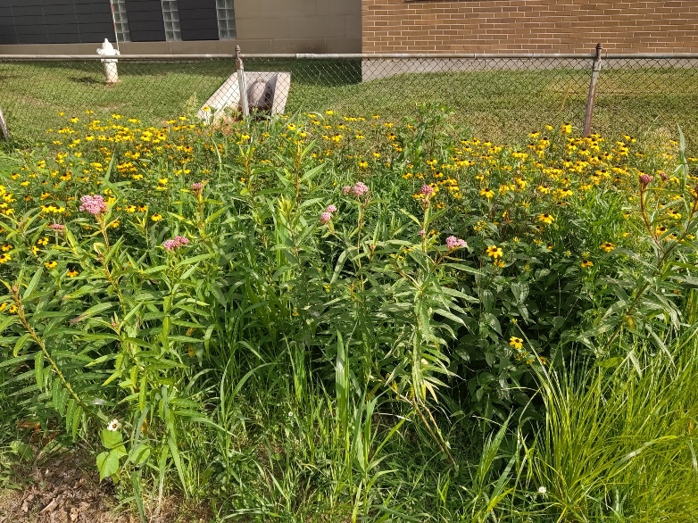
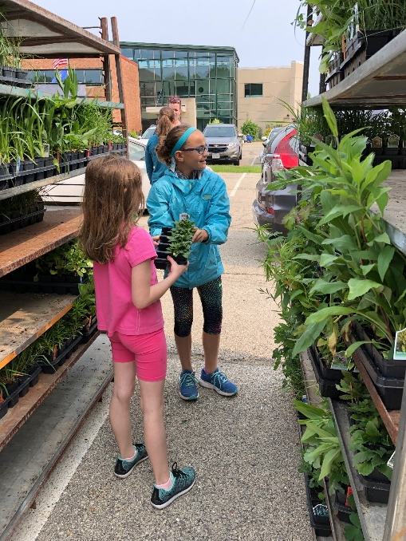
Plant Dane encourages Dane County residents and organizations to build native gardens and rain gardens through educational opportunities, resources and access to low cost native plants.
Sponsored by the Madison Area Municipal Stormwater Partnership (MAMSWaP) in an effort to reduce and improve quality of stormwater runoff to our lakes, rivers and streams.

Slide 3
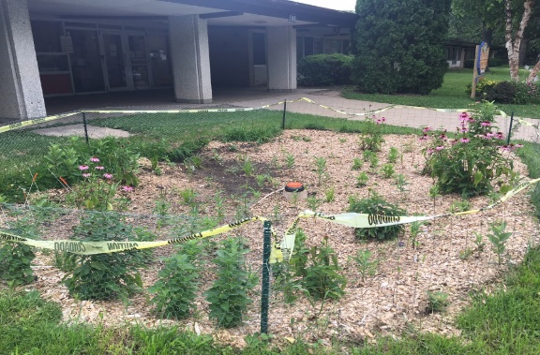
ORDER native plants online-
-40+ species including garden kits
-$XXXXX/each (order in multiples of 4)
-order deadline XXXX
DONATE funds for native plants for school/community projects through Plant Dane order system.
-donate by XXXX
GROW native plants for community projects.
-seed and instructions provided
-training available
LEARN how to build a rain garden. Workshop on
Feb. 29th- 8:30-11:30AM at the Fitchburg Community Center. $10
www.ripple-effects.com/plantdane
Notes:
All info on our plant dane website www.ripple-effects.com/plantdane including species lists. Online registration for workshop.
The growing native plants program is very new and we are partnering with the Office of Lakes and Watershed on it. Basically we are asking people to learn how to grow native plants from seed in milk jugs. They hold trainings in the fall and then participants are asked to grow and take care of the plants until the following fall. The idea is that these would be grown to give to schools or groups who need plants, not individuals. We have a link to the program on our web site along with an application for FREE plants. There are 2 cycles that groups can apply for one with plant delivery in June and one with plant delivery in early fall. We are hoping to provide plants to groups in June through any donations made through the Plant Dane cost share program and get fall plants from the volunteer growers.
Fun facts:
13 annual Plant Dane cost-share program
280 participants in 2016
13700 plants ordered in 2016

