Slide 1
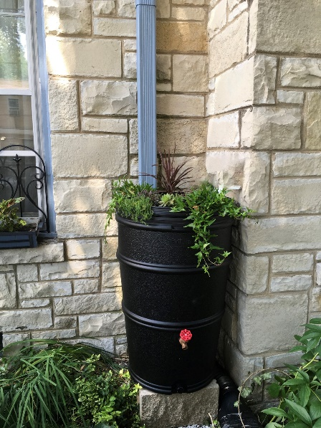
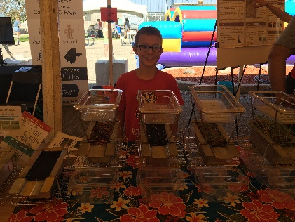
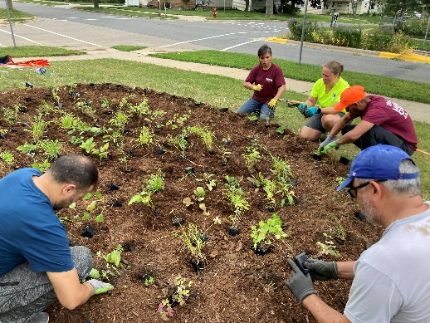
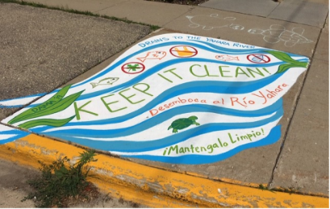
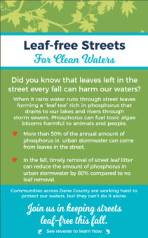
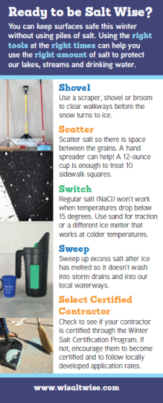
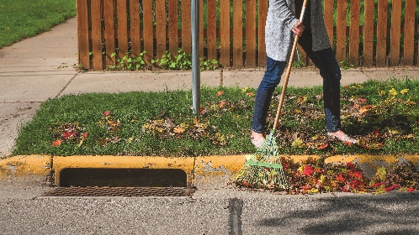
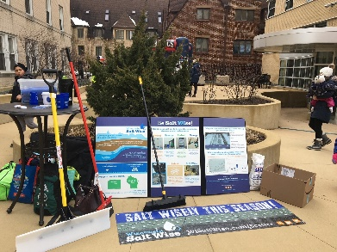
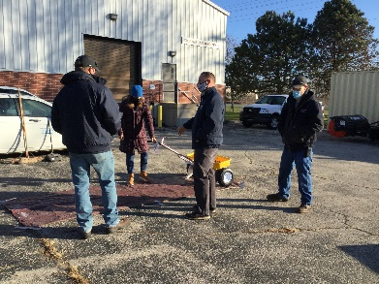
Ripple Effects Education and Outreach Programs
Late Winter/Spring
Spring/Summer
Fall
NEW
Fall
Fall/Winter
Notes:
Here’s an overview of some of our key programs that we focus on each season and I’ll go into more detail on these in the next few slide. There will always be a need for basic education and increased awareness of stormwater issues and solutions, but we really try and develop programs that are focused on behavior change and reducing the barriers to people actually taking action.

Slide 2
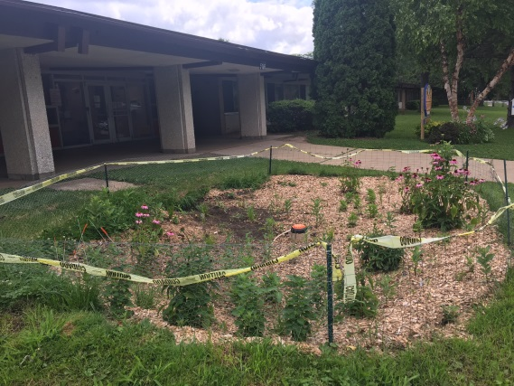
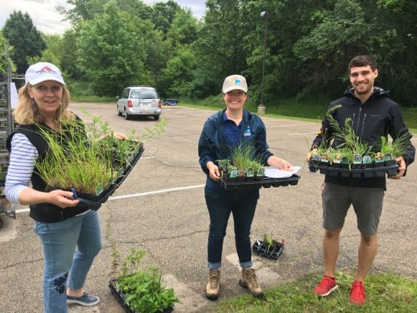
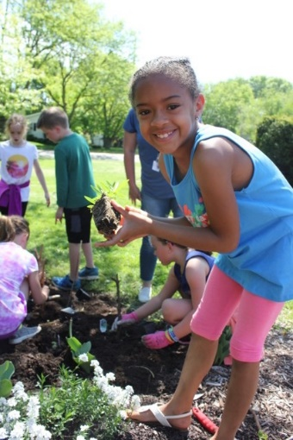
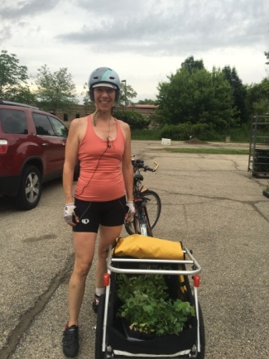
Plant Dane
Goal: Encourage residents and organizations to plant native gardens and rain gardens to increase infiltration and reduce stormwater runoff.
Options:
Order Low cost native plants- 50+ species, $2.50/each
Donate plants for Free Native Plants for School and Community Projects (spring)
Grow native plants from seed-training and seed provided. (fall)
Learn – attend a workshop/webinar
Notes:
Sold about 30,000 plants in 2022, fund 30-40 native plant projects each year. I’d like to provide more individualized help on the rain garden front. There are some efforts in the works through a grant the Arb received and a pilot reimbursement program in the City of Madison that might help move in that direction.

Slide 3
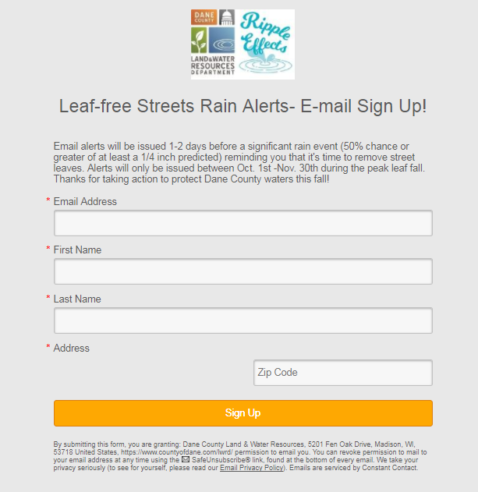
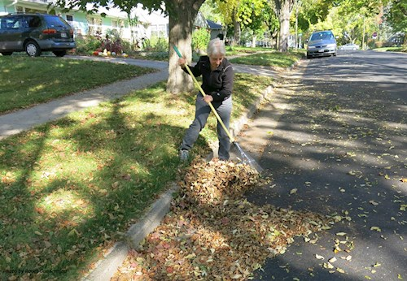
Leaf-free Streets for Clean Waters
Goal: Encourage residents to actively remove street leaves before the rain.
Target Audience: Residents and businesses located in densely populated urban areas with a high concentration of large terrace trees.
Key Messages:
Leaves left in the street every fall are a major source of phosphorus to urban stormwater.
When it rains water runs through street leaves forming a "leaf-tea" rich in dissolved phosphorus that drains to our lakes, rivers and streams.
Safely removing street leaves before the rain can significantly reduce the amount of phosphorus in urban stormwater- Join us in keeping streets leaf-free this fall!
Yard signs
Text/email rain alerts
Notes:
-launched program in 2017 as a result of the USGS/City of Madison leaf study data showing that leaves in the streets during the rain are a major source of phosphorus to our waters.
-Residents see this as a municipal issue, no ownership for leaves on streets

Slide 4
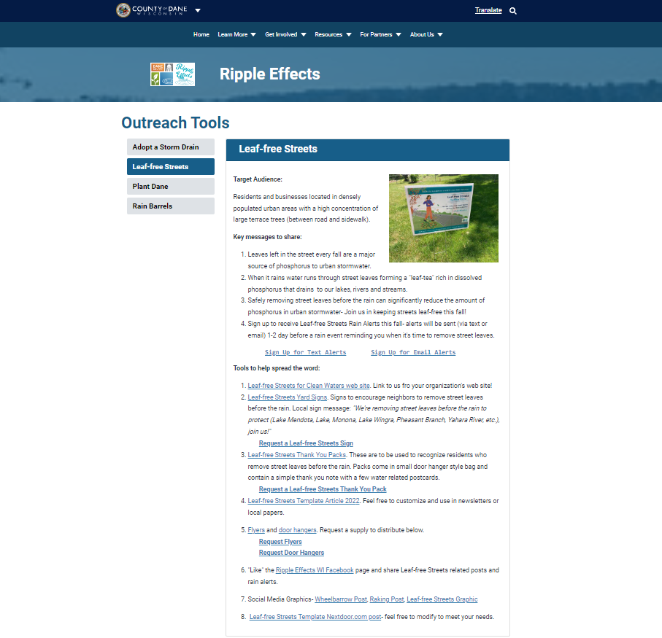
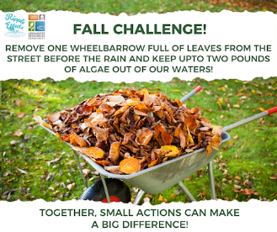
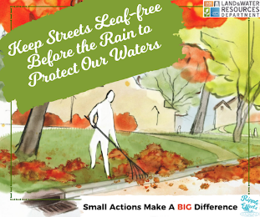
Partner Toolkits

Slide 5
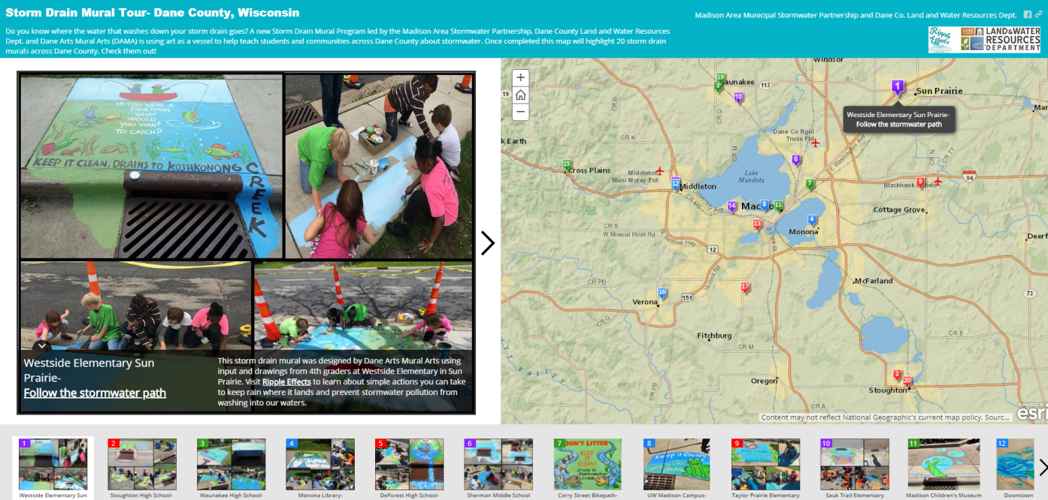
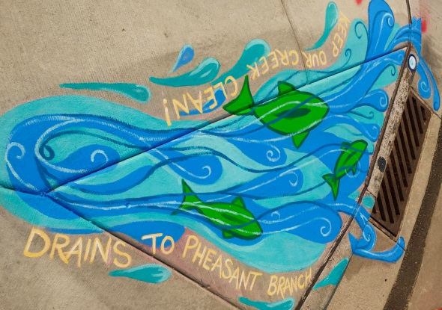
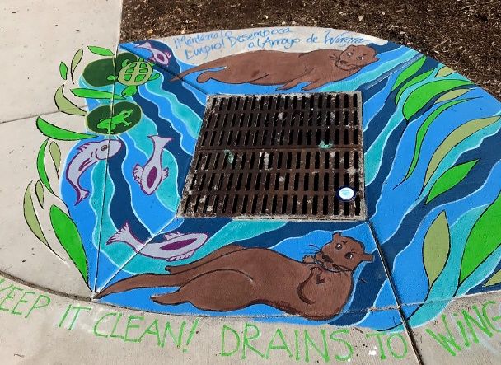
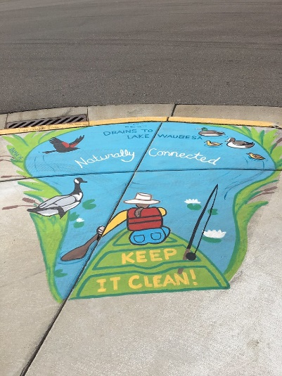
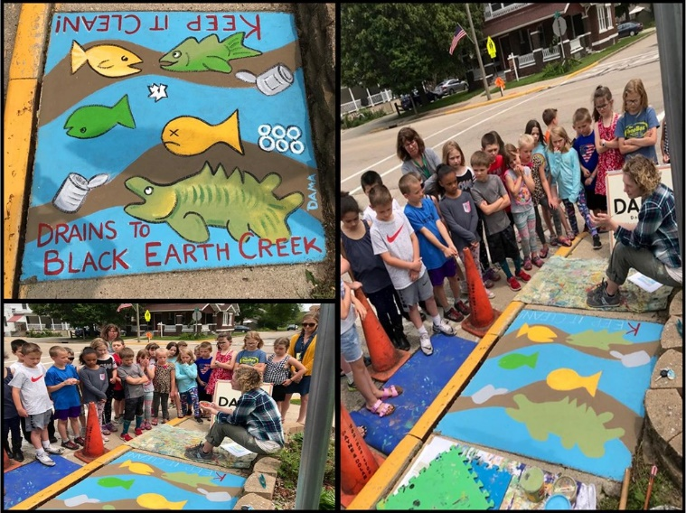
Storm Drain Murals
Storm Drain Mural Program
Goal: Raise awareness that stormwater runoff drains to local waters.
2023 Storm Drain Mural Applications Available in Dec.
Notes:
-Grant program where groups can apply to get a storm drain mural painted in their community.
-No cost to the municipality or applicant
-Option to help design and paint of choose from a catalogue of designs
- 30 murals across the county. Try to choose public areas near parks, libraries where people will see them.

Slide 6
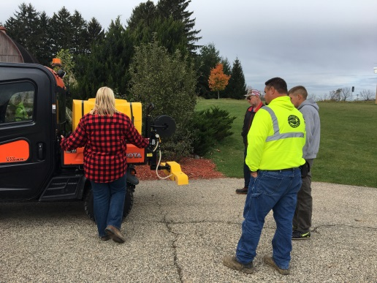
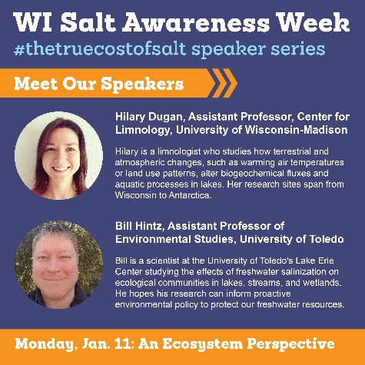
WI Salt Wise- wisaltwise.com
Goal: Reduce salt pollution in our lakes, streams, and drinking water.
Target Audiences:
Applicators
Homeowners
Salt Retailers
Businesses
Key Messages:
Once you put salt down, it doesn’t go away
Excessive salt use harms our waters and infrastructure.
Mechanical removal first.
Use the right product for conditions.
Apply the correct amount,
a little goes a long ways.
Outreach Methods/Tools:
Trainings/Demos
Presentations, articles,
videos and materials for partners.
Chloride Reduction Grants
(Madison Metro. Sewerage District)
Notes:
Founding member of WI Salt Wise
+Starting to see interest with applicators especially since the launch of the City of Madison certification program. Now that we have some case studies we can refer to and local municipalities and applicators implementing changes it’s a lot easier to promote BMPs with applicators.

Slide 7
NEW! Rain Barrels
Notes:
Sold about 30,000 plants in 2022, fund 30-40 native plant projects each year. I’d like to provide more individualized help on the rain garden front. There are some efforts in the works through a grant the Arb received and a pilot reimbursement program in the City of Madison that might help move in that direction.

Slide 8
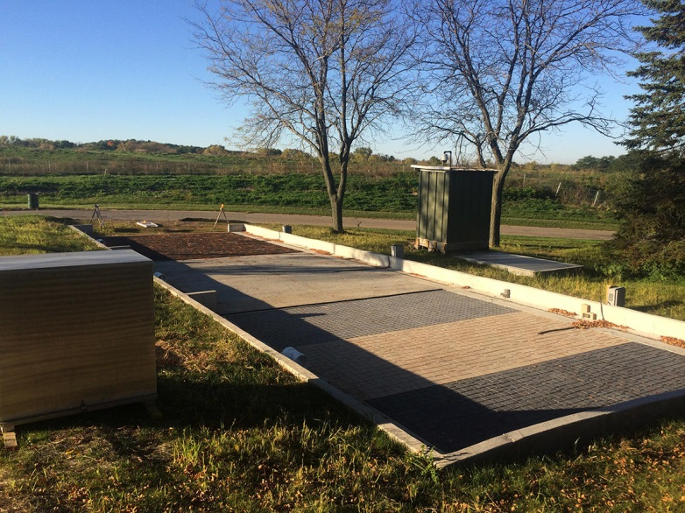
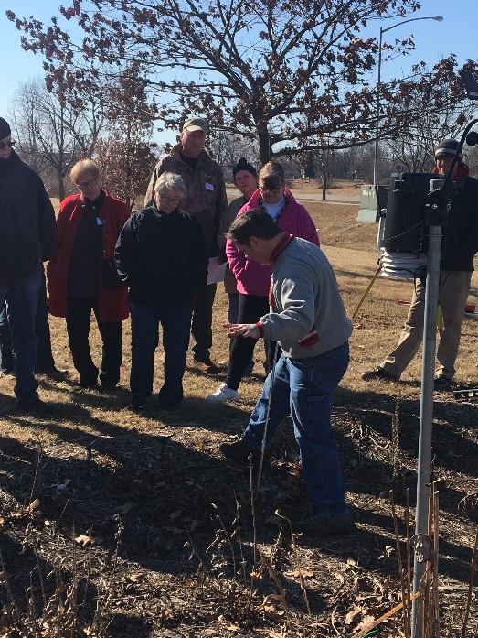
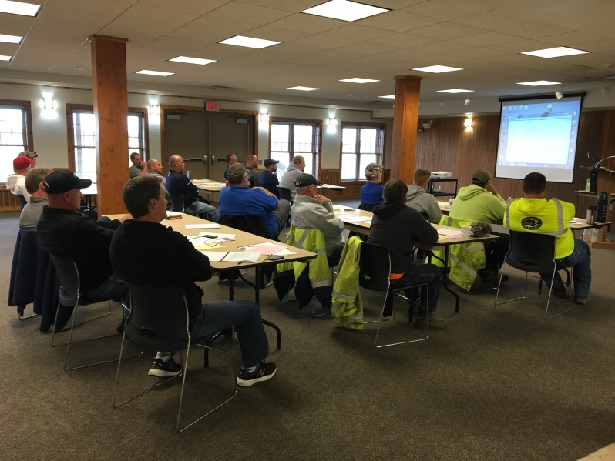
Trainings
Illicit Discharge Training
Permeable Pavement Bus Tour
Rain Garden Workshop
Salt Certification Workshops
Notes:
Make sure that we as municipalities are setting a good example and doing the right thing.

Slide 9
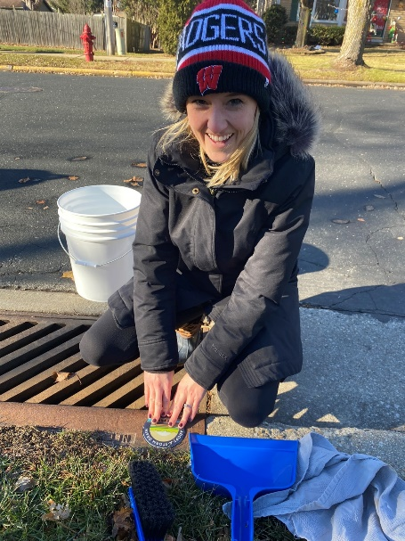
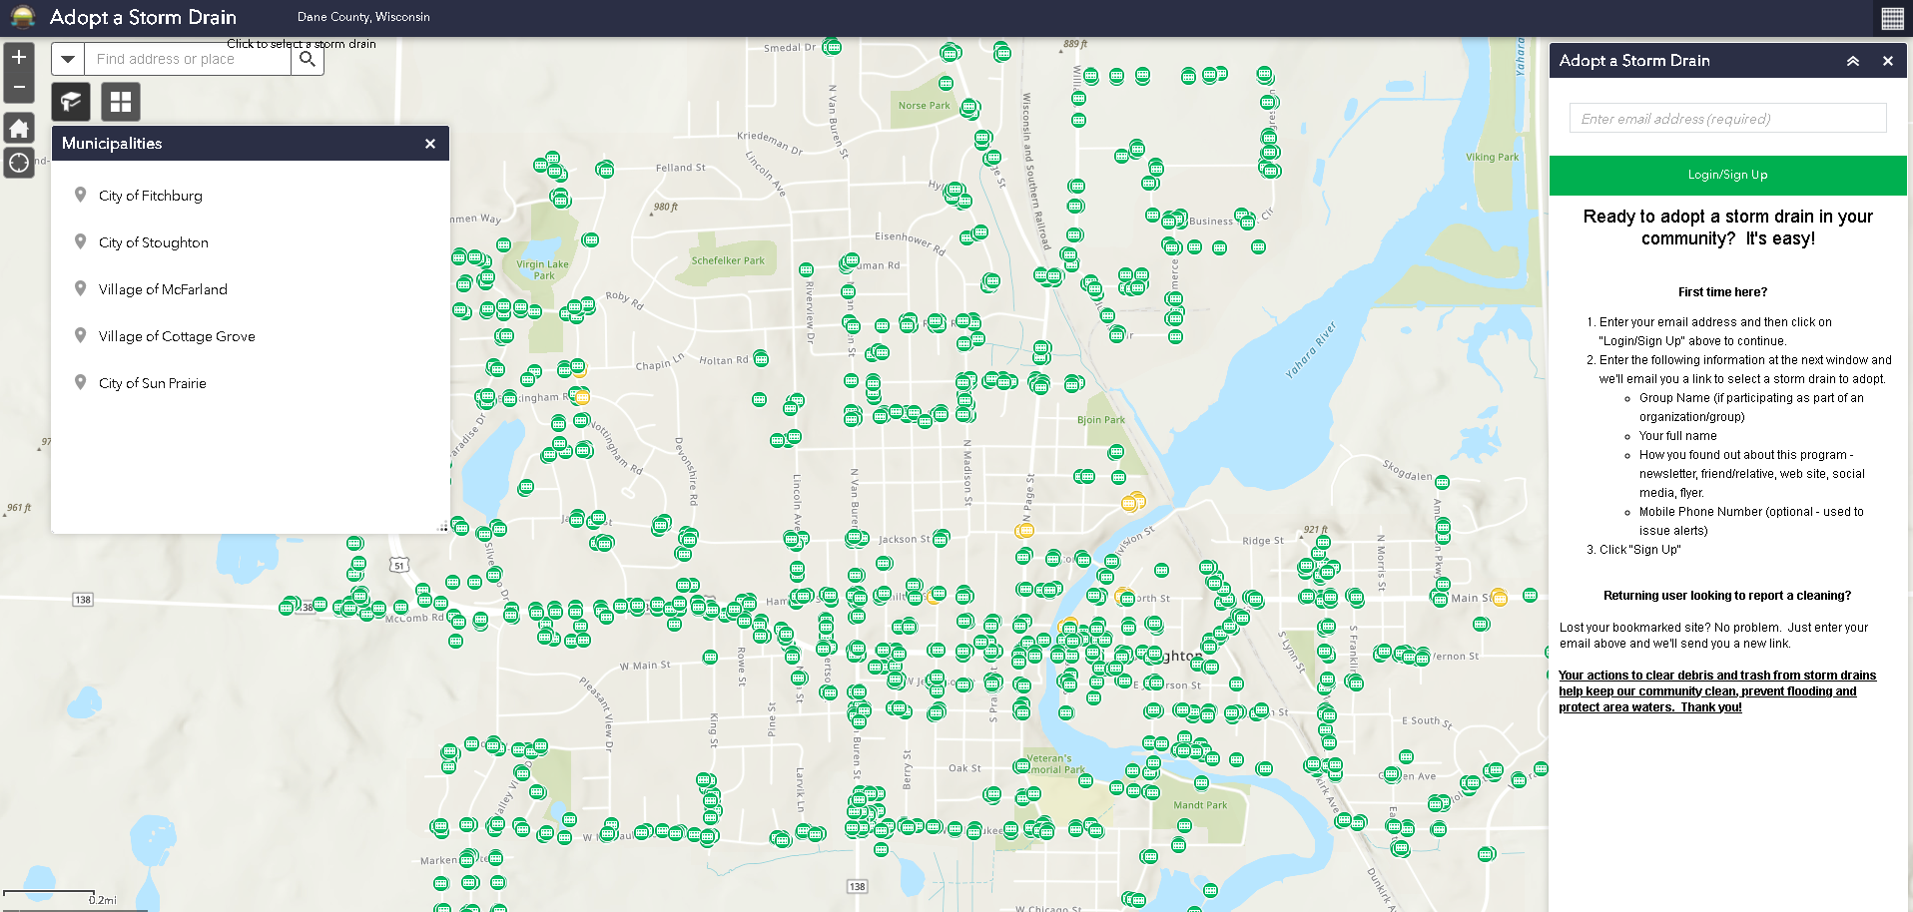
NEW! Adopt A Storm Drain Program
Join us in keeping storm drains clear to prevent flooding and pollution out of local waters. It’s easy!
Communities- McFarland, Cottage Grove, Sun Prairie, Fitchburg, Stoughton. Coming soon- Middleton!
Adopt a nearby storm drain(s)
Receive a storm drain cleaning kit
Commit to cleaning the drain at least once a month, before
the rain (trash, leaves, debris, snow, etc.)
Report cleanings on web site
Report spills or discharges near storm drains
Notes:
Launched in Nov. 2021 in five communities including Stoughton. Have more than 100 drains adopted so far, 25 in Stoughton.

Slide 10
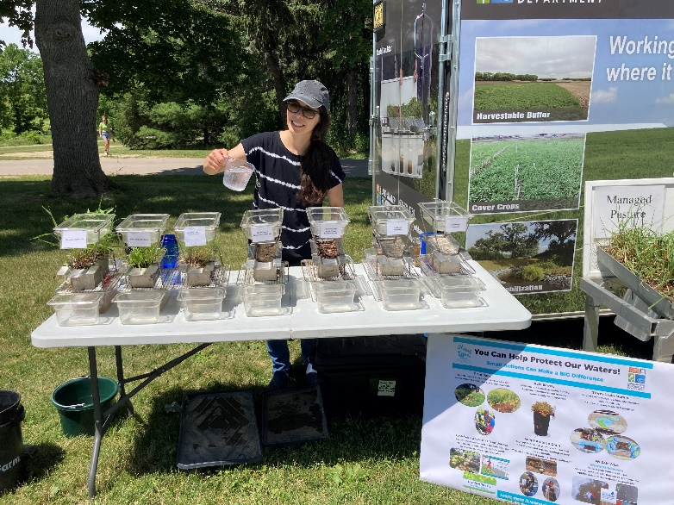
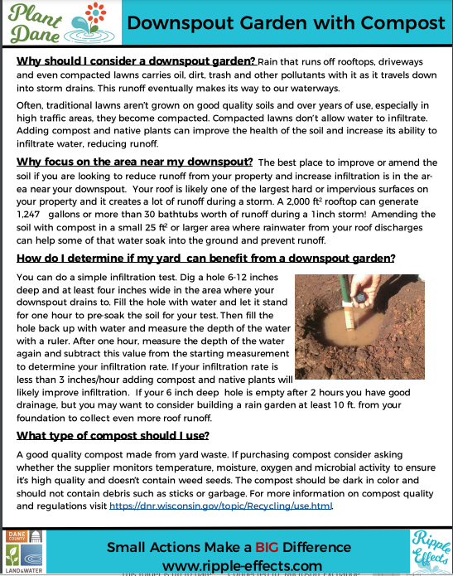
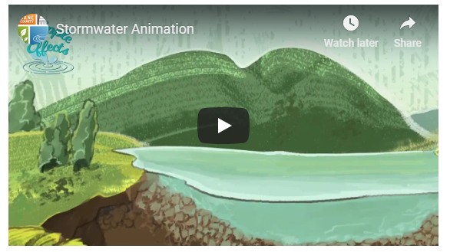
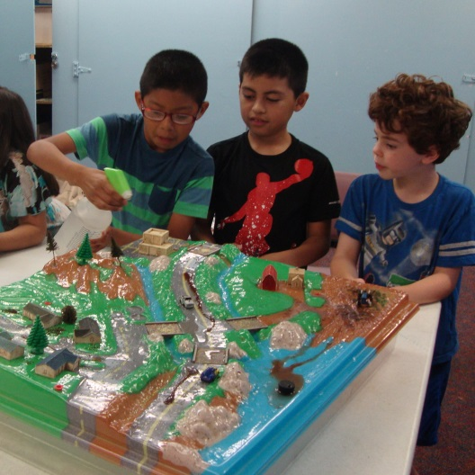
Educational Resources
Tabletop Rainfall Simulator
Videos, Planting Plans, Instructions
Enviroscape
Trainings/Demo Recordings

Slide 11
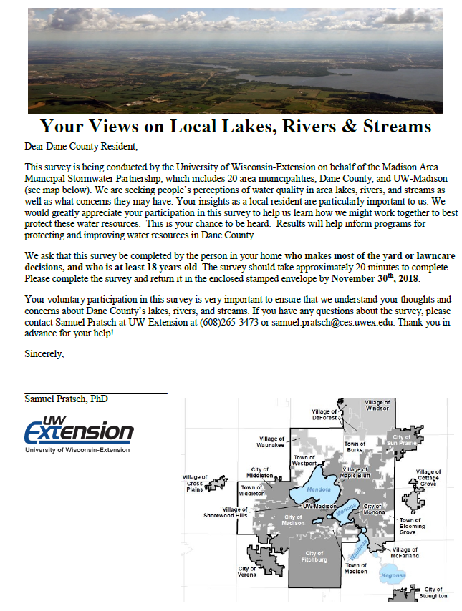
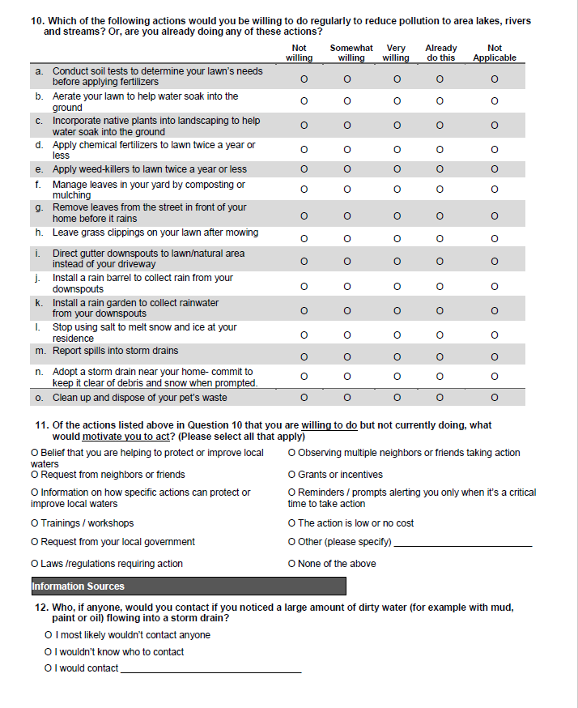
Survey Results
MAMSWaP 2018/19 Stormwater Survey
Highlights:
Mailed random sample survey- 431 responses (29%)
Do you live in a watershed? 49% responded “Yes”, 33% “Don’t Know”, 18% “No”
Where does stormwater runoff go? 19% responded to a municipal sewerage treatment plant
Main impacts of stormwater runoff – Flooding #1 answer
Willingness to take actions (somewhat or very willing):
-56%- incorporate native plants
-60%- aerate lawn
-58% -install rain barrel
-40%- remove street leaves before rain
-61%- Adopt a Storm Drain***
-73%- report spills***
-45%- stop using winter salt
-58%- install a rain garden
43% of respondents wouldn’t know who to
contact if they noticed a spill to a storm drain
Notes:
Continuous need for education-
-only 50% responded yes that they live in a watershed- people don’t understand the connection between what we do on land impacts our waters.
-20% of people think the water that enters the storm drain is treated as is the case in a CSO, not SSS
In the process of creating a county ordinance that would give enforcement authority to Dane County public health across the county. We don’t have that right now which makes it difficult to develop an outreach campaign where we have a single point of contact or hotline that we can direct reports to. It’s an easy ask of people to let us know if something other than rain is going down the drain. It’s also an education tool to help people understand that whatever goes down the storm drain ends up in our waters.

Slide 12
Questions?
Enter your contact information here
www.ripple-effects.com

