Slide 1
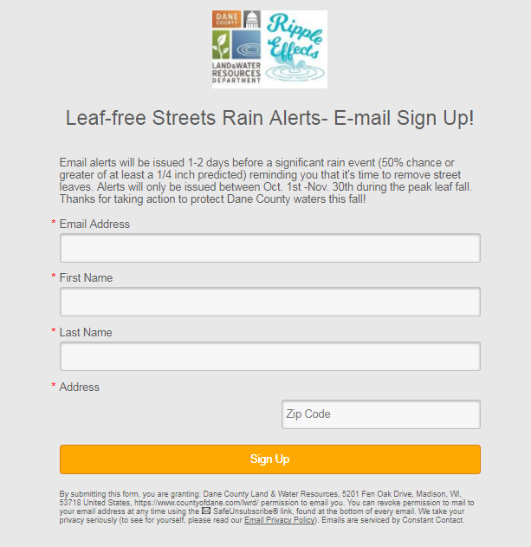
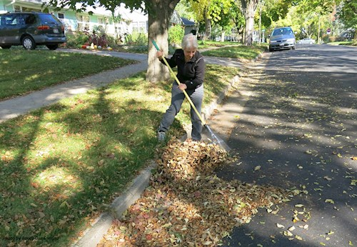
Leaf-free Streets for Clean Waters
Goal: Encourage residents to actively remove street leaves before the rain.
Target Audience: Residents and businesses located in densely populated urban areas with a high concentration of large terrace trees.
Key Messages:
Leaves left in the street every fall are a major source of phosphorus to urban stormwater.
When it rains water runs through street leaves forming a "leaf-tea" rich in dissolved phosphorus that drains to our lakes, rivers and streams.
Safely removing street leaves before the rain can significantly reduce the amount of phosphorus in urban stormwater- Join us in keeping streets leaf-free this fall!
Yard signs
Text/email rain alerts
Notes:
-launched program in 2017 as a result of the USGS/City of Madison leaf study data showing that leaves in the streets during the rain are a major source of phosphorus to our waters.
-Residents see this as a municipal issue, no ownership for leaves on streets

