Slide 1
Date - Location
Name
Affiliation

Slide 2
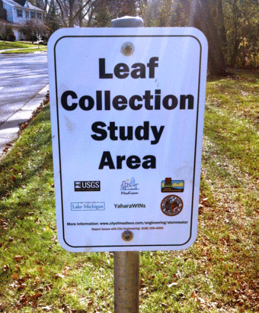
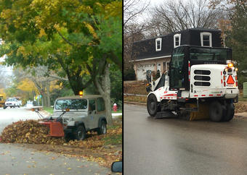
USGS/City of Madison Leaf Study
Goal: Determine if removing leaves from streets before the rain can reduce nutrient contributions to local water bodies.
Study Site: Two medium-high density residential areas on the west side of Madison with curb and guttered streets. Both had 17% tree canopy (ash and maple) covering streets.
Method: Remove leaves from street in test area before fall rainfall events and measure phosphorus and nitrogen in runoff.
Notes:
2013-2016 calibration 13-14, treatment phase 15-16 will continue through 2020

Slide 3
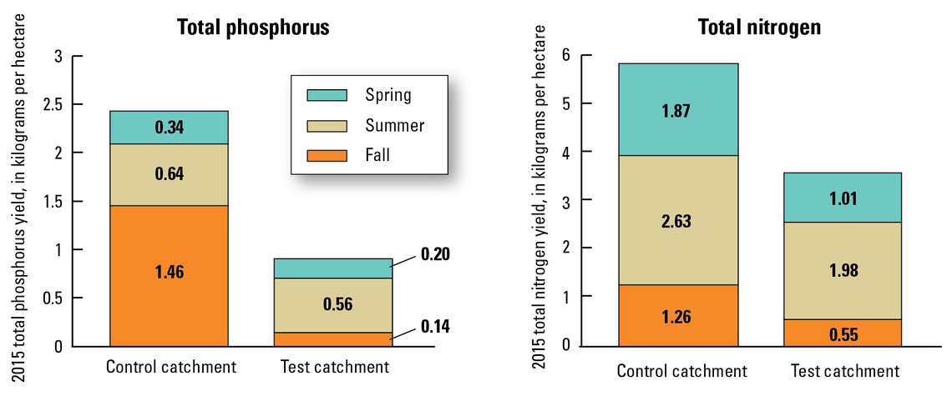
USGS/City of Madison Leaf Study

Slide 4
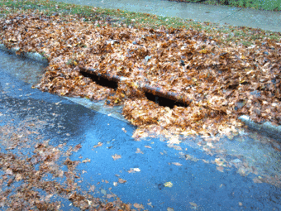
USGS/City of Madison Leaf Study
Highlights:
Leaves are a significant source of phosphorus to urban stormwater.
Nearly 60 percent of the annual urban phosphorus yield can come from leaf litter in the fall.
Timely removal of leaf litter from streets can reduce phosphorus load by 80 percent compared with no removal.
Leaf removal is one of a few options available to reduce dissolved phosphorus.

Slide 5
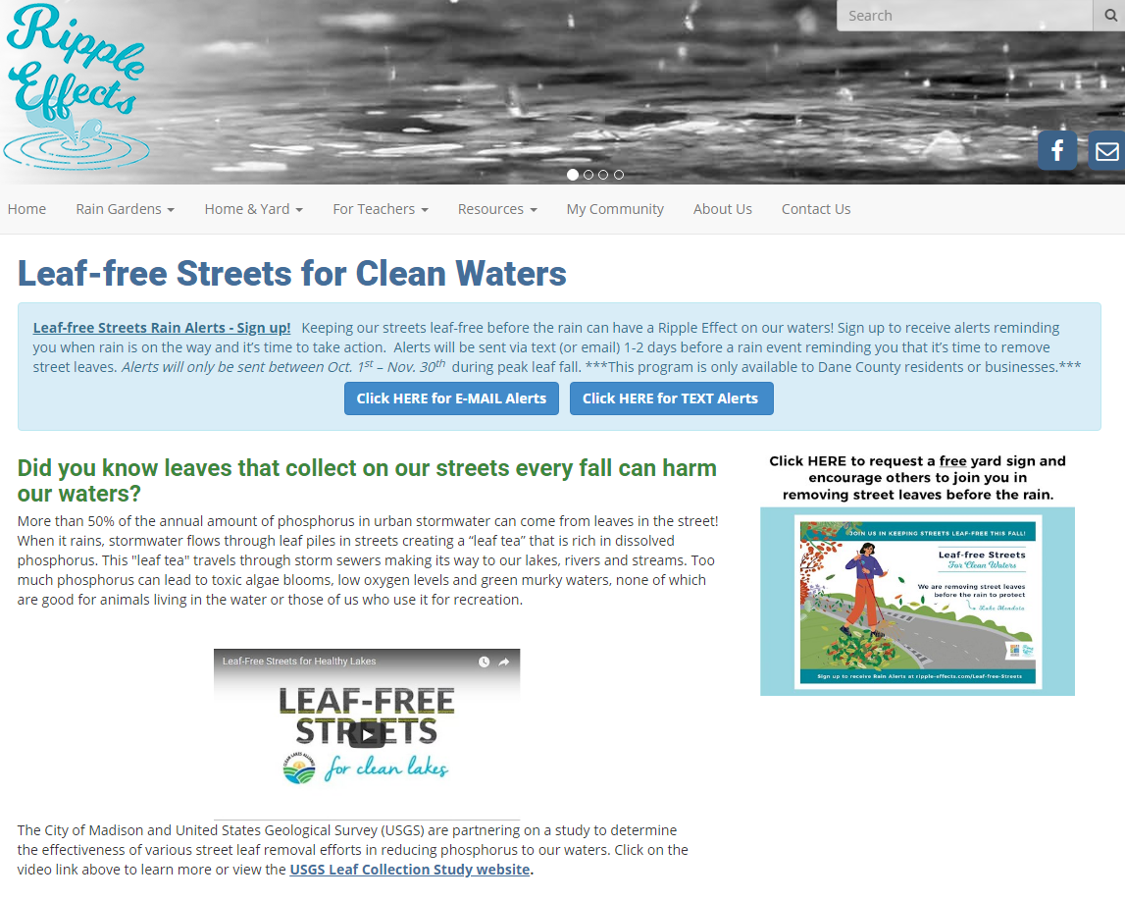
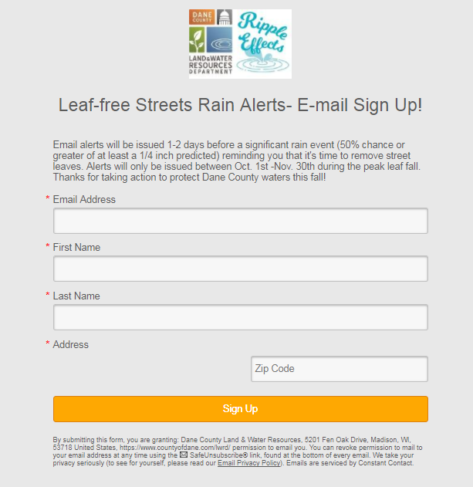
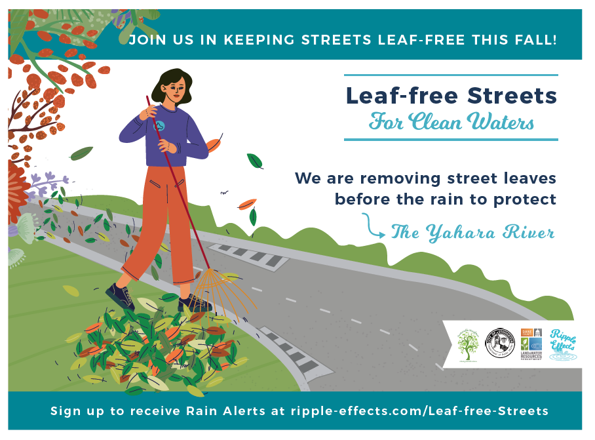
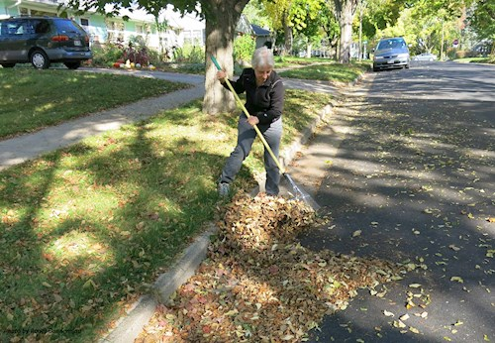
Get Involved!
Notes:
Danewaters.com

Slide 6
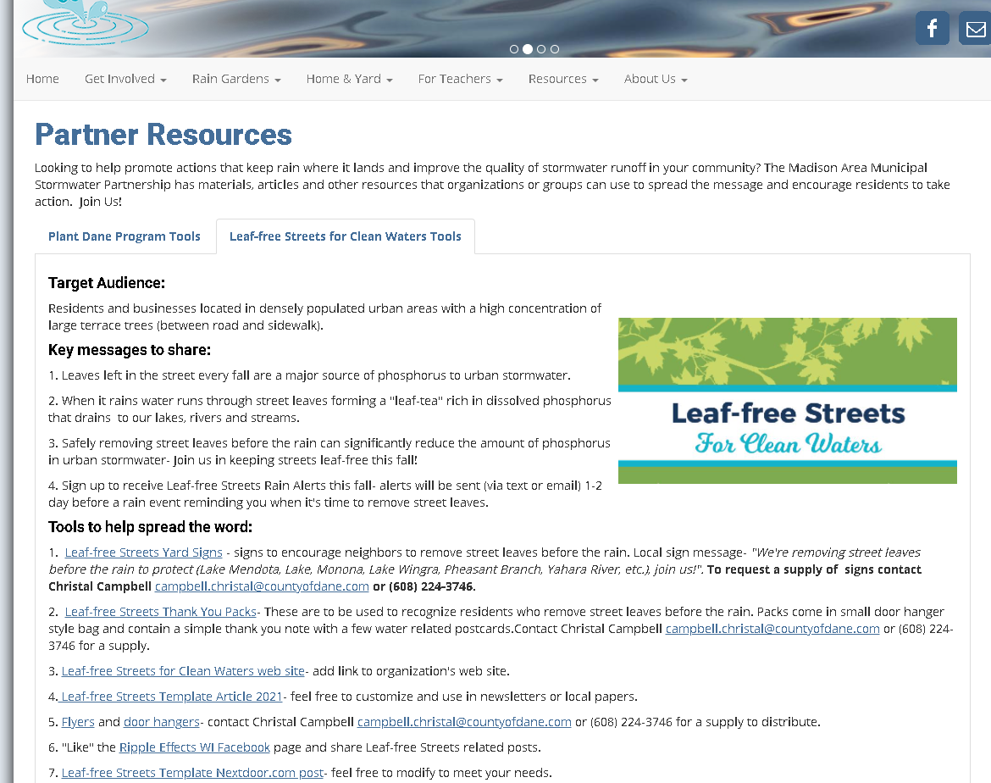
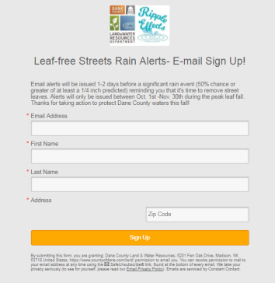
Partner Toolkits
Notes:
83 text sign ups and 147 email sign ups

Slide 7
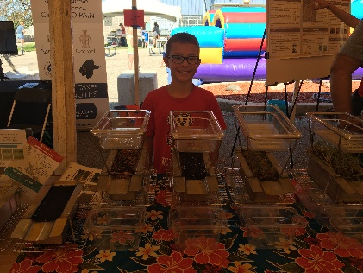
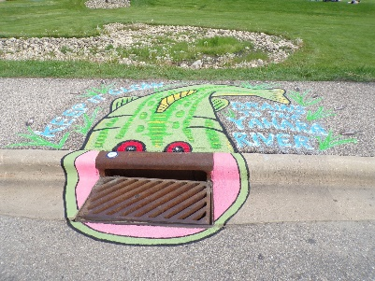
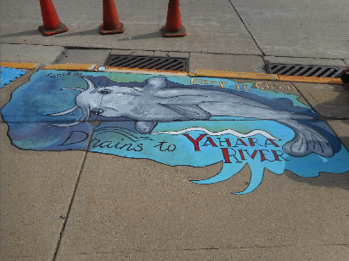
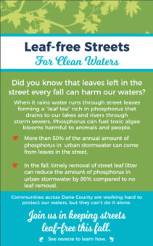
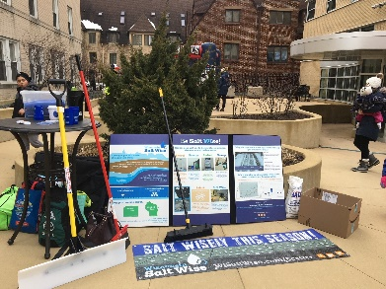
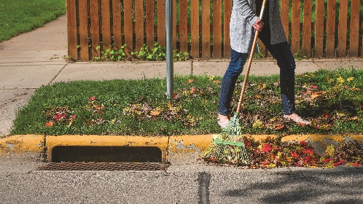
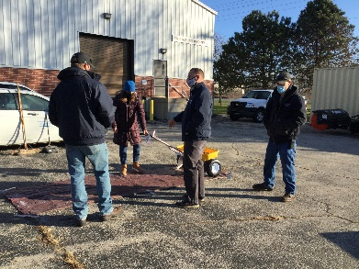
Seasonal Education and Outreach Programs
Late Winter/Spring
Spring/Summer
Fall
Fall
Fall/Winter
Notes:
Here’s an overview of some of our key programs that we focus on each season and I’ll go into more detail on these in the next few slide. There will always be a need for basic education and increased awareness of stormwater issues and solutions, but we really try and develop programs that are focused on behavior change and reducing the barriers to people actually taking action.

Slide 8
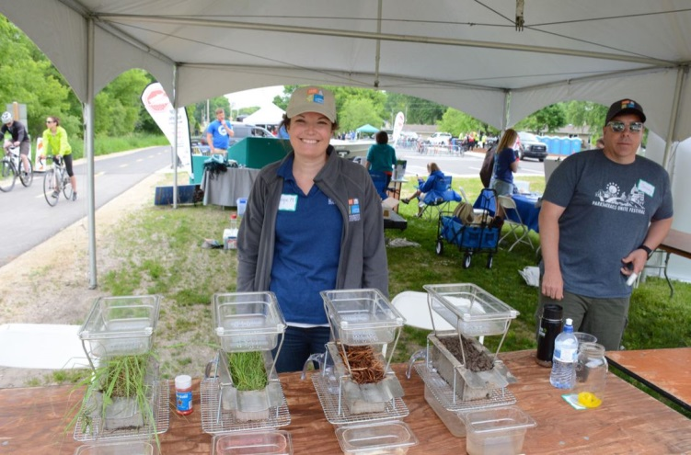
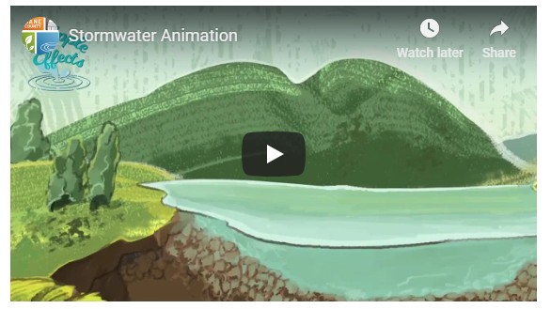
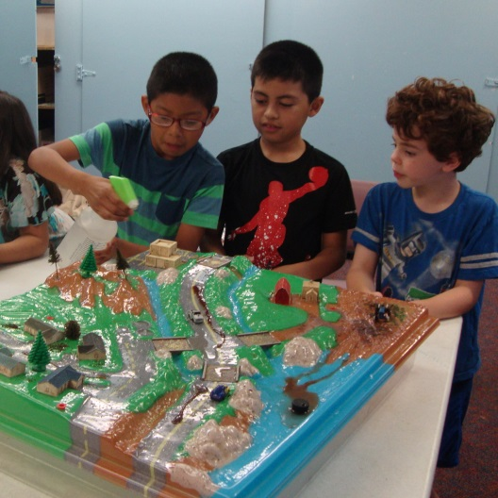
Educational Resources
Tabletop Rainfall Simulator
Stormwater Animation Video
Enviroscape
Rainfall Simulator Demo Video

Slide 9
Questions?
Enter your contact information here
www.ripple-effects.com

