Slide 1
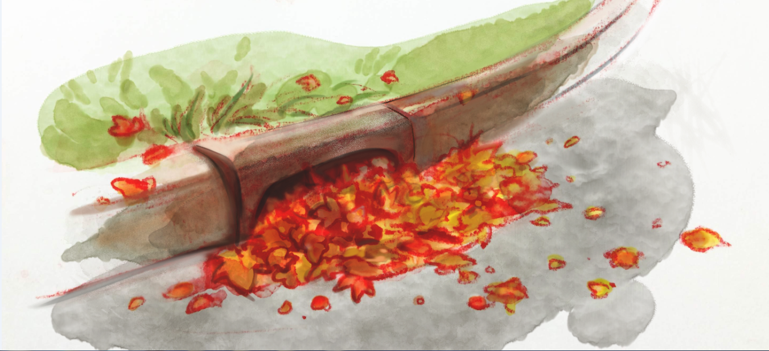
Leaf-free Streets for Clean Waters
Location
Date
Name and Affiliation

Slide 2
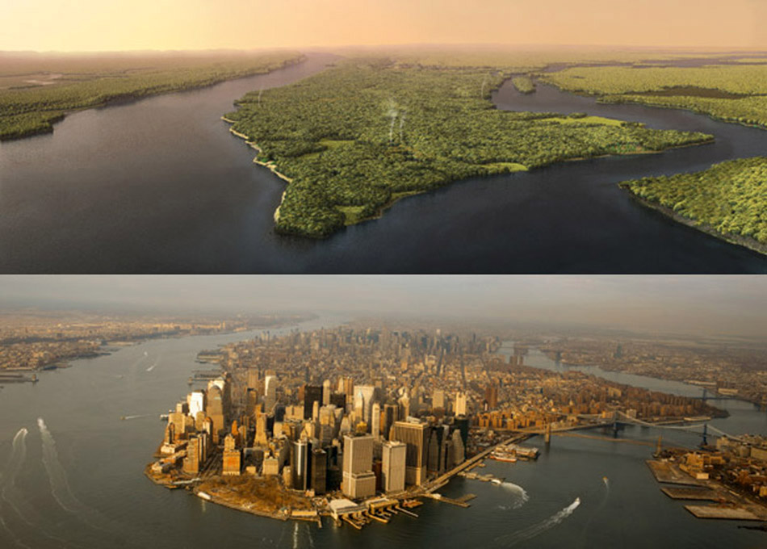
Changing Landscapes
http://urbangeographies.tumblr.com/
Notes:
So has stormwater runoff always been an issue? I feel like the this image helps to answer that question.
Changed Landscapes: we moved from this… to this…
Our landscapes have changed dramatically – humans have taken over and there are very few natural spaces left. Sometimes its hard to understand the scale of our impact – see Manhattan image.
Even natural areas in our neighborhoods and communities tend to be dominated by lawns and/or non native species.
It’s not that we can’t incorporate more naturals spaces – but culturally, clean, manicured lawns and decorative plants (who cares where there from) have become the cultural norm.

Slide 3
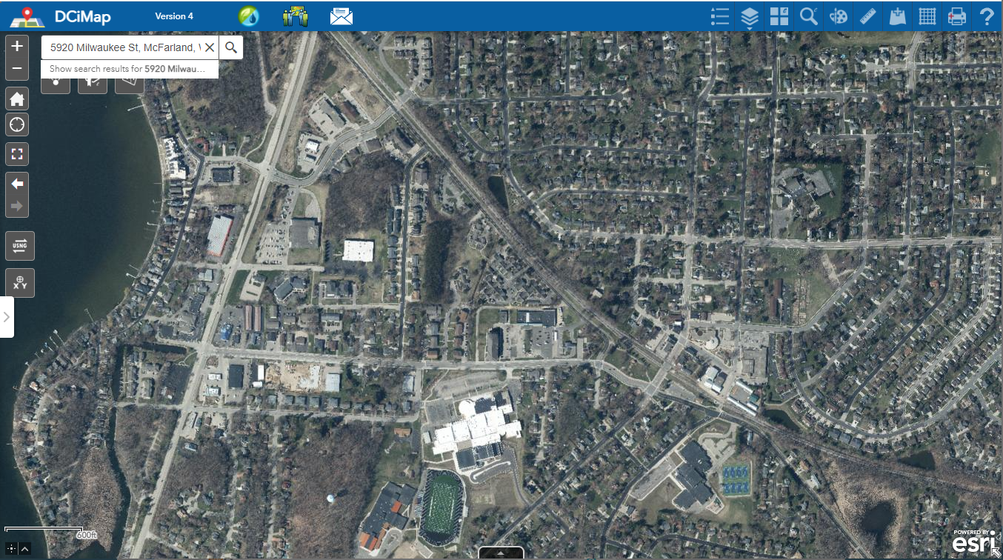
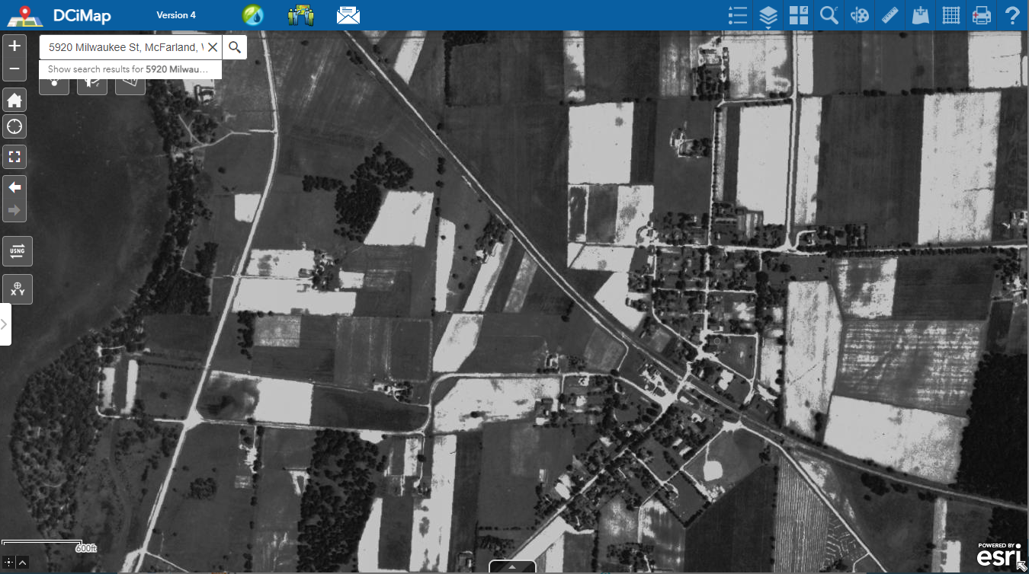
Changing Landscapes
2020
1937
Notes:
Back in the early 1900s Mcfarland was

Slide 4
Changing Landscapes
In natural systems much of the rain that falls...
…soaks into the earth
Notes:
More native plants and natural spaces – why? Because in natural systems, much of the rain that falls soaks into the earth

Slide 5
Changing Landscapes: Runoff
Image: greatlakesresilience.org
Notes:
http://greatlakesresilience.org/sites/default/files/casestudy_img_TwoHarbors_LandUseChangeAndSurfaceRunoff.jpg
This urbanization has an impact on how much water soaks into the ground.
Going back to the water cycle, before the land was developed with houses, businesses and roads, here is how the cycle worked. 80-100% of the water soaked in and only 10-20% ran off.
As development takes place, more and more water runs off instead of soaking in.

Slide 6
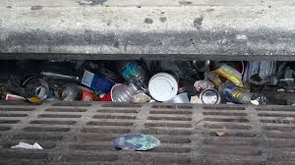
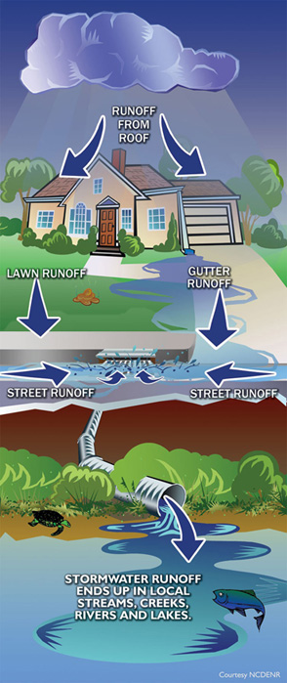
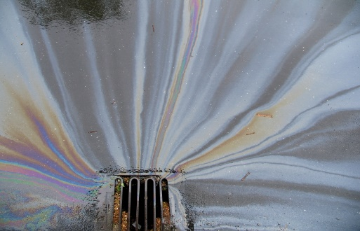
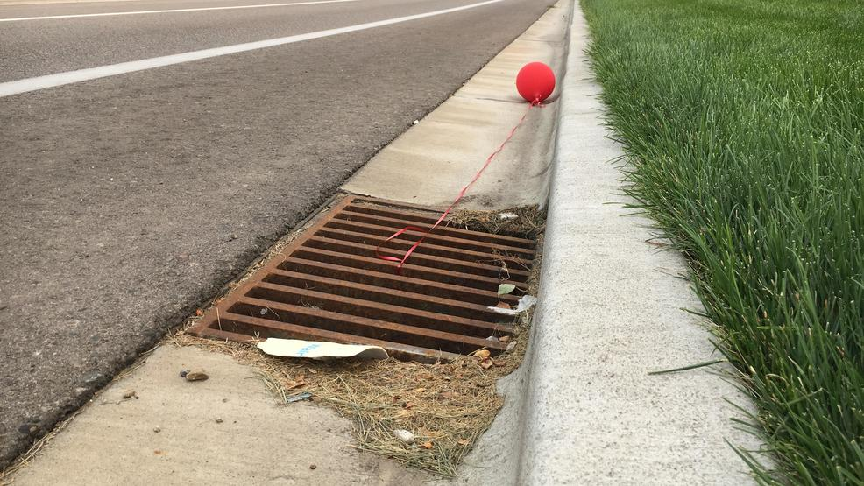
Changing Landscapes: Runoff
Rain that runs off our lawns, roofs, pavement is called Stormwater runoff.
Most runoff that enters our storm drains is NOT treated and ends up in our lakes, rivers and streams.

Slide 7
Problem- Too much runoff!
How much water runs off the roof of an average house during a 1” rain event?
Roof area of an average house
=1800 ft²
1,122 gallons!!!
(about 16 bathtubs)
Image: Rainscaping Iowa
How much water runs off your home?
https://water.usgs.gov/edu/activity-howmuchrain.html

Slide 8
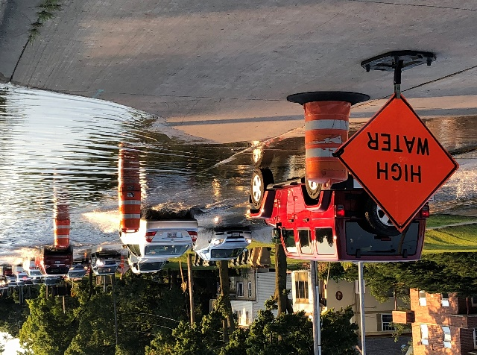
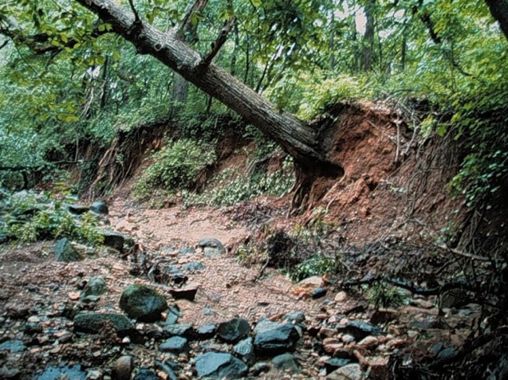
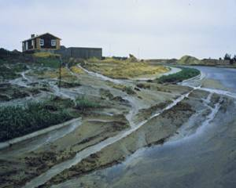
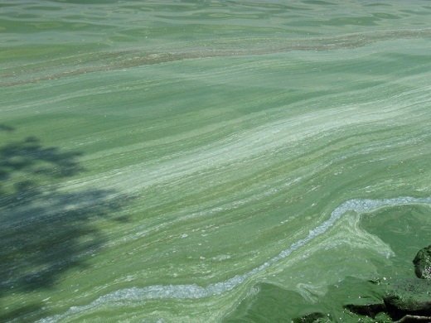
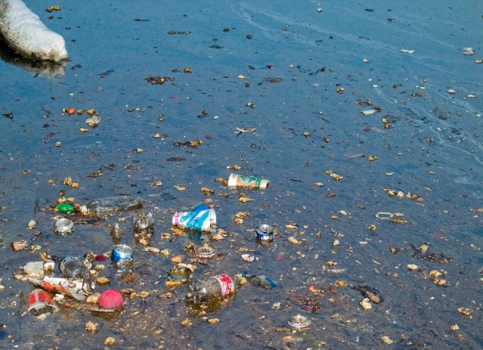
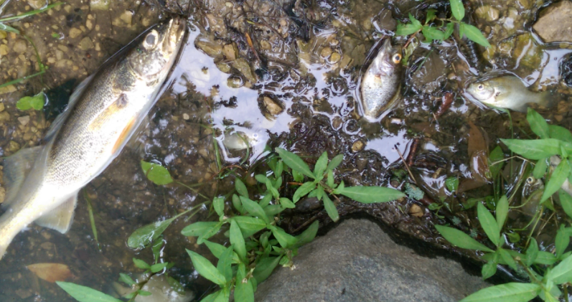
Too much runoff can cause BIG problems!
Flooding
Erosion
Polluted water
Harm wildlife
Photo: WDNR
Photo: UW Madison
1 lb. phosphorus = 500 lbs. algae

Slide 9
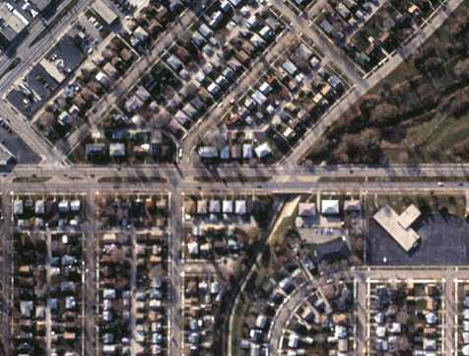
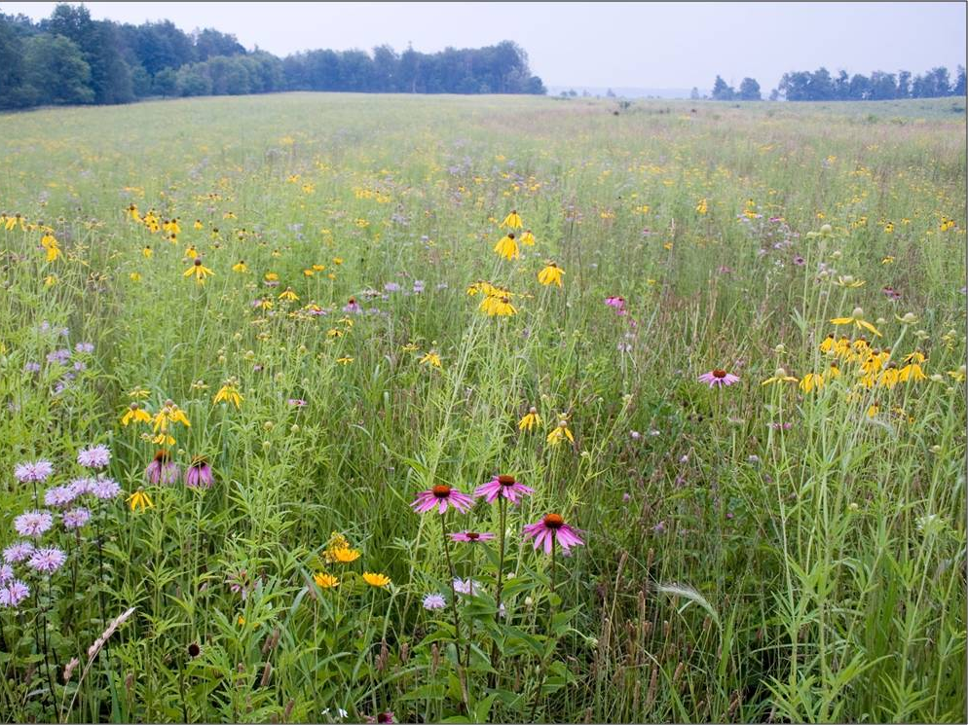
Solutions: Help water soak into the soil
Need to make this
Act more like this
Notes:
Need to make changes so our cityscapes function more like our rural landscapes.

Slide 10
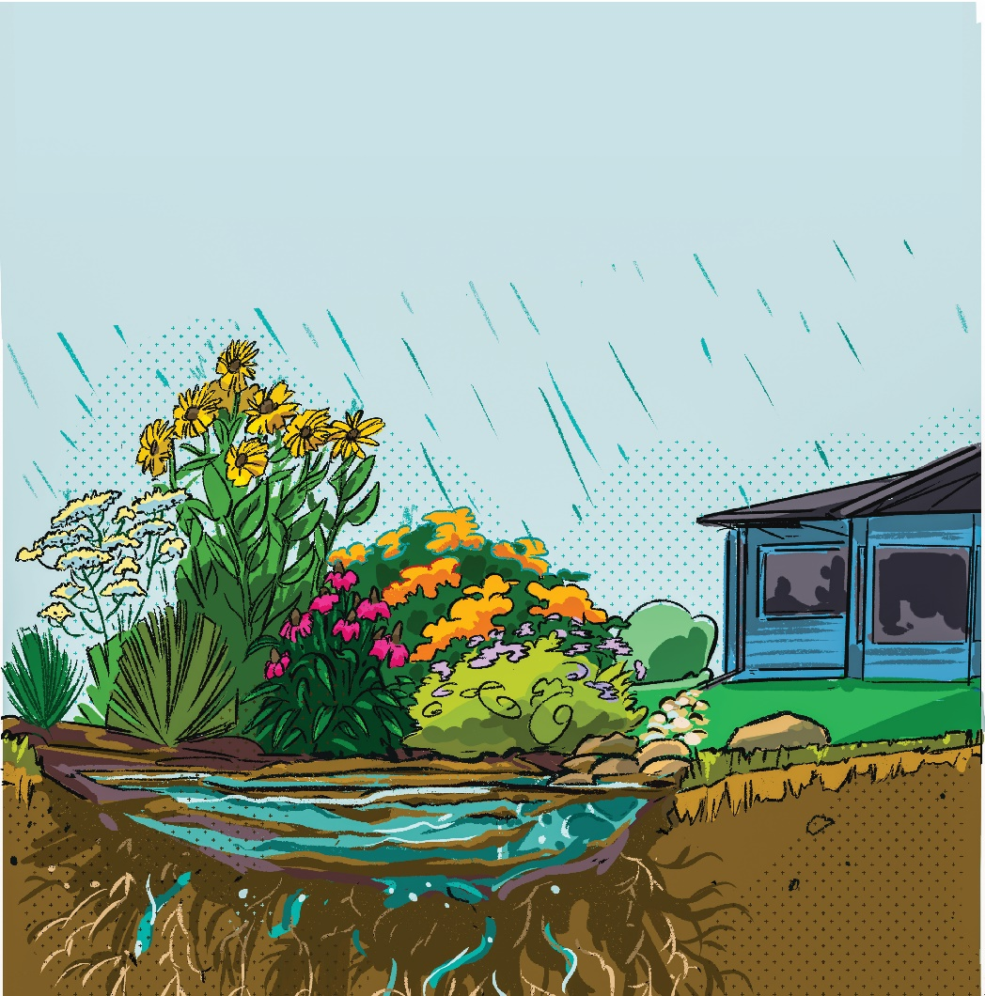
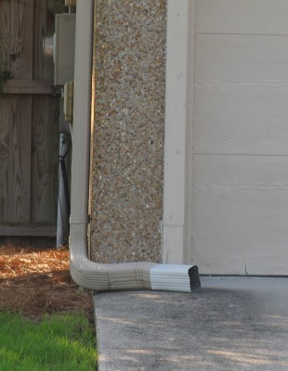
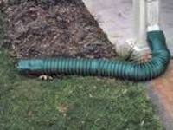
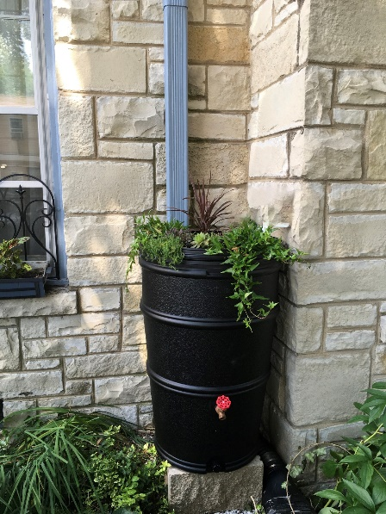
Solutions: Help water soak into the soil
Native Plantings, Downspout Gardens and Rain Gardens
Downspout Redirection
Rain Barrels

Slide 11
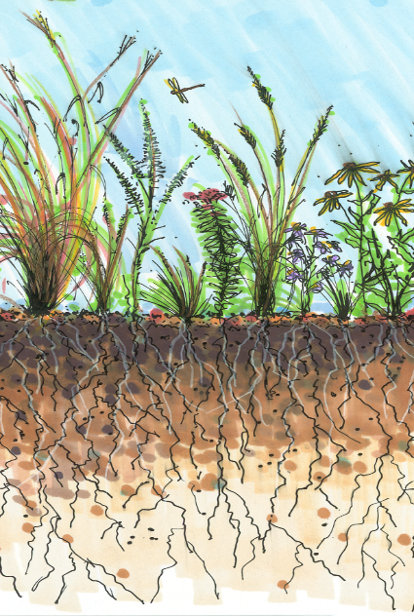
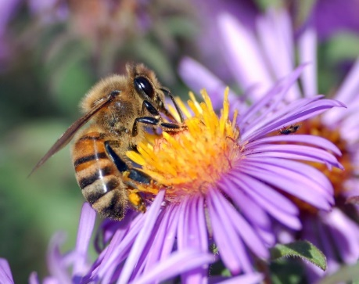
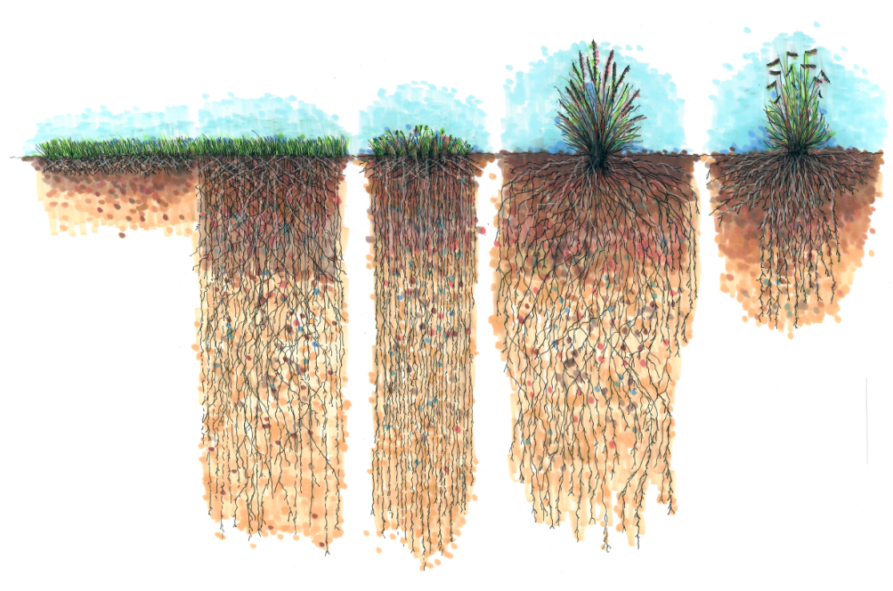
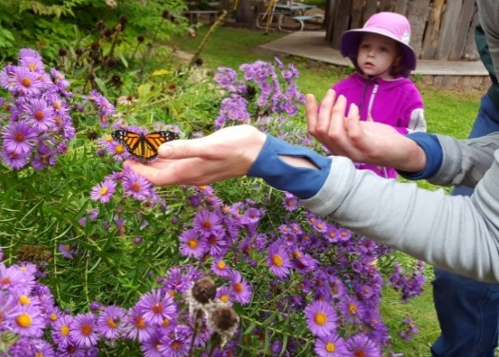
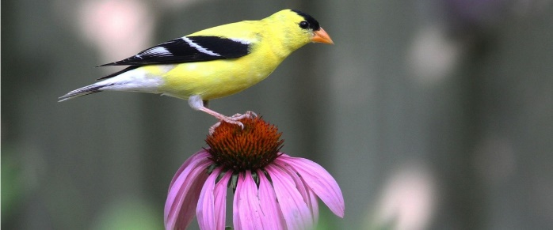
Benefits of Native Plants
Deep root systems that help infiltrate rain water
Adapted to the local climate and soils
Drought tolerant
Disease resistant
Developed complex relationships with the local organisms and ecosystem
Image: Rainscaping Iowa
Kentucky bluegrass
buffalo grass
Photo: Theresa Nelson
Notes:
Buffalo Grass native to WI not great for high traffic areas
Other Benefits of Native Plants - Native plants have:
Adapted to the local climate and soils
Drought tolerant
Disease resistant
Developed complex relationships with the local organisms and ecosystem

Slide 12
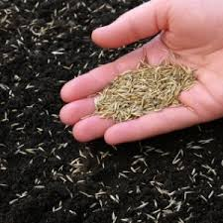
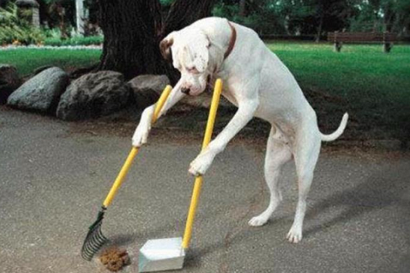
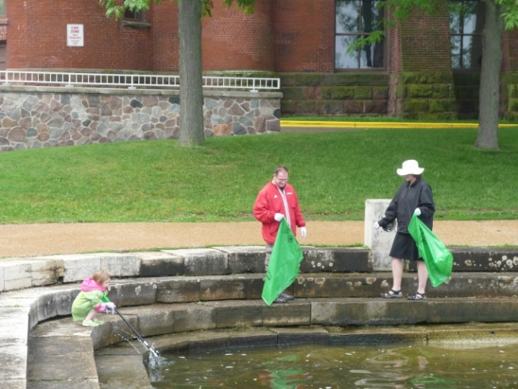
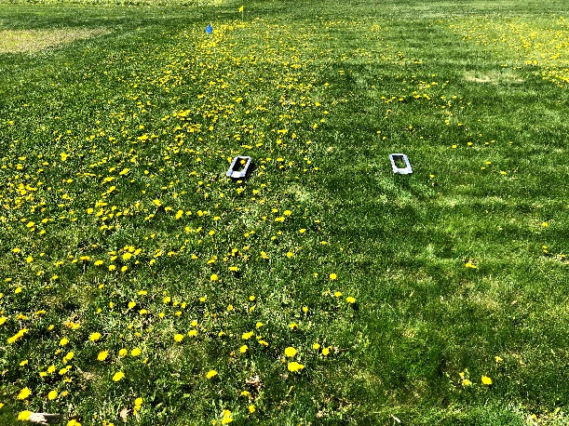
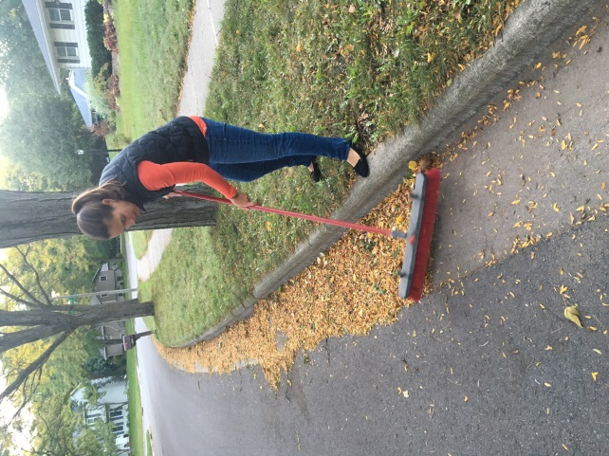
Solutions: Only Rain Down the Storm Drain
Cover bare soil to prevent erosion
Pick up after pets
Dispose of Trash and hazardous chemicals properly
Use the right amount of salt for safety
Maintain a healthy
lawn using
Keep leaves out of the street before the rain
minimum amount of
fertilizer/herbicides
Notes:
www.danecountycleansweep.com
https://uwlab.soils.wisc.edu/farmers/lawn-garden/
Pet waste contains nutrients and bacteria harmful to aquatic life and humans using local waters.
Rain water that runs through leaves on the street creates a “leaf-tea” rich in dissolved phosphorus. This tea fuels algae growth in our lakes.

Slide 13
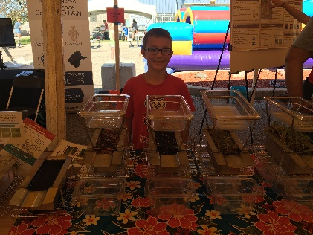
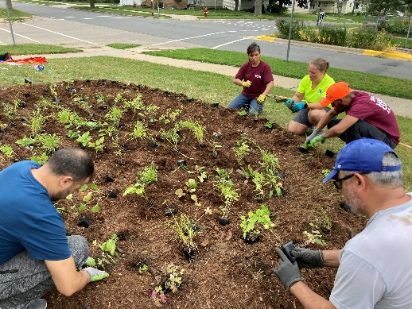
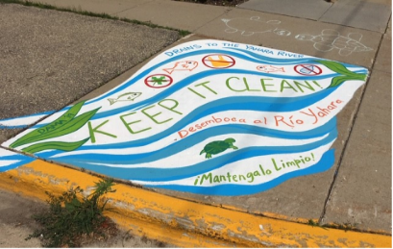
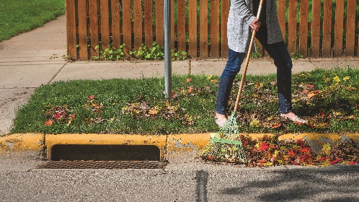
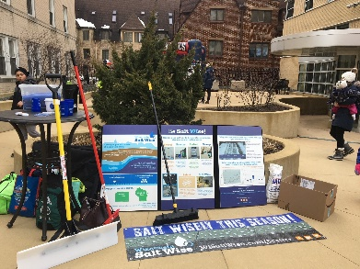
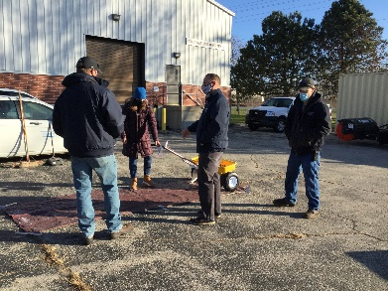
Ripple Effects Education and Outreach Programs
Late Winter/Spring
Spring/Summer
Fall
NEW
Fall
Winter
Notes:
Here’s an overview of some of our key programs that we focus on each season and I’ll go into more detail on these in the next few slide. There will always be a need for basic education and increased awareness of stormwater issues and solutions, but we really try and develop programs that are focused on behavior change and reducing the barriers to people actually taking action.

Slide 14
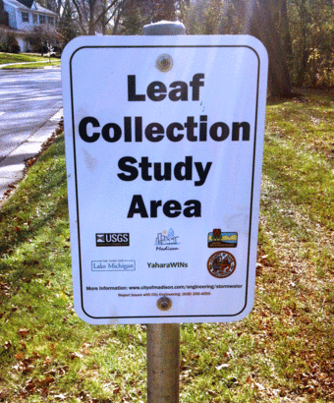
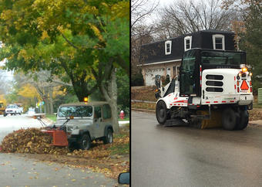
USGS/City of Madison Leaf Study
Goal: Determine if removing leaves from streets before the rain can reduce nutrient contributions to local water bodies.
Study Site: Two medium-high density residential areas on the west side of Madison with curb and guttered streets. Both had 17% tree canopy (ash and maple) covering streets.
Method: Remove leaves from street in test area before fall rainfall events and measure phosphorus and nitrogen in runoff.
Notes:
2013-2016 calibration 13-14, treatment phase 15-16 will continue through 2020

Slide 15
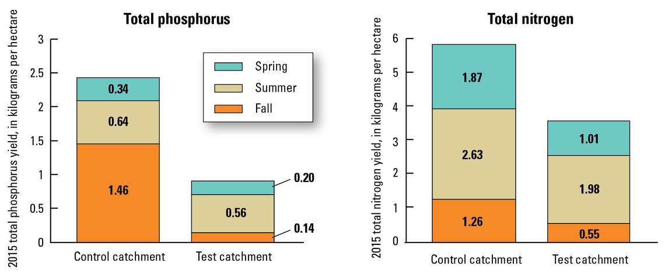
USGS/City of Madison Leaf Study

Slide 16
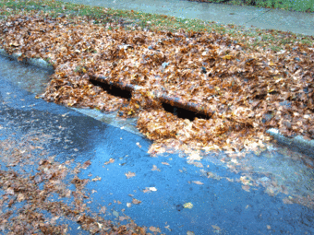
USGS/City of Madison Leaf Study
Highlights:
Leaves are a significant source of phosphorus to urban stormwater.
Nearly 60 percent of the annual urban phosphorus yield can come from leaf litter in the fall.
Timely removal of leaf litter from streets can reduce phosphorus load by 80 percent compared with no removal.
Leaf removal is one of a few options available to reduce dissolved phosphorus.

Slide 17
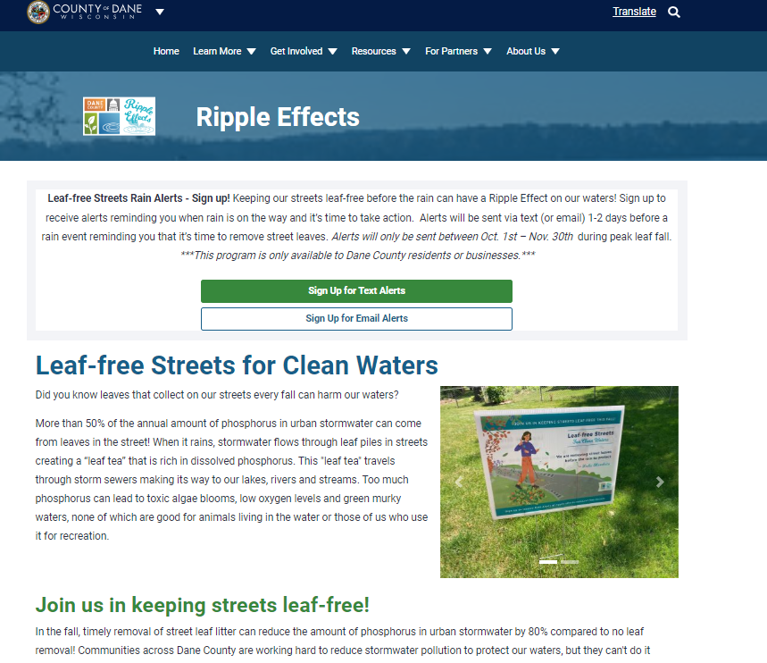
Get Involved!

Slide 18
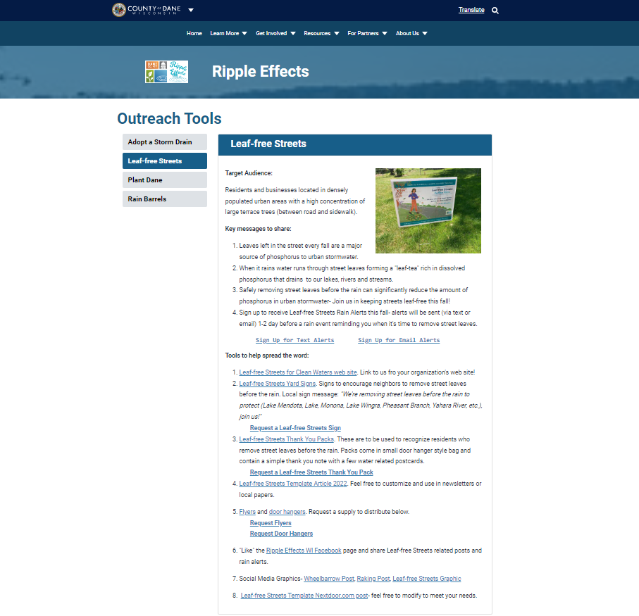
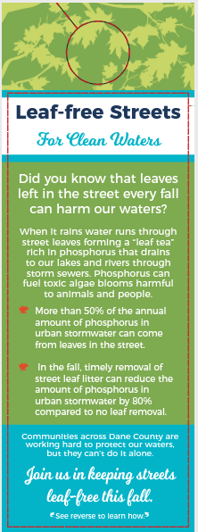
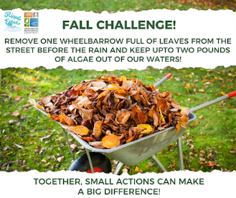
Partner Toolkits

Slide 19
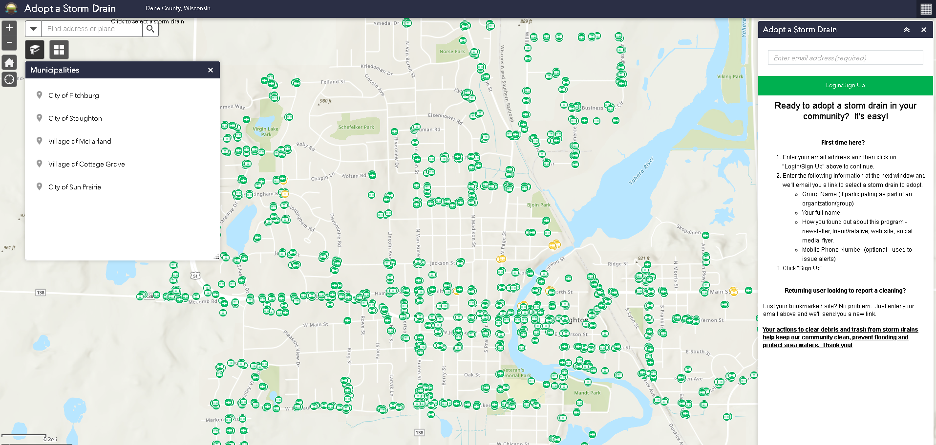
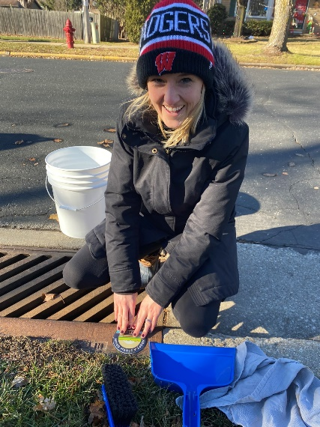
NEW Adopt A Storm Drain Program
Join us in keeping storm drains clear to prevent flooding and pollution out of local waters. It’s easy!
Create an account
Adopt a nearby storm drain(s)
Receive a storm drain cleaning kit
Commit to cleaning the drain at least once a month, before the rain (trash, leaves, debris, snow, etc.)
Report cleanings on web site
Report spills or discharges near storm drains
Girl Scout Troop 1022
Notes:
Launched in Nov. 2021 in five communities including McFarland. More than 200 drains adopted across 7 communities. Mcfarland has 69 drains adopted by 20 volunteers and 142 cleanings reported. Troop 1022 adopted 10 storm drains and reported 56 cleanings since April 2022.

Slide 20
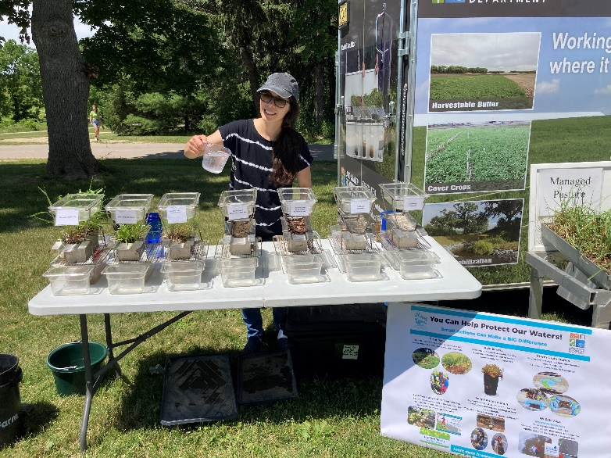
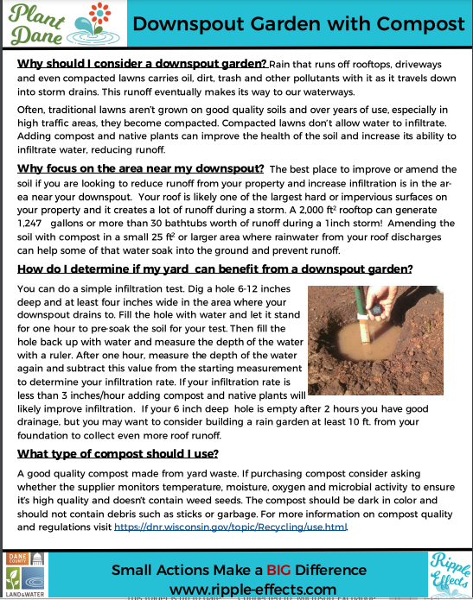
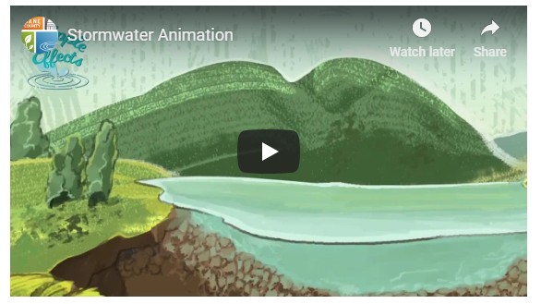
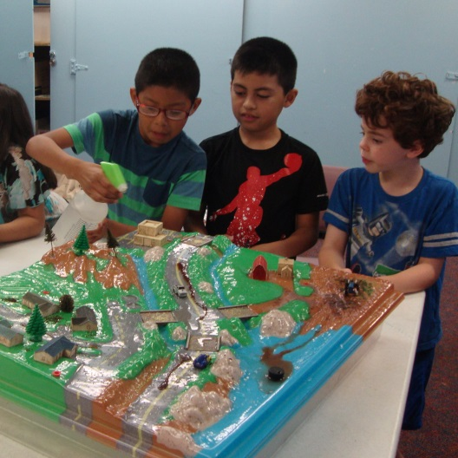
Educational Resources
Tabletop Rainfall Simulator
Videos, Planting Plans, Instructions
Enviroscape
Trainings/Demo Recordings

Slide 21
Questions?
Your Name
Your Contact Information
www.ripple-effects.com

