Slide 1
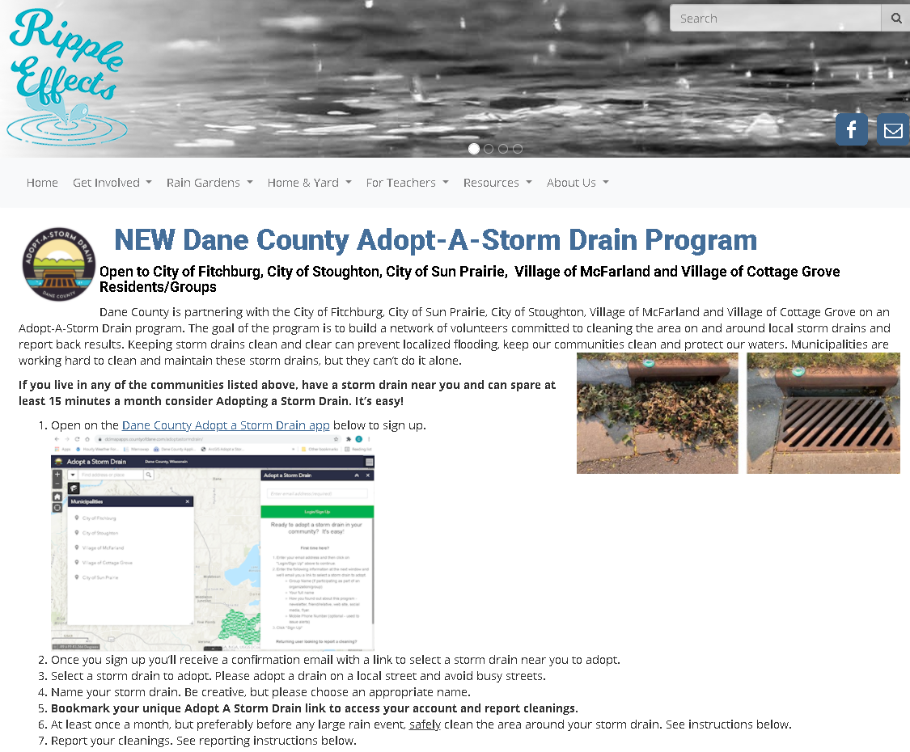
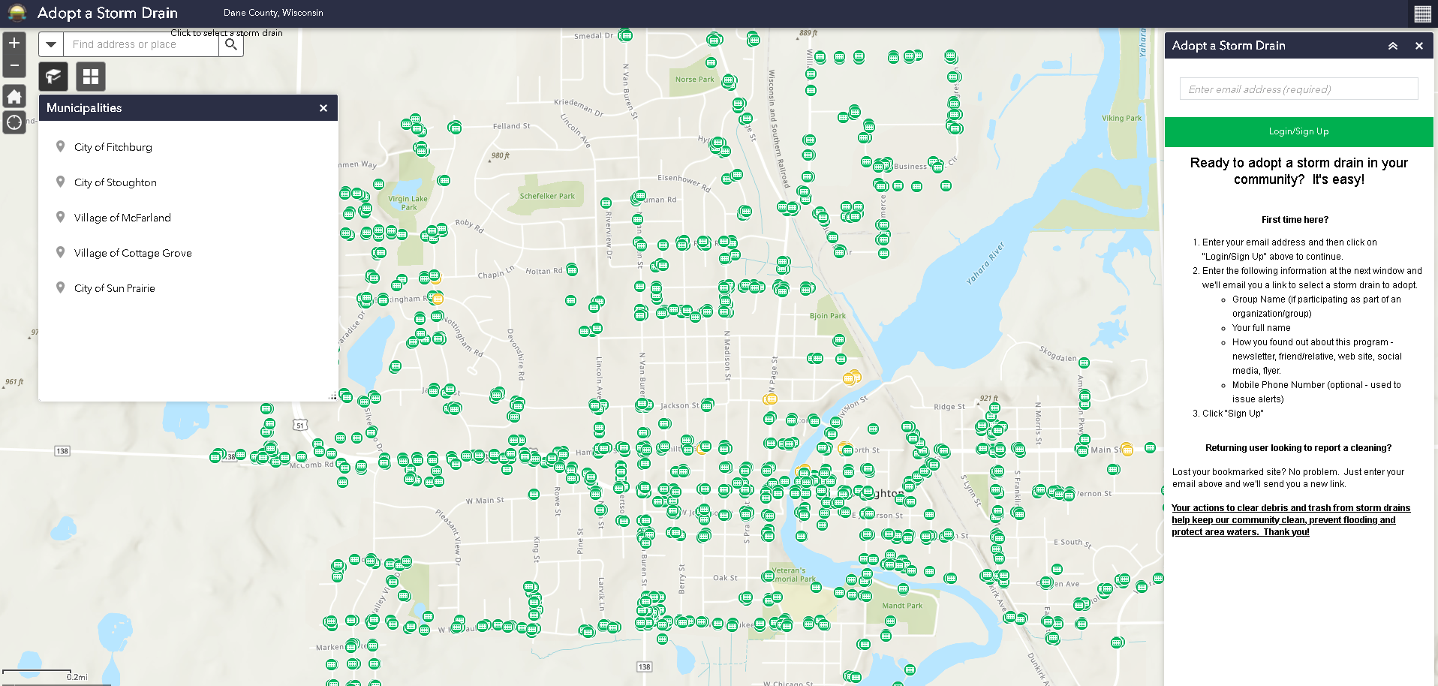
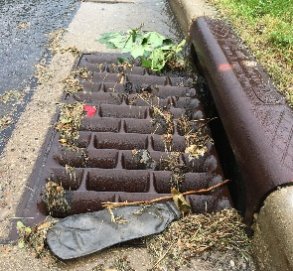
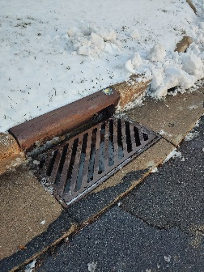
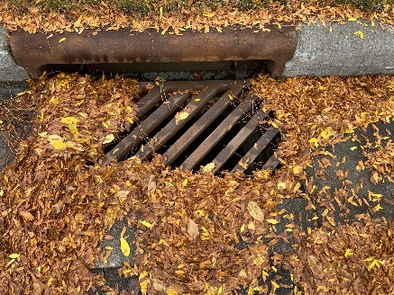
NEW Adopt A Storm Drain Program
Join us in keeping storm drains clear to prevent flooding and pollution out of local waters. It’s easy!
Create an account
Adopt a nearby storm drain(s)
Receive a storm drain cleaning kit
Commit to cleaning the drain at least once a month, before the rain (trash, leaves, debris, snow, etc.)
Report cleanings on web site
Report spills or discharges near storm drains
Notes:
Launched in Nov. 2021 in five communities including Stoughton. Have more than 100 drains adopted so far, 25 in Stoughton.

Slide 2
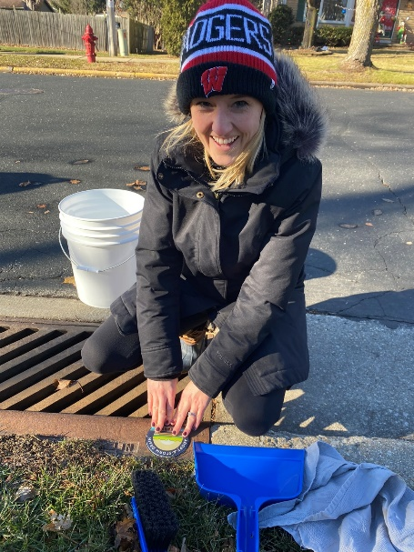
NEW! Adopt A Storm Drain Program
Join us in keeping storm drains clear to prevent flooding and pollution out of local waters. It’s easy!
Communities- McFarland, Cottage Grove, Sun Prairie, Fitchburg, Stoughton. Coming soon- Middleton!
Adopt a nearby storm drain(s)
Receive a storm drain cleaning kit
Commit to cleaning the drain at least once a month, before
the rain (trash, leaves, debris, snow, etc.)
Report cleanings on web site
Report spills or discharges near storm drains
Notes:
Launched in Nov. 2021 in five communities including Stoughton. Have more than 100 drains adopted so far, 25 in Stoughton.

